Slide 2
The Gods
The ancient Maya people believed in a pantheon (large group) of gods, only a few of which are mentioned by the same name in different sources.
Many of them had overlapping roles and names.
Some had human form, some took the form of an animal and others were a phenomena of nature.

Slide 3
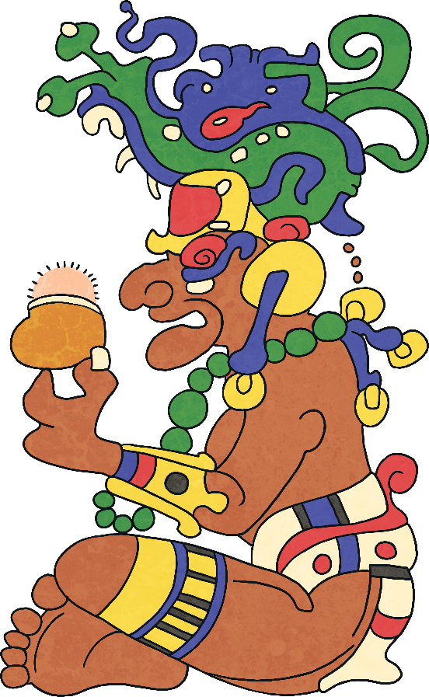
Itzamna
One of the creator gods.
Patron of learning and the inventor of writing.
He taught people literacy, medicine, science, art, sculpture and agriculture.
He also created the calendar.
Portrayed in human form as an old man with no teeth and a large nose.

Slide 4
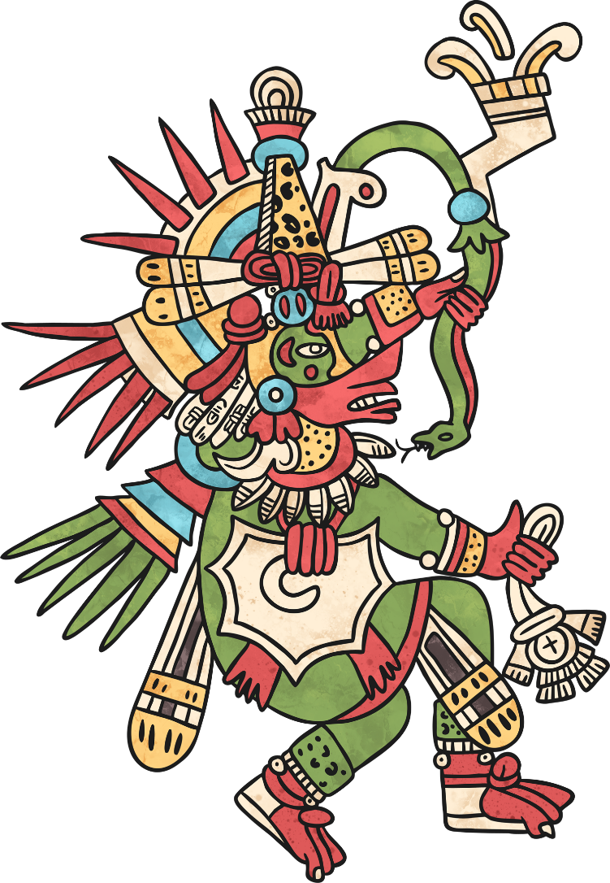
Kukulcan
Supreme god.
God of the four elements with the following items associated with each one:
maize-ear (earth)
fish (water)
lizard (fire)
vulture (air)
One of the creator gods.
God of resurrection and reincarnation.
His name means ‘feathered serpent’.

Slide 5
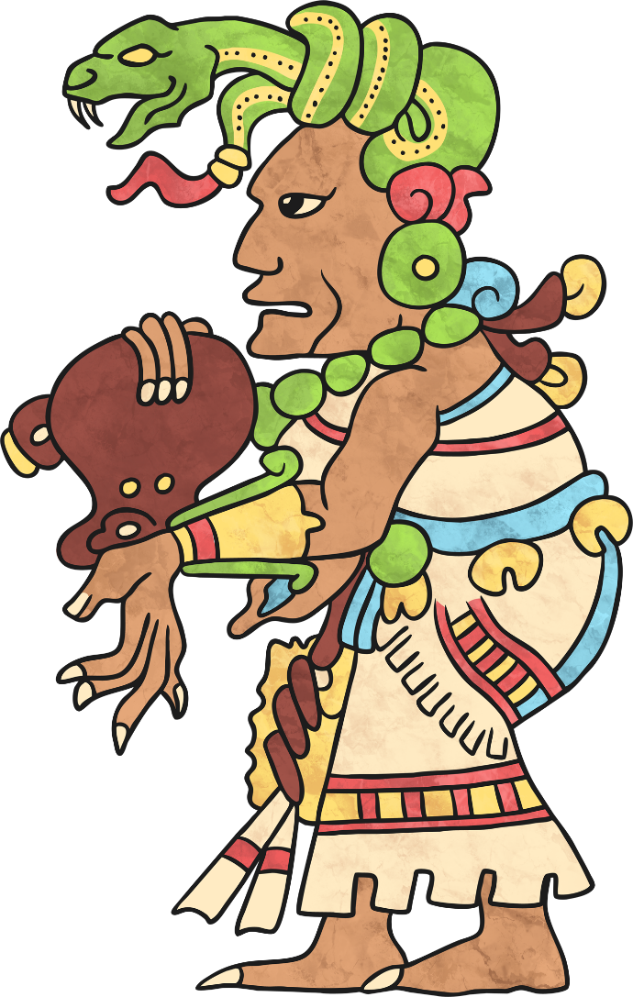
Ix Chel
Wife of Itzamna.
Goddess of childbirth, healing, weaving and the moon.
Portrayed in human form wearing a headdress of snakes entangled in her hair and toes and fingers that looked like jaguar claws.
Capable of causing floods and destruction.
The mother of many other gods.

Slide 6
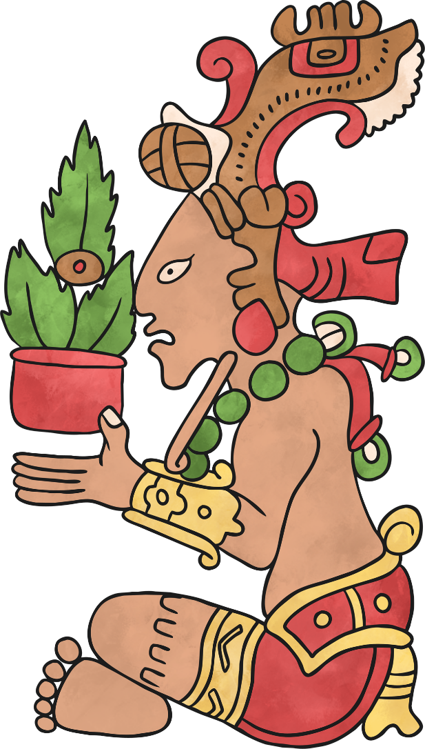
Hun-Hunahpu
Known as many other names, including ‘The Maize God’.
He was an important god because maize made up 80% of the diet of Maya people. They relied on the harvest being successful.
Mayans believe Hun-Hunahpu was killed by the Lord of Xibalba but was resurrected by his sons, the Hero Twins. He is therefore also seen as a figure of revival.

Slide 7
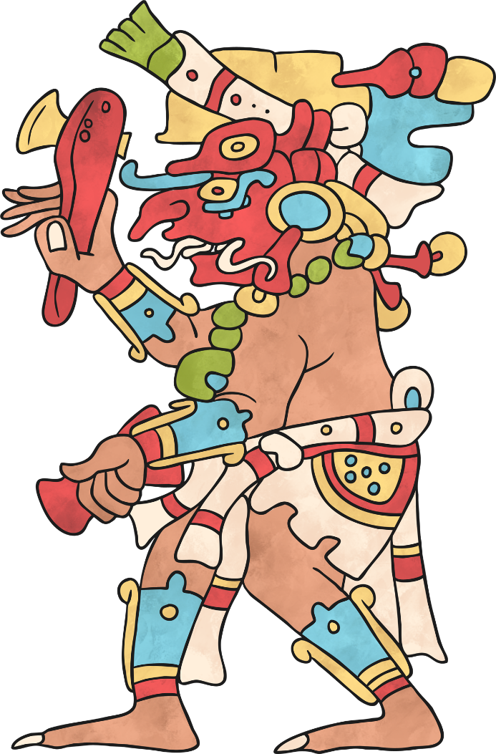
Chac
The supreme god of storms and rain.
Brought the rain needed to make crops grow.
Created storms, thunder and lightning and maintained water sources, such as wells, streams and springs.
Prayers and sacrifices were often offered to him to gain his favour.
Portrayed as a human with a curling snout and reptile fangs.

Slide 8
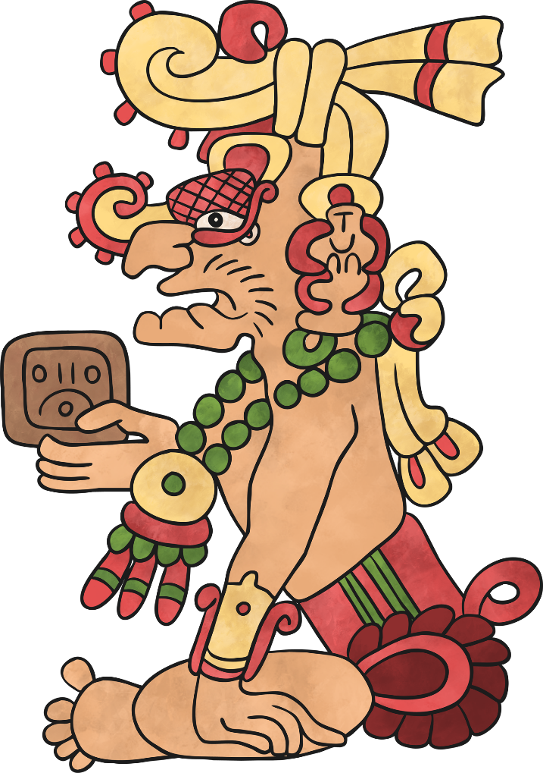
Kinich Ahau
The Sun God, sometimes called ‘The Face of the Sun’.
Also the god of healing and medicine.
He sunk below the Earth and travelled through the underworld at night, changing into the Jaguar God of the Night.

Slide 9
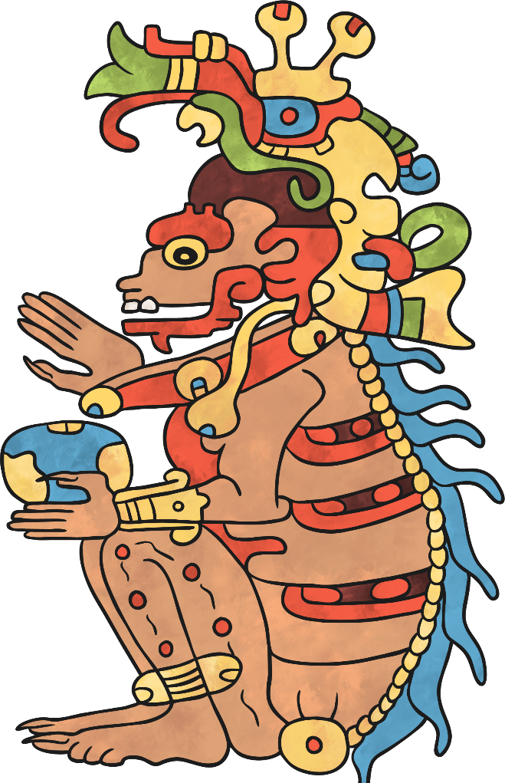
Kisin
God of Death.
Ruled Xibalba and controlled earthquakes.
He is associated with owls as the Maya people linked owls with the caves of Xibalba, the night and killing prey.
Portrayed as a human with a skeletal nose, jaw and spine and a body covered in hideous spots.
His name means ‘Stinking One’.

Slide 10
Religious Rituals
The ancient Maya would perform rituals to gain favour with the gods.
Public festivals related to special dates on the Maya calendar or occasions to plead for a healthy harvest, the health of a ruler, or to win a war.
Before a ritual or festival, people would go without certain food or pierce their tongues, lips, cheeks or ears to offer a sacrifice of human blood.
The festivals were colourful and noisy with processions, banners, drums and trumpets.

