Slide 1
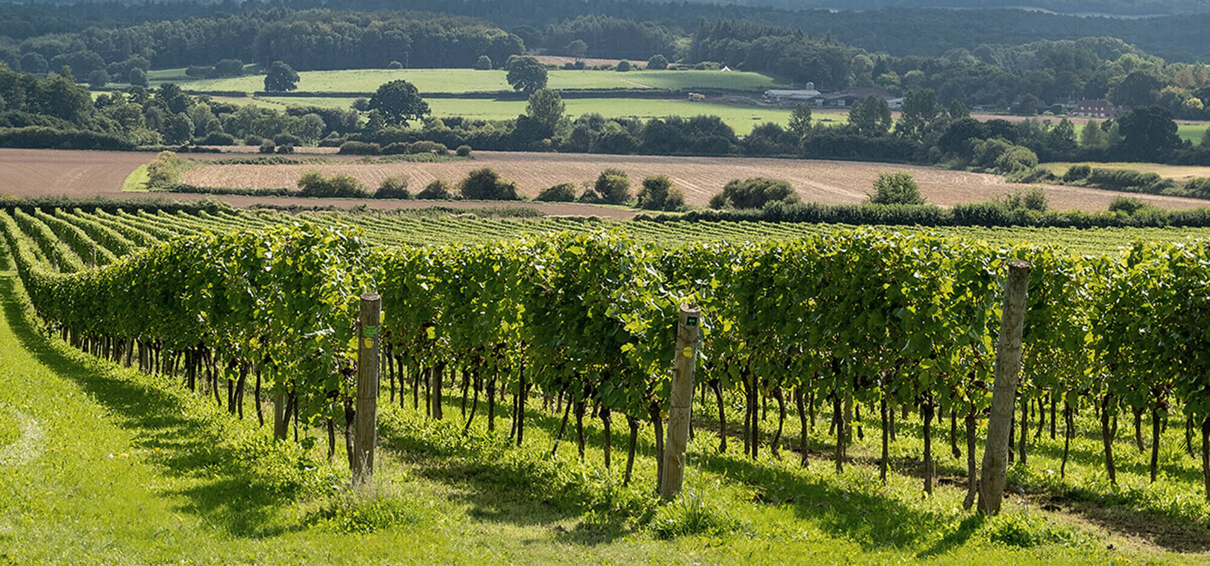
The Parable of the Tenants in the Vineyard
Matthew Chapter 21 Verses 33-45

Slide 2
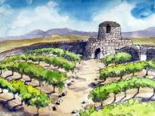
Jesus was in the temple and said, “Hear another parable:
There was a certain landowner who planted a vineyard and set a hedge around it, dug a winepress in it and built a tower.
Here is a drawing someone has done of this scene.
Do you know what a vineyard is? It’s somewhere they grow grapes to be turned into wine.
In this part of the story, the person who owns the land has planted a vineyard with a winepress (to press the grapes to turn them into wine) and has made the vineyard secure by growing a hedge around it and building a watch tower.

Slide 3
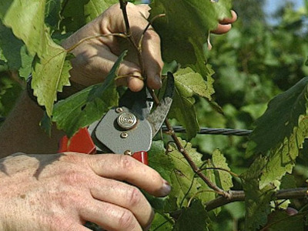
He leased it to vine-dressers and went off to a far country.
A vine-dresser is someone who looks after the vines. They would prune them and tend to them until the grapes are ready.
Do you know what ‘leased’ means? You can lease a flat – it’s a bit like renting somewhere or something.
Someone who rents or leases somewhere is called a ‘tenant’ which is where the name of the parable comes from.

Slide 4
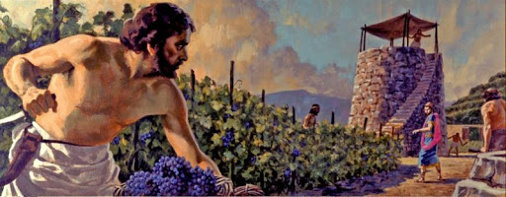
Now when the season for fruit drew near, he sent his servants to the vine-dressers that they might receive its fruit.
And the vine-dressers took his servants, beat one, killed one, and stoned another.
Again, he sent other servants, more than the first, and they did likewise to them.

Slide 5
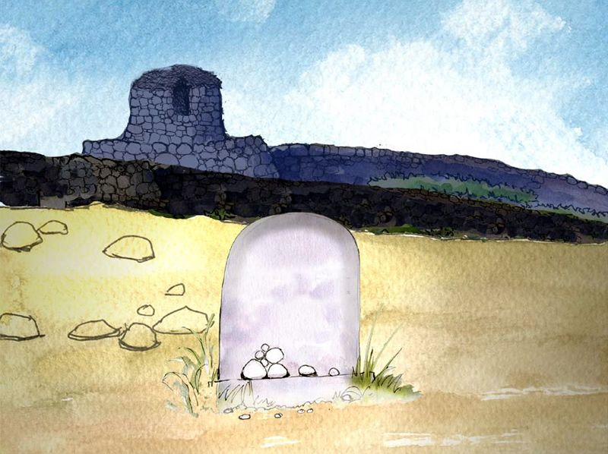
Then last of all he sent his son to them, saying ‘They will respect my son.’
But when the vine-dressers saw the son, they said among themselves, ‘This is the heir. Come, let us kill him and seize his inheritance.’
And they caught him,
and cast him out of
the vineyard and killed him.
Do you know what an heir is? You might have heard of it being used in phrases such as ‘heir to the throne’. It means the next person in line. That person normally inherits (is given everything – money, houses, possessions, etc) when someone dies.

Slide 6
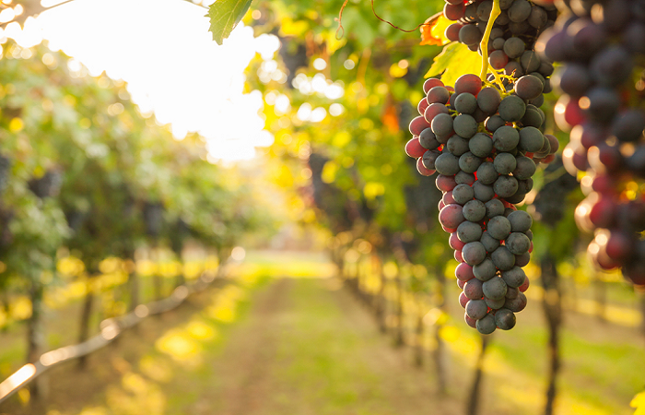
Jesus asked those around him:
“When the owner of the vineyard comes, what will he do to those vine-dressers?”
The people answered, “He will destroy those wicked men miserably, and lease his vineyard to the other vine-dressers who will give to him the fruits in their seasons.”

Slide 7
Let’s think about Christianity:
God created a beautiful world for people to live in. He asked humans to look after it for him.
God sent messages to the people through different prophets.
People often didn’t believe what the prophets said. Sometimes they laughed at the prophets or were horrible to them.
Eventually, God sent his own son Jesus to share his messages. But some of the people on Earth still didn’t listen or believe and eventually killed him.

Slide 8
Can you spot any similarities between this and today’s parable?
The vineyard is like the Earth. God is like the landowner and the people on Earth are like the vine-dressers (or tenants).
God sent prophets to pass on his messages just like the landowner sent his servants to get the fruits from the vineyard.

Slide 9
Many people didn’t listen to the prophets and treated them badly. This was like the servants the landowner sent who were beaten and killed.
God felt he had no other choice than to send Jesus down to Earth to pass on his messages. This is like the landowner who sent his own son.
Many people on Earth still didn’t listen to Jesus and eventually he was put to death on the cross. This is similar to the landowner’s son who was killed.

