Slide 2


f
r
o
g

Slide 3
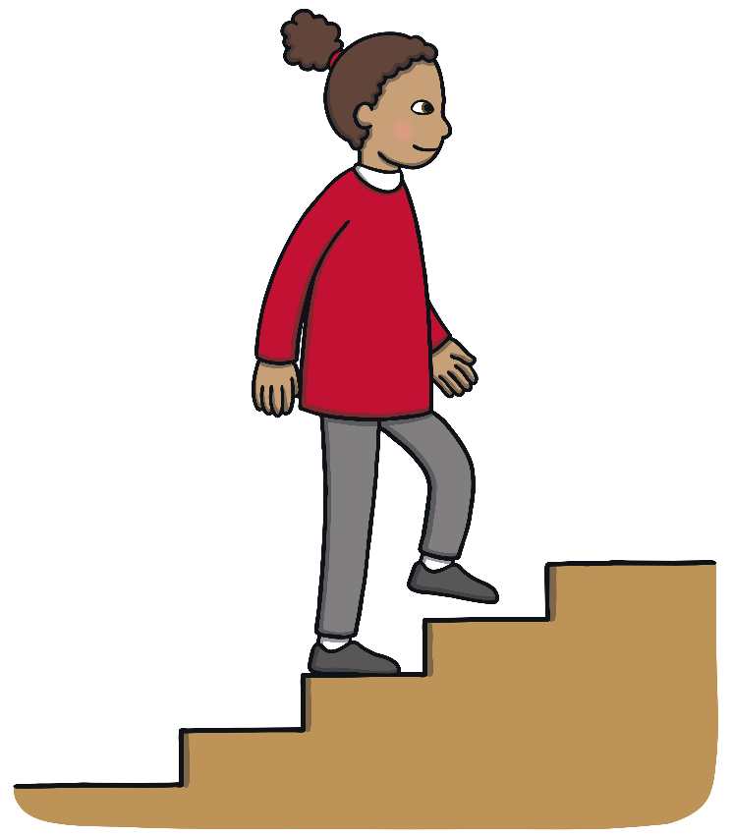
s
t
e
p

Slide 4

t
w
i
n

Slide 5

d
r
o
p

Slide 6

f
l
a
g

Slide 7

p
l
u
m

Slide 8

c
l
a
p

Slide 9
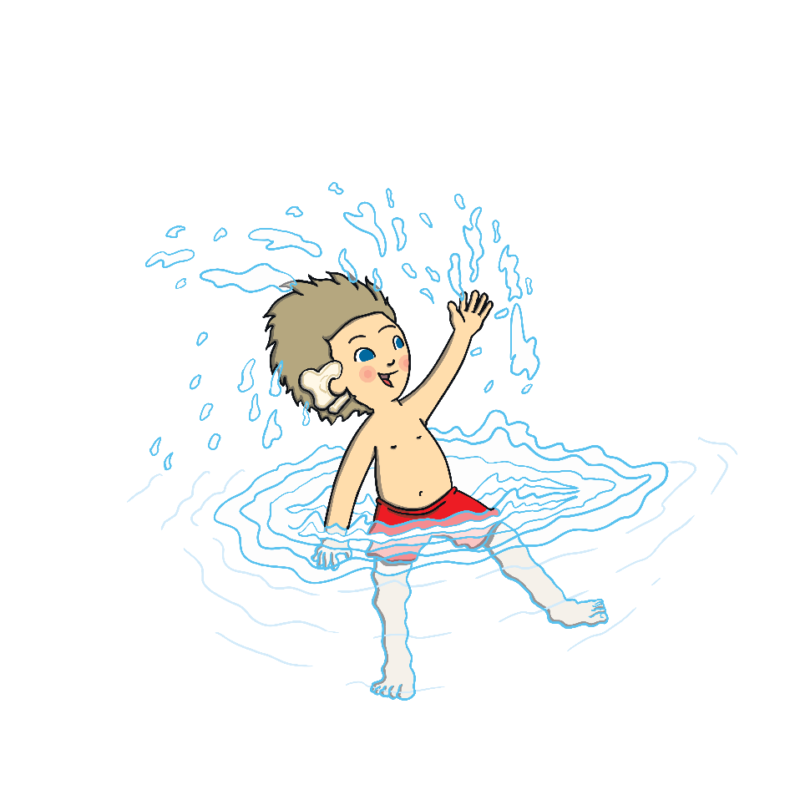
s
w
i
m

Slide 10

s
t
o
p

Slide 11

c
r
a
b

Slide 12



Well done!

