Slide 1


Why did Jesus come to Earth?
Why do you think Jesus came to Earth?
Jot down some of your ideas.
You could write these as bullet points or create a spider diagram.

Slide 2

Here are two ideas:
Jesus came to Earth to get people into Heaven.
Jesus came to Earth to
make Earth more like heaven.

Slide 3
Jesus came to Earth to get people into Heaven.
Jesus came to Earth to make Earth more like heaven.
How do you feel about these ideas?
Do you agree with either or both of them? Why?
How do you think Christians would feel about them? Why?
Write down your responses in full sentences.

Slide 4




Most Christians believe that both statements are true.
Let’s look at each statement.
1. Jesus came to Earth to get people into Heaven.
Many Christians believe that Jesus came to Earth to show humans how to behave in better ways. He taught them how to be kind, caring, loving and forgiving. These qualities helped them become better people and be ready to enter Heaven when the time came.

Slide 5
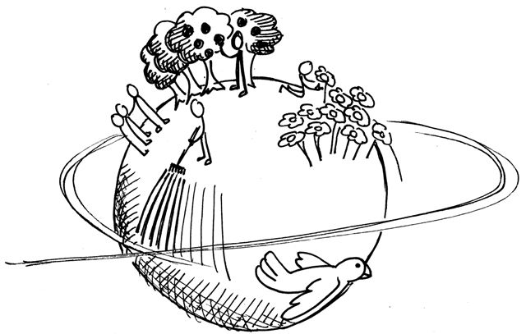
2. Jesus came to Earth to make Earth more like Heaven.
Many Christians believe that Jesus
came to Earth to help make it
a better place. He wanted to teach people
how to love and care for one another
and for the Earth. In doing so, the Earth
would become a much nicer place and be
more like Heaven.
In the Bible, we often hear the phrase
the ‘Kingdom of God’. Jesus wanted to
make Earth the ‘Kingdom of God’ and
therefore a place more like Heaven.

Slide 6

In your own words, now try and summarise what most Christians believe about why Jesus came to Earth.

