Slide 1
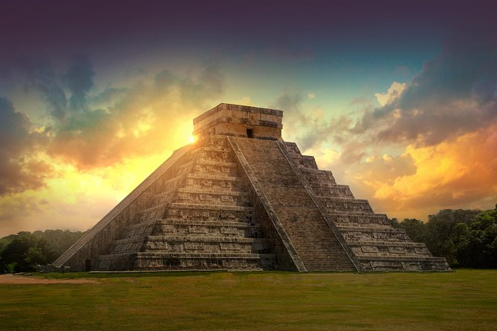
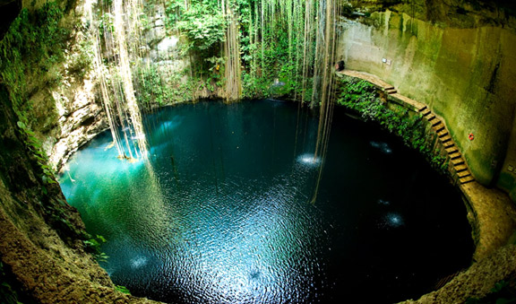
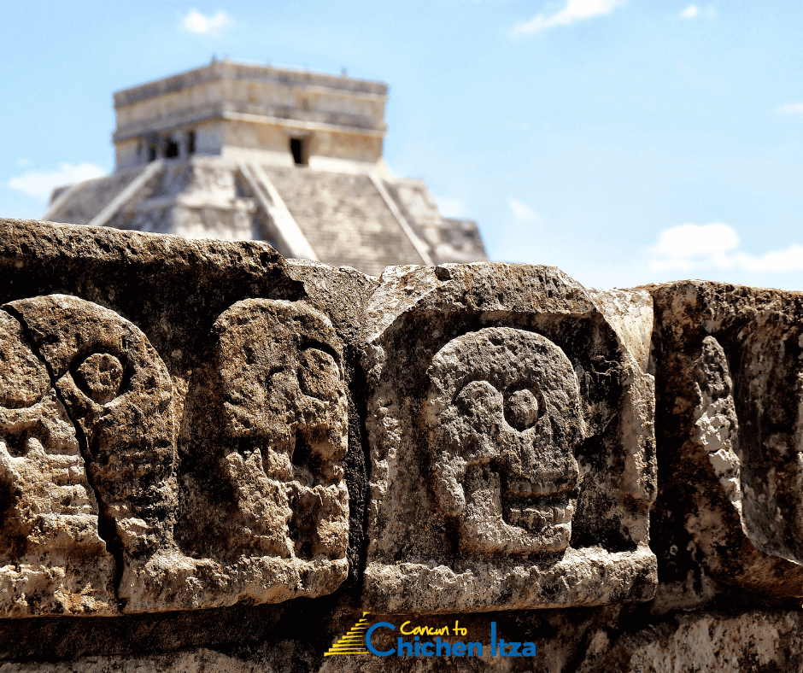
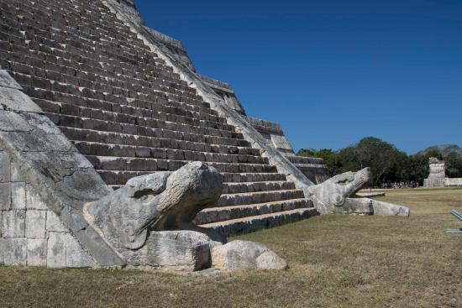
Mystical Chichen Itza
To the north of the Yucatan Peninsula is Chichen Itza. It is the base of all Mayan culture and one of the most famous archaeological sites on the planet famous for it’s architecture and mysticism. Discover why you can not miss this wonderous place.
The brilliant ruins of Chichén Itzá tell the story of a once dazzling ancient city that was the centre of the Maya empire in Central America. The stepped pyramids, temples, columned arcades, and other stone structures of Chichén Itzá were sacred to the Maya and formed the advanced urban centre of their empire from A.D. 750 to 1200.
Tourists love to visit Chichen Itza in the spring to see the serpent. When the late afternoon sun hits the northwest corner, triangular shadows cascade down and end at the serpents head, creating a look like a snake slithering down the pyramid.
The name comes from a large sinkhole known as the Sacred Cenote or 'mouth of the well of the Itza' into which the Maya threw offerings of jade and gold, and as the presence of bones shows…human sacrifices!
Chichen Itza is one of the 7 modern wonders of the world…visit now!

