Slide 1


RE
A Recap of Our Learning this Half Term

Slide 2
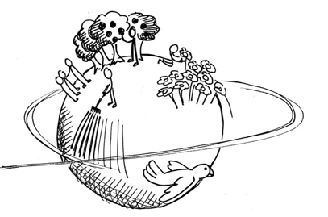
In the first lesson this half term, we thought about these two quotes:
Jesus came to Earth to get people into Heaven.
Jesus came to Earth to make Earth more like Heaven.
We looked at how Christians believe that both of these are true.
Jesus helped people learn how to be kind, caring, loving and forgiving, therefore becoming better people who were ready to enter Heaven.
In teaching people to be better, Earth became a nicer place and more like Heaven.

Slide 3
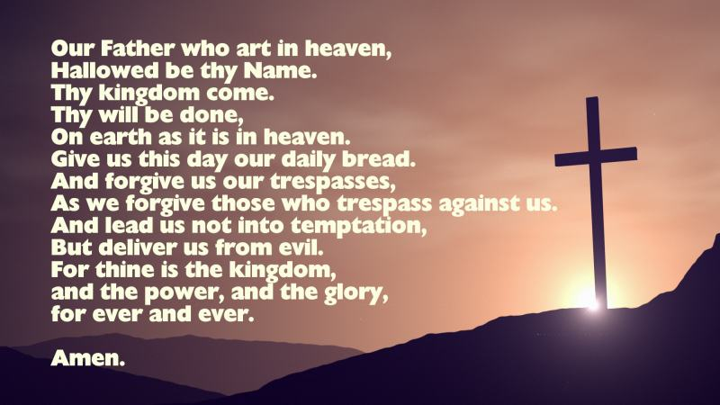
In the second lesson this half term, we looked at The Lord’s Prayer.
We thought about what each line meant.
We learnt that this is a very special prayer which Jesus taught his disciples to pray.
He shared it with them and told them to say it even after he had died.

Slide 4
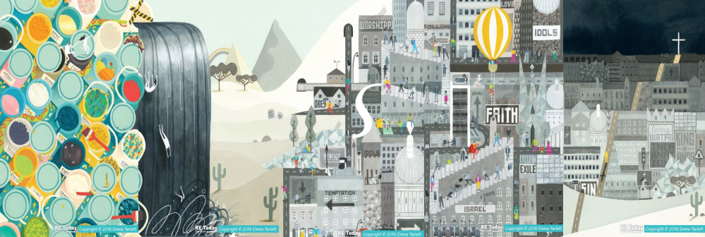
In our third session, we looked at the ‘Big Frieze’ picture.
We identified things which were not good in the world before Jesus came. These were things which he wanted to change and improve for everyone.
Can you remember any of the things you spotted?

Slide 5
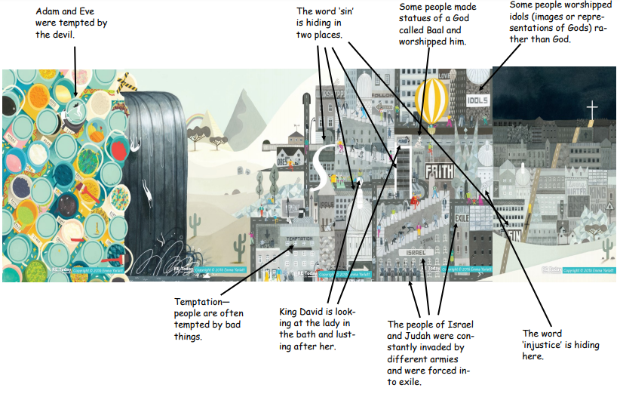

Slide 6
Last week, we explored two parables together.
First we talked about what parables were. Can you remember what a parable is?
A parable is a story which Jesus told to his followers with a clear moral or meaning.

Slide 7
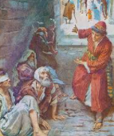
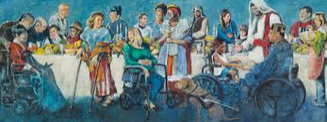
The first parable we read was ‘The Parable of the Feast’.
Can you remember what this parable was about?
What was the meaning/moral?
What was Jesus trying to teach his followers?

Slide 8
Luke 14: 12-24 The Parable of the Feast
‘Then he also said to him who invited him, “When you give a dinner or a supper, do not ask your friends, your brothers, your relatives, nor your rich neighbours, lest they invite you back, and you be repaid. But when you give a feast, invite the poor, the maimed, the lame, the blind. And you will be blessed, because they cannot repay you; for you shall be repaid at the resurrection of the just.”
Now when one of those who sat at the table with him heard these things, he said to him, “Blessed is he who shall eat bread in the kingdom of God!”
Then he said to him, “A certain man gave a great supper and invited many, and sent his servant at supper time to say to those who were invited, ‘Come, for all things are now ready.’
But they all with one accord began to make excuses. The first said to him, ‘I have bought a piece of ground, and I must go and see it. I ask you to have me excused.’
And another said, ‘I have bought five yoke of oxen, and I am going to test them. I ask you to have me excused.’
Still another said, ‘I have married a wife, and therefore I cannot come.’
So that servant came and reported these things to his master. Then the master of the house, being angry, said to his servant, ‘Go out quickly into the streets and lanes of the city, and bring in here the poor and the maimed and the lame and the blind.’
And the servant said, ‘Master, it is done as you commanded, and still there is room.’
Then the master said to the servant, ‘Go out into the highways and hedges, and compel them to come in, that my house may be filled. For I say to you that none of those men who were invited shall taste my supper.’

Slide 9
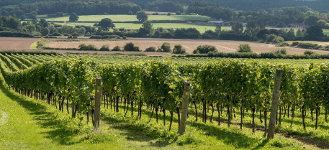
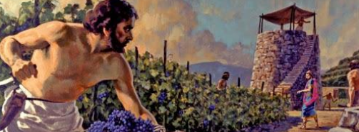
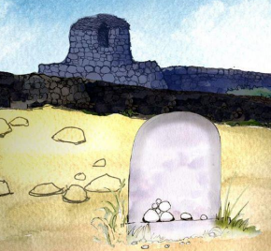
The second parable we read was ‘The Parable of the Tenants in the Vineyard’.
Can you remember what this parable was about?
What was the meaning/moral?
What was Jesus trying to teach his followers?

Slide 10
Matthew 21:33-46 The Parable of the Tenants in the Vineyard
“Hear another parable: There was a certain landowner who planted a vineyard and set a hedge around it, dug a winepress in it and built a tower. And he leased it to vine-dressers and went into a far country. Now when the season for fruit drew near, he sent his servants to the vine-dressers, that they might receive its fruit. And the vine-dressers took his servants, beat one, killed one, and stoned another. Again he sent other servants, more than the first, and they did likewise to them. Then last of all he sent his son to them, saying ‘They will respect my son.’
But when the vine-dressers saw the son, they said among themselves, ‘This is the heir. Come, let us kill him and seize his inheritance.’
And they caught him, and cast him out of the vineyard, and killed him. Therefore, when the owner of the vineyard comes, what will he do to those vine-dressers?
They said to him, ‘He will destroy those wicked men miserably, and lease his vineyard to other vine-dressers who will render to him the fruits in their seasons.’

Slide 11
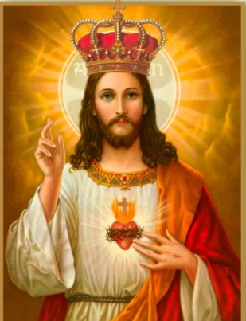
Today we are going to bring all of your learning from this half term together.
I want you to think about the time when Jesus was on the Earth.
What kind of king do you think he was?
What qualities did he have?
What evidence is there in the Bible to support your ideas?
Work through the activity sheet on the website so you can record
your responses to these questions.

