Slide 1



Slide 2
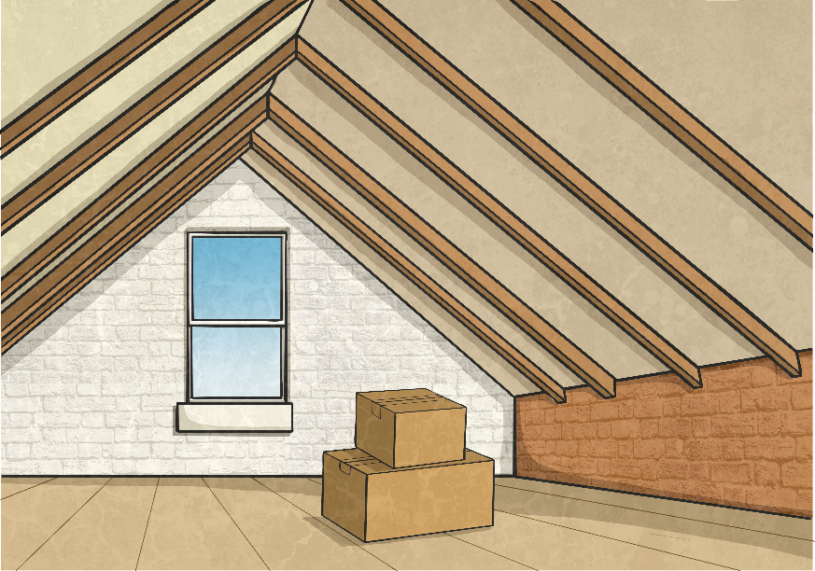
Adding the Suffix -cious
In this picture, we can see a lot
of space in the attic.
We could describe the attic
as very spacious.
By adding the suffix –cious to the root word, we have turned
a noun into an adjective.
space
spacious
(noun)
(adjective)

Slide 3
Rule for Adding the Suffix -cious
If the root word ends in –ce, remove –ce and replace it with –cious.
For example:
grace
grace
gracious
This will change the word from a noun into an adjective.

Slide 4
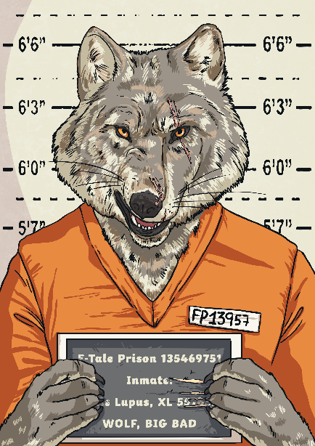
Your Turn: Adding the Suffix -cious
The character we see in this picture has
a lot of malice.
How could we add the suffix –cious to turn the noun malice into an adjective to describe
this person?
As our root word ends in –ce, we need to remove these letters and add the suffix –cious. This will change the noun into an adjective.
malice
malicious
(noun)
(adjective)

Slide 5
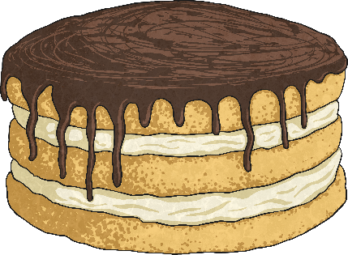

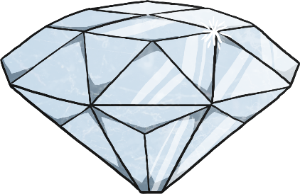
Words Ending in -cious
Sometimes, adjectives end in the suffix –cious which do not follow the rule. The next few slides will explain where these words have originated from.
precious
delicious
ferocious
These words are adjectives. They end in –cious but this has not been added using the rule.

Slide 6
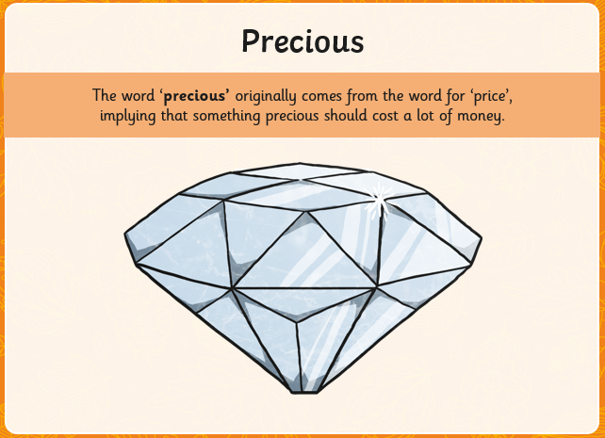

Slide 7
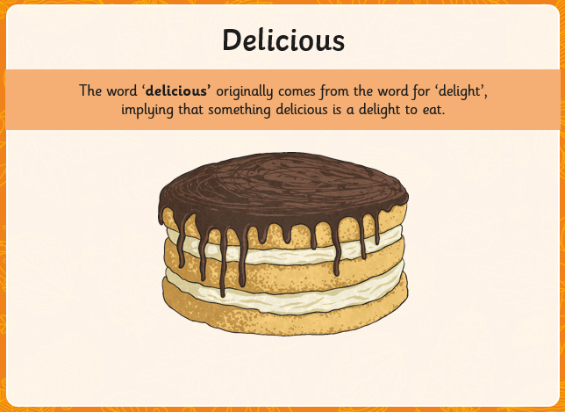

Slide 8
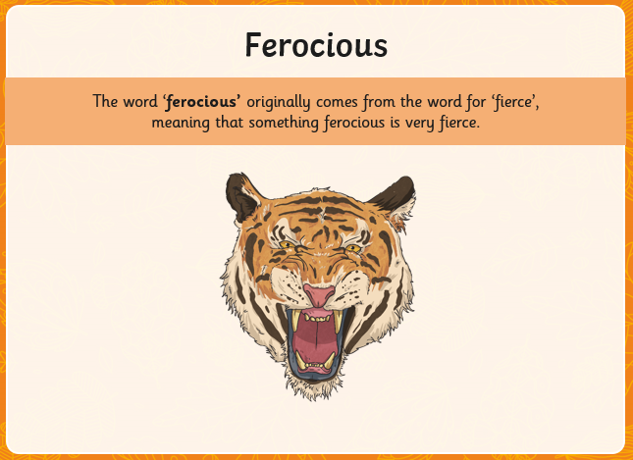

Slide 9
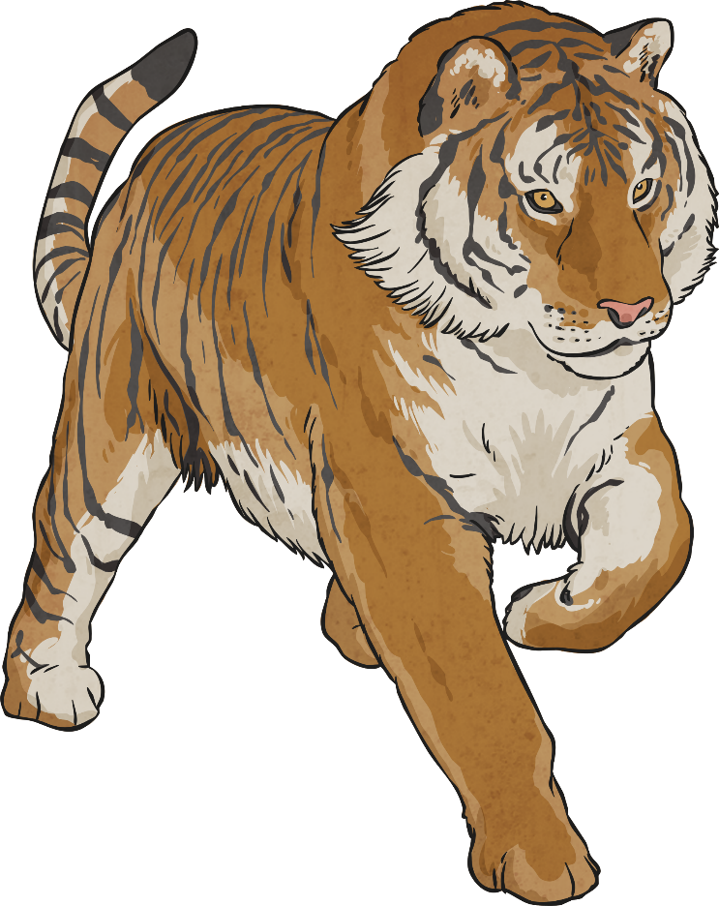
Say What You See!
Click on the panels to reveal the illustration behind.
Pick one numbered square at a time.
Can you spot the
–cious word that is illustrated in the picture? Discuss it with a partner.
How many squares did you need to reveal?
1
2
3
4
5
6
7
8
9
Reveal Answer
vicious or ferocious
Notes:
Animation made by Jon

Slide 10

Say What You See!
Click on the panels to reveal the illustration behind.
Pick one numbered square at a time.
Can you spot the
–cious word that is illustrated in the picture? Discuss it with a partner.
How many squares did you need to reveal?
1
2
3
4
5
6
7
8
9
Reveal Answer
precious
Notes:
Animation made by Jon

