Slide 1
Spellings
Try saying these words out loud. What sound does the last part of each word make?
repetitious nutritious
superstitious infectious
ambitious cautious

Slide 2

They all made a /shus/ sound.
Put your finger to your lips and say /shus/.
All of our spelling words this week spell the ‘shus’ sound with the spelling ‘tious’.

Slide 3
Try matching the root words to the words with the ‘tious’ suffix.
infection
superstition
repetition
caution
ambition
nutrition
cautious
repetitious
infectious
ambitious
superstitious
nutritious

Slide 4
Try matching the root words to the words with the ‘tious’ suffix.
infection
superstition
repetition
caution
ambition
nutrition
cautious
repetitious
infectious
ambitious
superstitious
nutritious

Slide 5
Did you notice the spelling pattern?
If the root word ends in –tion
Then we need to take off the ‘ion’
And replace it with ‘ious’
caution
caution
cautious

Slide 6
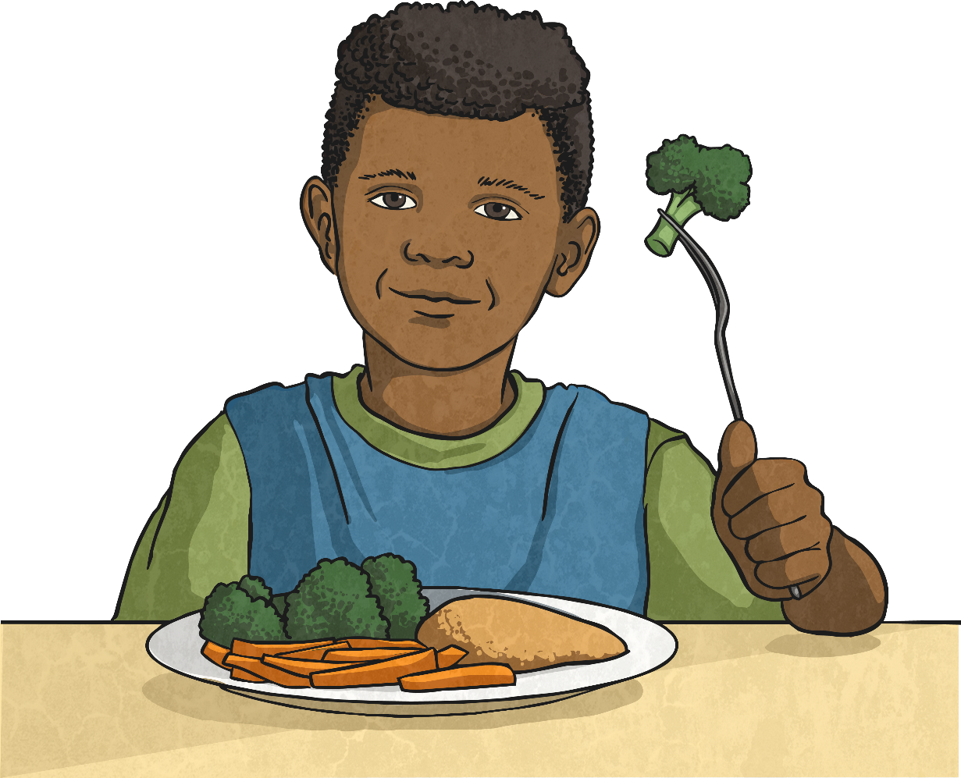
Which -tious word do you think fits in this sentence?
Jenna’s mum tried hard to make him a healthy and nutritious lunch.

Slide 7
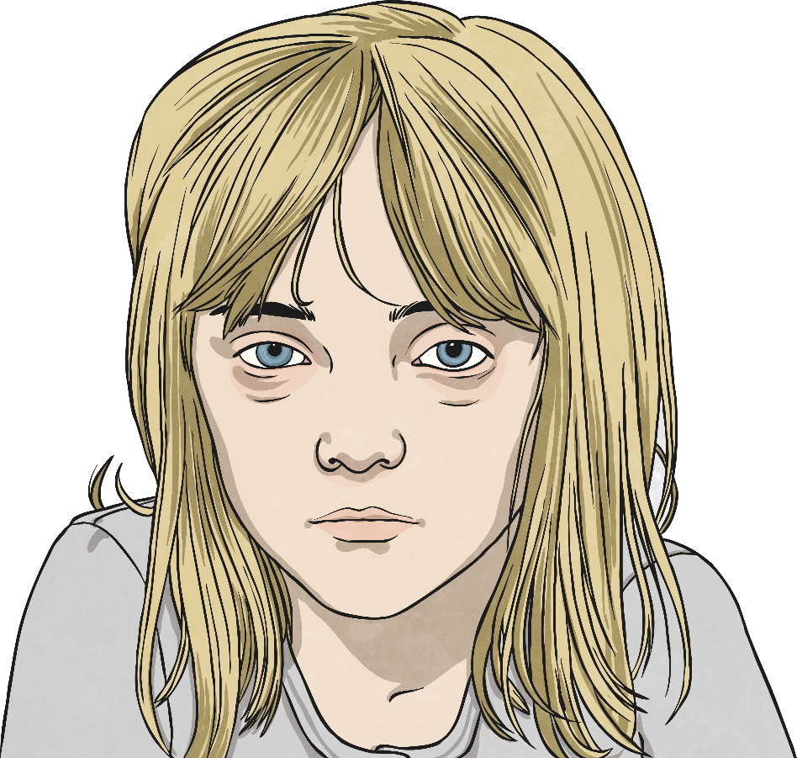
Which -tious word do you think fits in this sentence?
To be on the safe side, Stacey wasn’t going to the party as her cold might still be infectious.

