Slide 1
Spellings
Let’s start with a quick recap.
Last week, we were looking at the spelling rule ‘i before e except after c’ when the letters make the sound ‘ee’.
Start by playing the game ‘ten strikes then your out’ on the next few slides to revise some of these spellings.

Slide 2


Let’s play ‘Ten Strikes and You’re Out!’ Click on the letters that you think are missing to try to make the word in the sentence. Every time you guess a letter incorrectly, press the ‘Uh-oh’ button to make a pin disappear! Can you guess all of the missing letters before you strike out?
To deliberately mislead someone.
_ _ _ _ _ _ _
Uh-Oh!
e
e
a
b
c
d
e
f
g
h
i
j
k
l
m
n
o
p
q
r
s
t
u
v
w
x
y
z
Notes:
When an incorrect letter is chosen, press the ‘Oh no!’ button to add a part to the Hangman illustration.

Slide 3
Let’s play ‘Ten Strikes and You’re Out!’ Click on the letters that you think are missing to try to make the word in the sentence. Every time you guess a letter incorrectly, press the ‘Uh-oh’ button to make a pin disappear! Can you guess all of the missing letters before you strike out?
The upper interior surface of a room.
_ _ _ _ _ _ _
i
Uh-Oh!
a
b
c
d
e
f
g
h
i
j
k
l
m
n
o
p
q
r
s
t
u
v
w
x
y
z
Notes:
When an incorrect letter is chosen, press the ‘Oh no!’ button to add a part to the Hangman illustration.

Slide 4
Let’s play ‘Ten Strikes and You’re Out!’ Click on the letters that you think are missing to try to make the word in the sentence. Every time you guess a letter incorrectly, press the ‘Uh-oh’ button to make a pin disappear! Can you guess all of the missing letters before you strike out?
Be presented with or given something.
_ _ _ _ _ _ _
Uh-Oh!
e
e
a
b
c
d
e
f
g
h
i
j
k
l
m
n
o
p
q
r
s
t
u
v
w
x
y
z
Notes:
When an incorrect letter is chosen, press the ‘Oh no!’ button to add a part to the Hangman illustration.

Slide 5
Spellings
Today we are going to be looking at how the letters ‘ei’ can make the ‘ai’ sound.

Slide 6
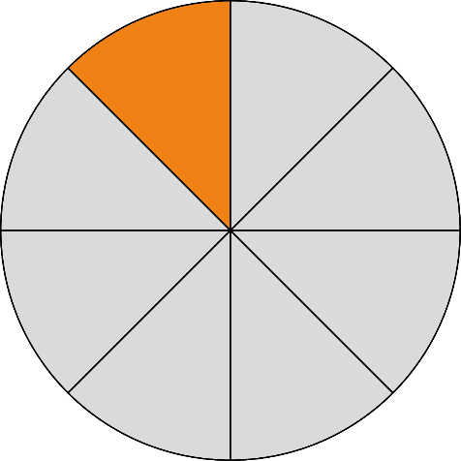



What do these two words have in common?
eighth
neighbour
Both words have the same long ‘ai’ sound but unusually here it is spelt with ‘ei’.

Slide 7
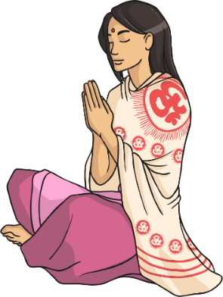
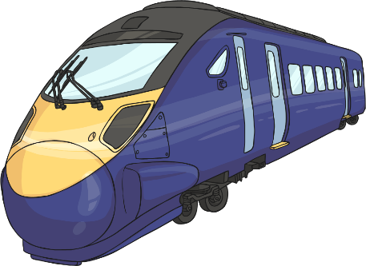
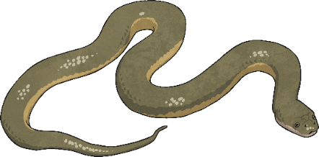
What other ways can a long ‘ai’ be formed in words?
a-e as in snake
ai as in train
ay as in pray
But this week, we are looking at words that have a long ‘ai’ sound made with ‘ei’…

Slide 8




Can you think of any other words that have a long ‘ai’ made using ‘ei’?
Write any words you can think of on a whiteboard.
eighth
neighbour
eight
eighty
weight
vein
veil
beige
sleigh
freight

Slide 9
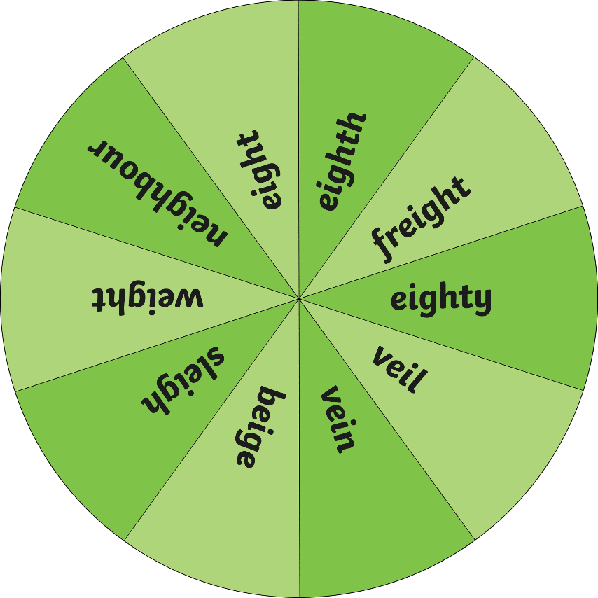
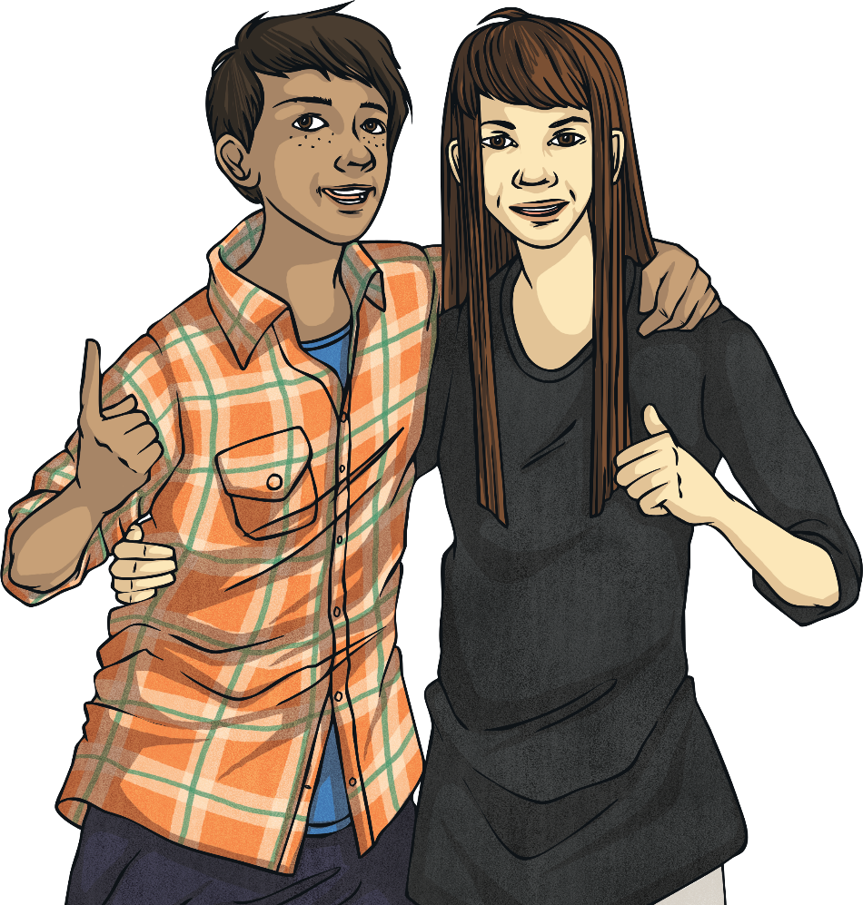
Now try to write an exciting sentence that contains that ‘ei’ word on your whiteboards. Does your sentence contain an exciting verb (doing word)? Could you add an ambitious adjective (describing word)?
Click the button to spin the wheel!
Spin
Notes:
Click the ‘Spin’ button to make the spinner spin ☺

