Slide 1

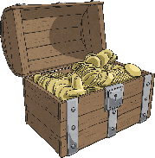
Coordinates
6
Coordinates are a useful way to locate a position on a map or grid.
5
4
Here is a map with a grid on. It shows where to find the treasure. Let’s work together to read the coordinates and locate the position of the gold!
3
2
1
0
1
2
3
4
5
6

Slide 2
Reading Coordinates
6
Look carefully at the numbers across the bottom of the grid and up the side of the grid.
5
4
3
We will use these numbers to give the position of the treasure.
2
1
0
1
2
3
4
5
6

Slide 3
Reading Coordinates
6
The numbers across the bottom of the grid are on the x-axis.
5
4
We always read the number on the x-axis first.
3
2
We can see that the treasure is positioned on line number 2 of the x-axis.
1
0
1
2
3
4
5
6

Slide 4
Reading Coordinates
6
The numbers up the side of the grid are on the y-axis.
5
4
We always read the number on the y-axis after the x-axis.
3
2
We can see that the treasure is positioned on line number 4 of the y-axis.
1
0
1
2
3
4
5
6

Slide 5
Reading Coordinates
6
We have located that the treasure is on line 2 of the x-axis (across) and line 4 of the y-axis (up).
5
4
There is a special way we write this as a coordinate:
3
2
(2,
4)
1
x-axis
y-axis
0
1
2
3
4
5
6

Slide 6
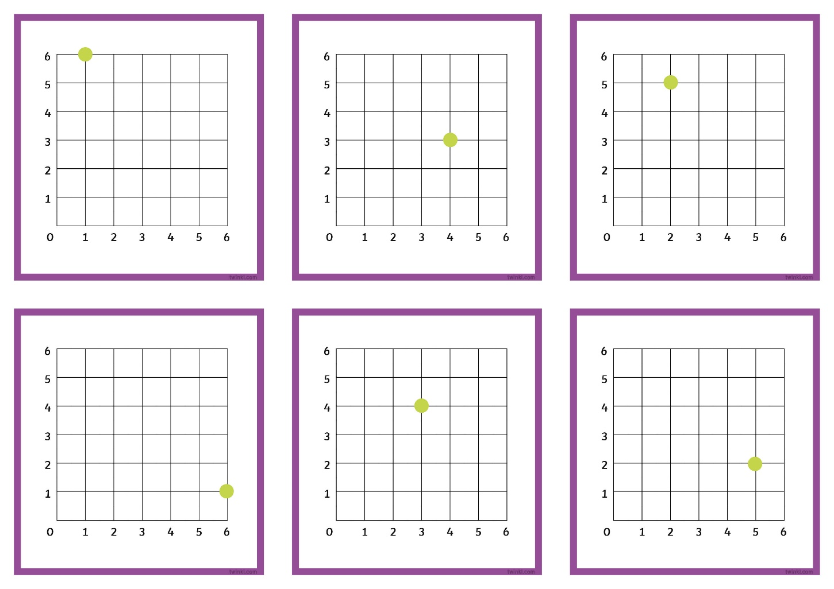
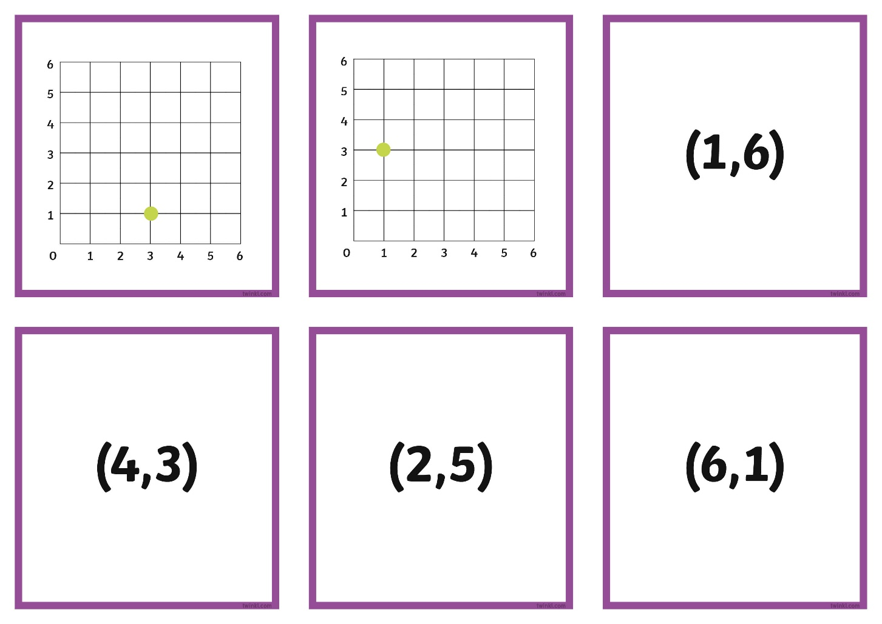
Can you work out the co-ordinates of each green spot?
(6,1)
(1,6)
(4,3)
(2,5)
(3,4)
(5,2)
(3,1)
(1,3)

Slide 7

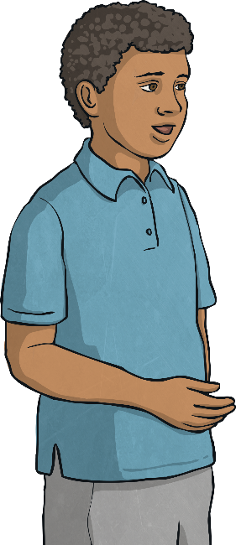

Coordinate Match Up
Click on the child who has read the coordinate correctly.
How has the other child got mixed up?
I think the purple circle is at coordinate (4, 3).
I think the purple circle is at coordinate (3, 4).
I was wrong. You always read the x-axis first!
I was correct. The purple circle is at (3,4).
6
5
4
3
2
1
0
1
2
3
4
5
6

Slide 8
Coordinate Match Up
Click on the child who has read the coordinate correctly.
How has the other child got mixed up?
I think the red circle is at coordinate (5, 2).
I think the red circle is at coordinate (5, 3).
6
I was correct. The red circle is at (5,2).
I was wrong. The orange circle is at (5,3).
5
4
3
2
1
0
1
2
3
4
5
6

