Slide 1


Art and Design
LS Lowry
Year One
Art and Design | KS1 | LS Lowry | Lowry Colours | Lesson 2

Slide 2
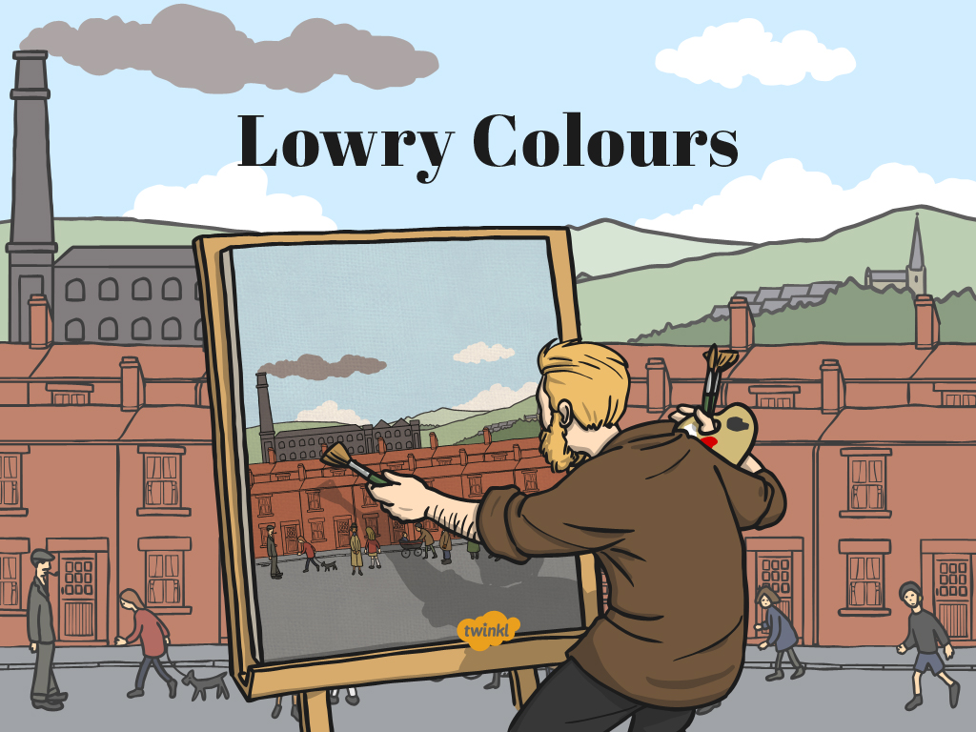

Slide 3
Aim
I can paint a seascape using colours I have mixed.
I can talk about the work of LS Lowry.
Success Criteria
I can mix paint from ‘Lowry colours’.
I can paint a seascape.
I can tell you something about ‘Lowry colours’.
I can tell you something about Lowry’s seascape paintings.

Slide 4
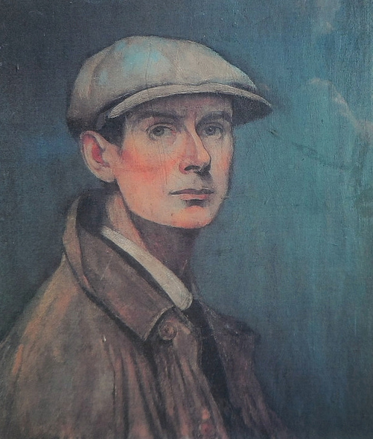
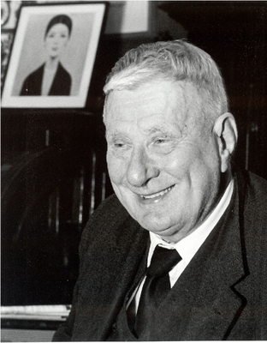
Who is LS Lowry?
Photo courtesy of Karen V Bryan and oknovokght (@flickr.com) - granted under creative commons licence – attribution

Slide 5
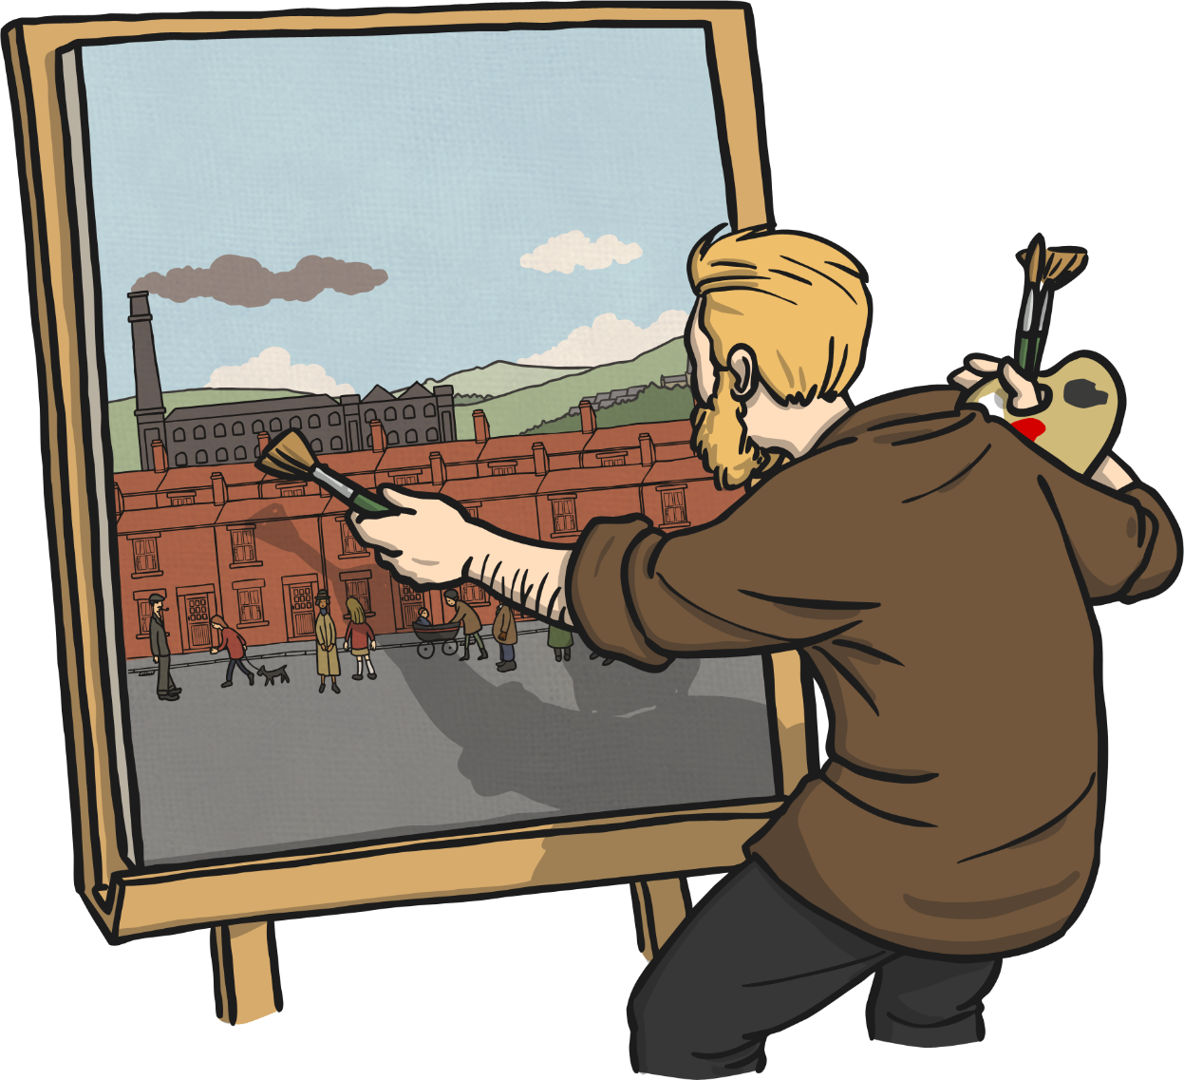
LS Lowry’s Paintings
The artist LS Lowry drew many pictures with pencil, pastel, charcoal and pens, but he is best known for his paintings.
He painted many different pictures of lots of different things.

Slide 6
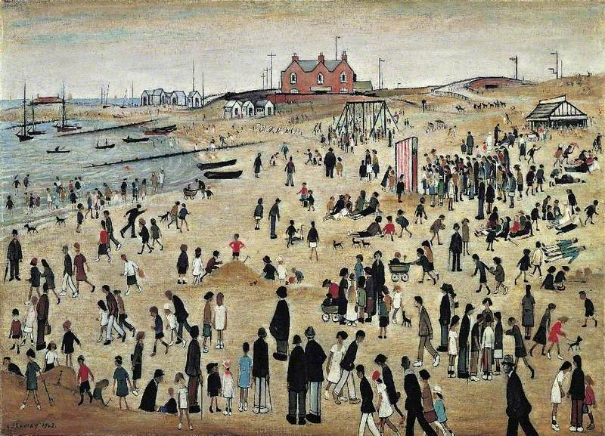
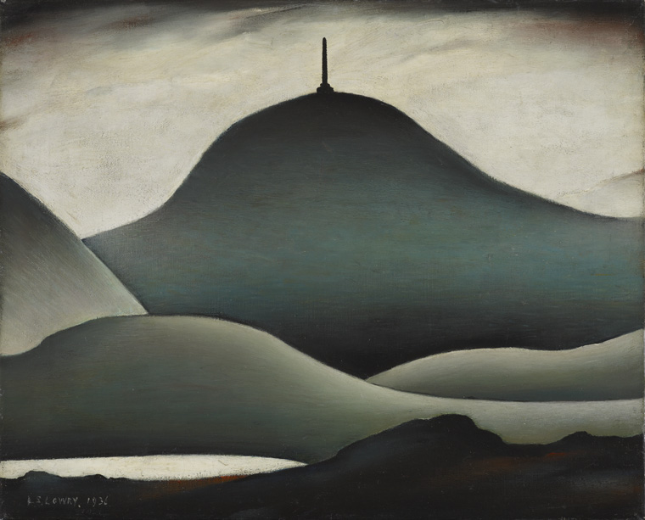


Lowry’s Paintings
He painted the seaside and the countryside.
Photos copyright to the estate of L S Lowry - all rights reserved - DACS 2014 - photo credit to the Arts Council Collection and copyright to The Lowry Collection - photo credit to thelowry.com

Slide 7
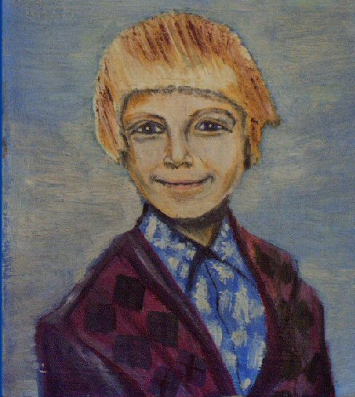
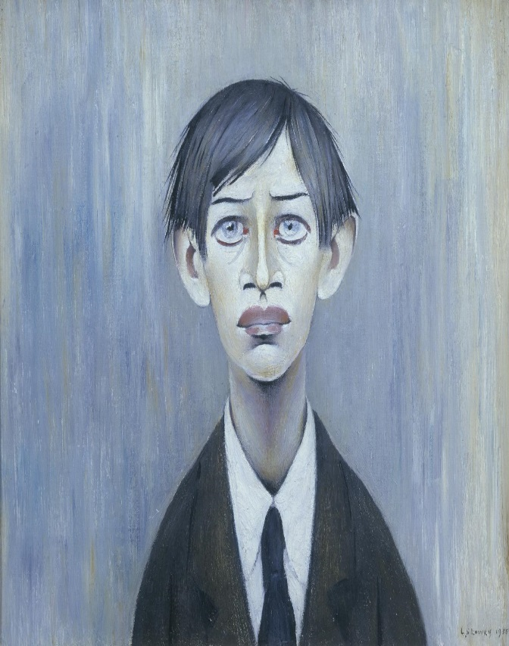


Lowry’s Paintings
He painted happy pictures and sad pictures.
Photos courtesy of ls-lowry.com and copyright to the estate of LS Lowry - photo credit to tate.org.uk

Slide 8
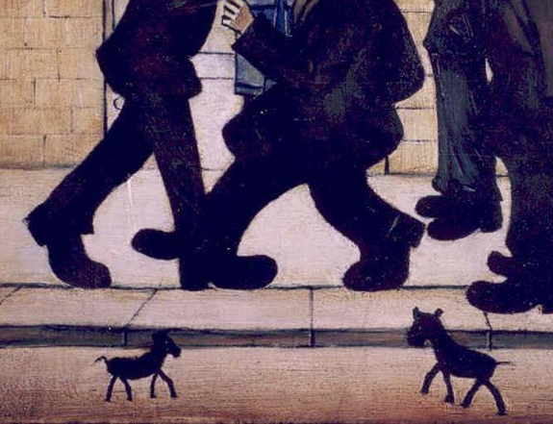
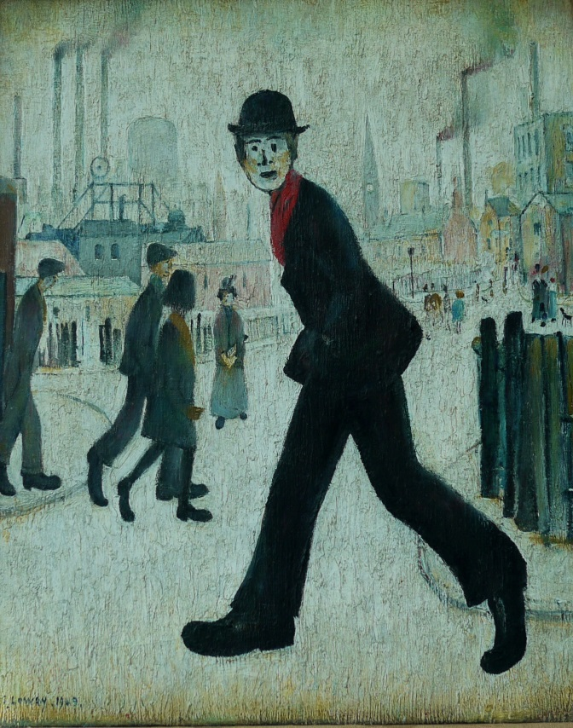


Lowry’s Paintings
He painted animals and people.
Photo courtesy of Smabs Sputzer (@flickr.com)-granted under creative commons licence- attribution

Slide 9
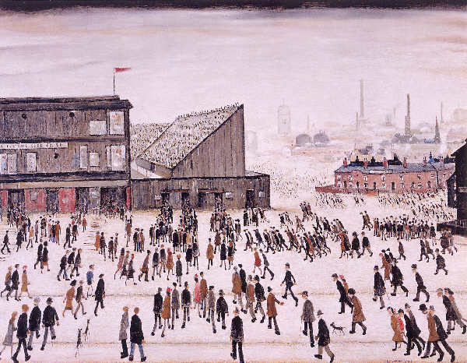
Lowry’s Paintings
He is best known for his paintings of the city that he lived and worked in.
This is one of Lowry’s industrial landscape paintings.
Going to the Match, 1928
by LS Lowry
Photo courtesy of mrrobertwade (wadey) (@flickr.com)-granted under creative commons licence- attribution

Slide 10
Lowry Colours
What colours can you see?
Photo courtesy of mrrobertwade (wadey) (@flickr.com)-granted under creative commons licence- attribution

Slide 11
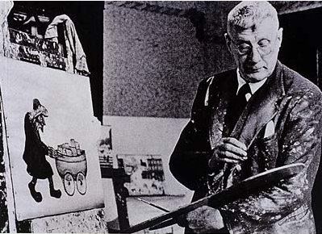





Lowry Colours
In all of his paintings, Lowry only used 5 colours of paint.
yellow
red
white
blue
black
Photo courtesy Black Stripe - front cover. Via Wikipedia

Slide 12


Lowry Colours
Red, yellow and blue are the primary colours.
You can use these to mix every other colour.

Slide 13


Lowry Colours
If you mix black with another colour it makes it darker.
If you mix white with another colour it makes it lighter.

Slide 14
















Lowry Colours
With these five paint you can mix any kind of colour you can think of.
The many colours in all of Lowry’s paintings are mixed from these five paints.

Slide 15
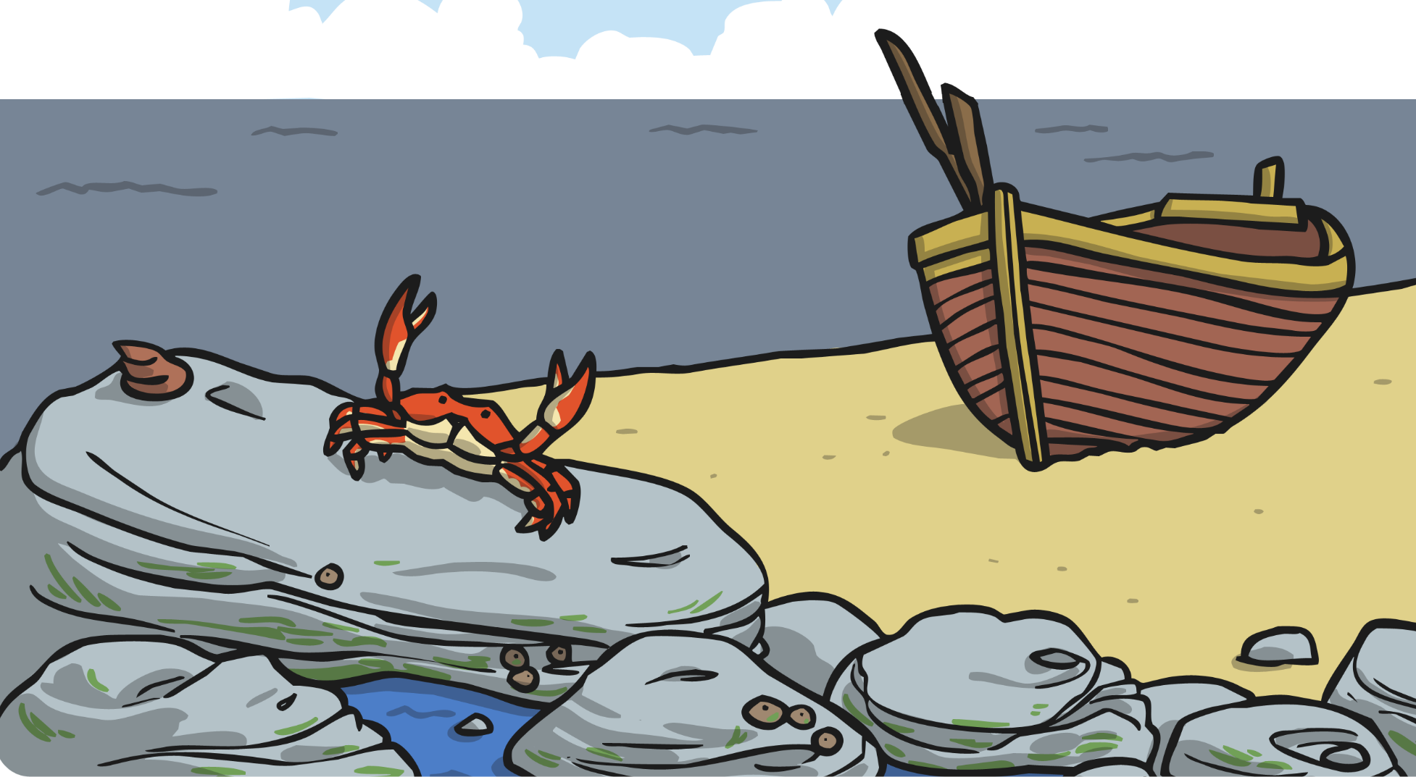
Seascapes
A ‘seascape’ is a painting of the sea.
Lowry loved the sea and often went on holiday to the seaside.
He painted lots of seascape paintings.
Like all of his paintings, they were painted with the same five colours.

Slide 16

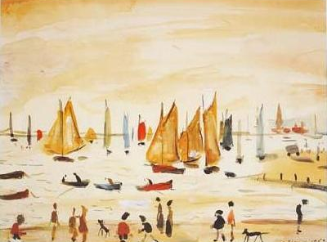
Seascapes
What colours can you see?
How can you make these colours from red, blue, yellow, black and white?
Yachts, 1959
by LS Lowry
Photo courtesy of thelowry.com

Slide 17








Painting a Seascape
You will need…
A4 paper
A3 card
Paint in
Lowry colours
Pallette
Brushes
Water
Rag
Using your five Lowry coloured paints, see how many different shades, tints and tones you can make.
See if you can make dark and light, pale and bright shades in lots of different colours. Practise on your paper.
Use these colours to paint a picture of the sea!
If you want, you can add a lighthouse, a beach or a boat.

Slide 18
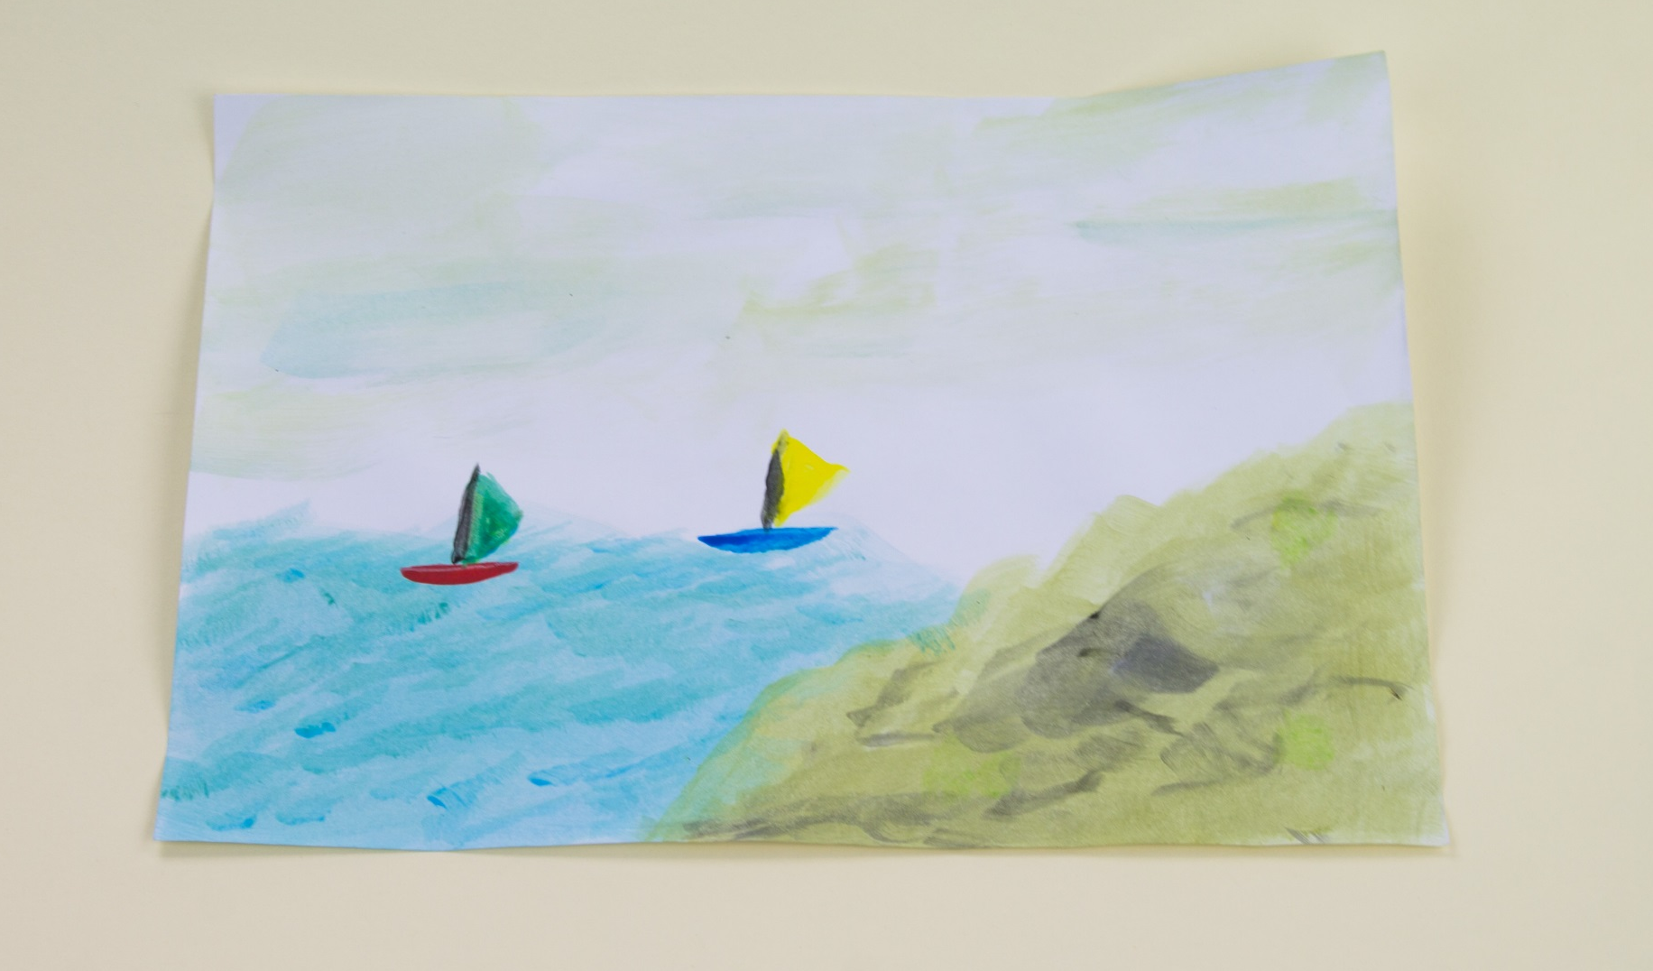
What a good one looks like…

Slide 19
















Can You Mix
Colours Like Lowry?

Slide 20





How do you make green?
blue
yellow

Slide 21



How do you make orange?
red
yellow

Slide 22

How do you make purple?
blue
red

Slide 23


How do you make pink?
red
white

Slide 24



How do you make grey?
black
white

Slide 25




How do you make brown?
yellow
red
blue

Slide 26



What do
you add to make a colour darker?
black

Slide 27



What do
you add to make a colour lighter?
white

Slide 28
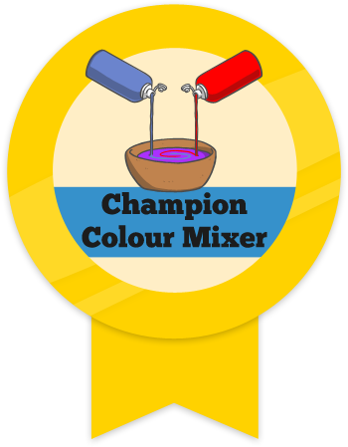


Well Done!
Now you can mix colours like Lowry!

Slide 29

Aim
I can paint a seascape using colours I have mixed.
I can talk about the work of LS Lowry.
Success Criteria
I can mix paint from ‘Lowry colours’.
I can paint a seascape.
I can tell you something about ‘Lowry colours’.
I can tell you something about Lowry’s seascape paintings.

