Slide 1


Art and Design
LS Lowry
Year One
Art and Design | KS1 | LS Lowry | Perspective | Lesson 3

Slide 2
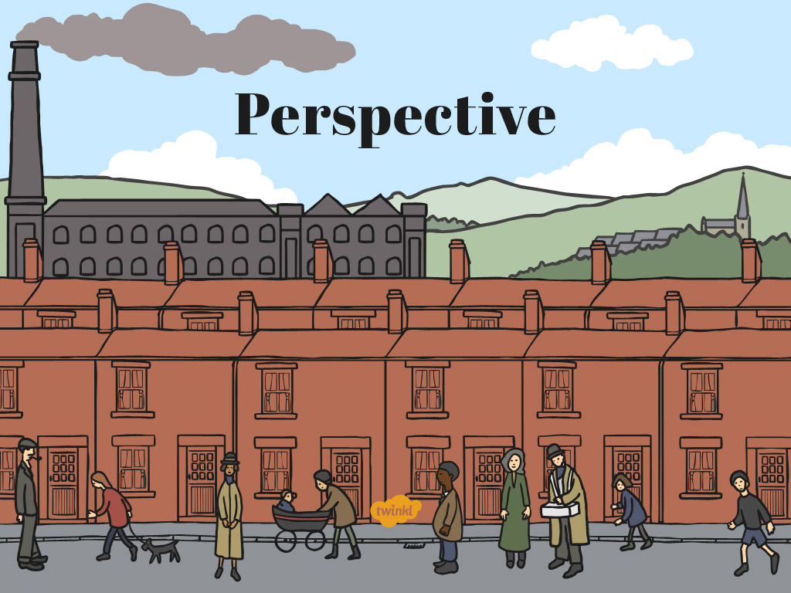

Slide 3
Aim
I can paint a background.
Success Criteria
I can paint things that are small so they look far away.
I can paint things in pale colours so they look far away.

Slide 4
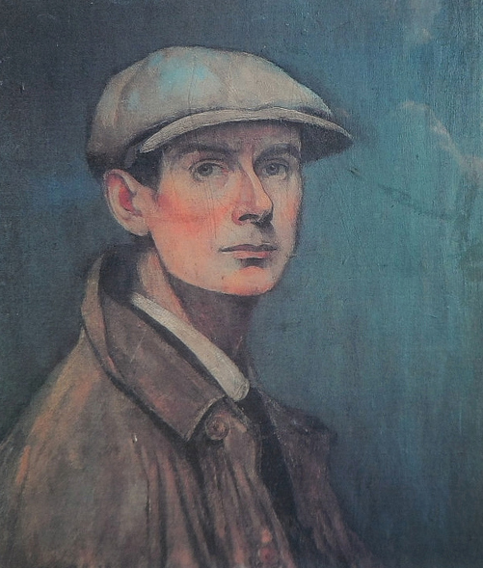
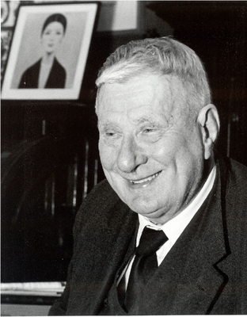
Who is LS Lowry?
Photo courtesy of Karen V Bryan and oknovokght (@flickr.com) - granted under creative commons licence – attribution

Slide 5
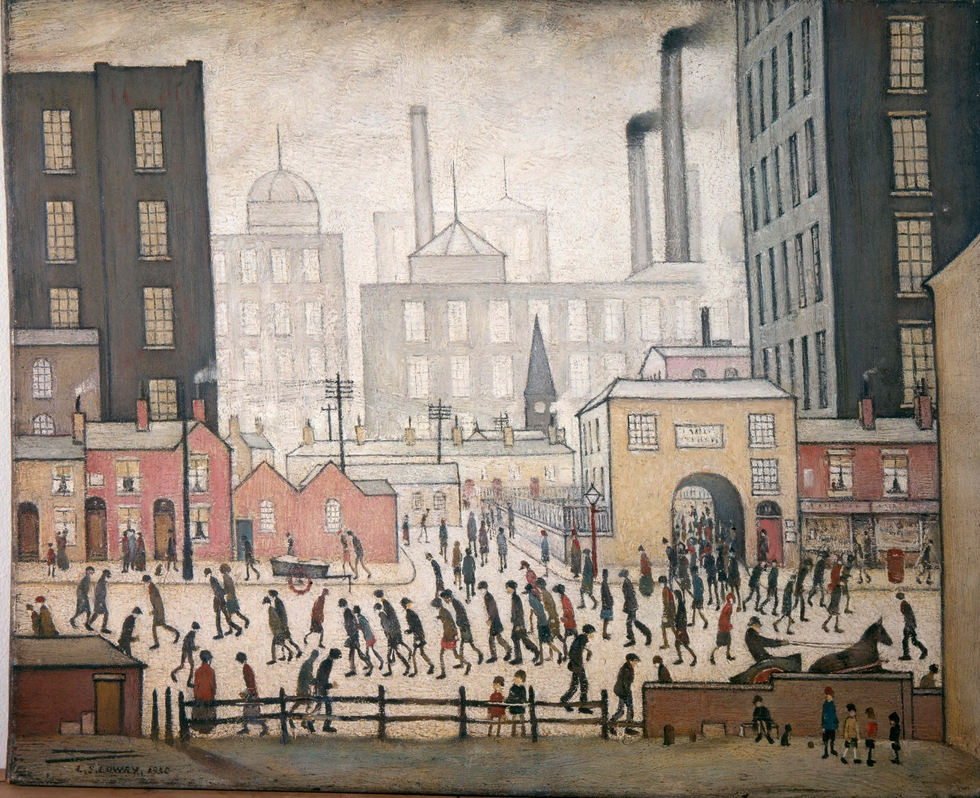
Lowry’s Industrial Landscapes
LS Lowry is most famous for his big paintings of the industrial landscape.
These are paintings of places in the city where lots of people live and work to make things.
Photo courtesy of mrrobertwade (wadey) (@flickr.com)-granted under creative commons licence- attribution

Slide 6

Lowry’s Industrial Landscapes
Lots of Lowry’s paintings show very big areas of the city. In them you can see things that are close and things that are far away.
Artists do this to make their pictures show big spaces, like you can see when you go outside in real life.
This is called perspective.
Coming From the Mill, 1930
by LS Lowry
Photo courtesy of mrrobertwade (wadey) (@flickr.com)-granted under creative commons licence- attribution

Slide 7
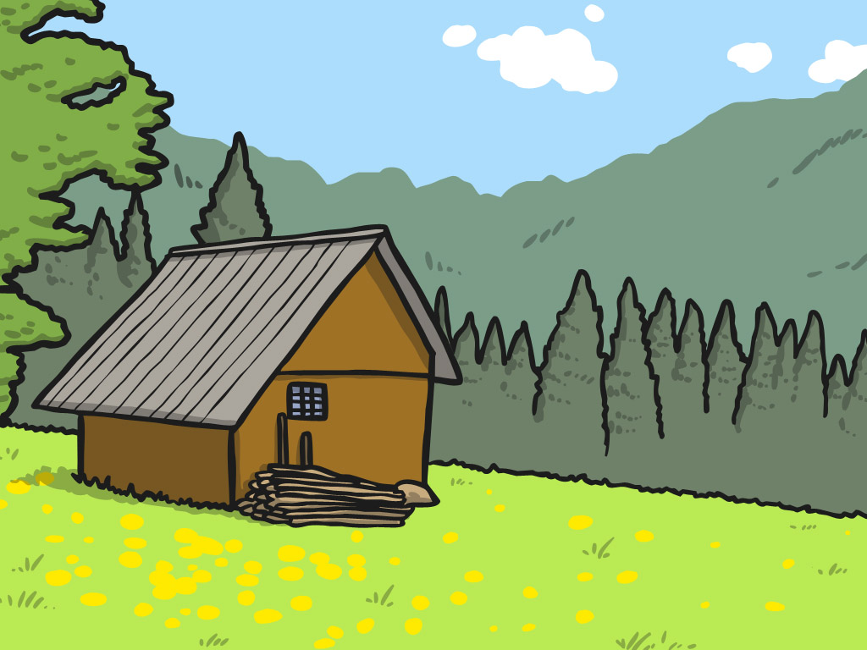

Perspective
Look at this picture.
Which things are very close?
Which things are in the middle?
Which things are far away?

Slide 8

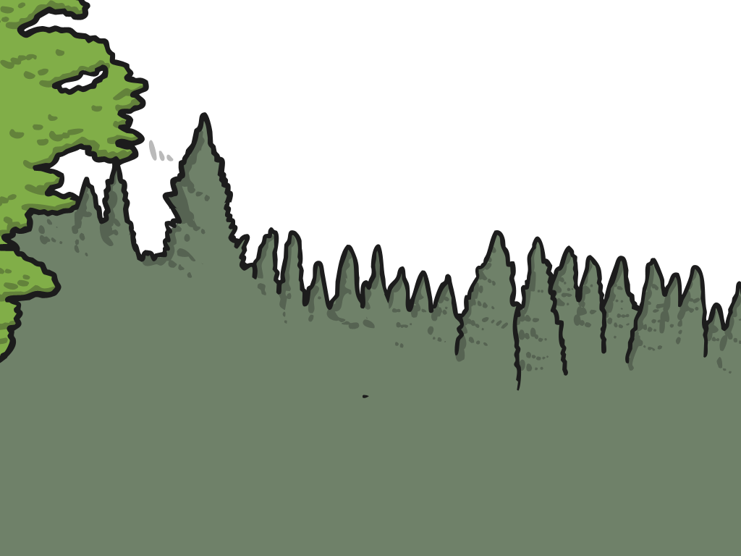
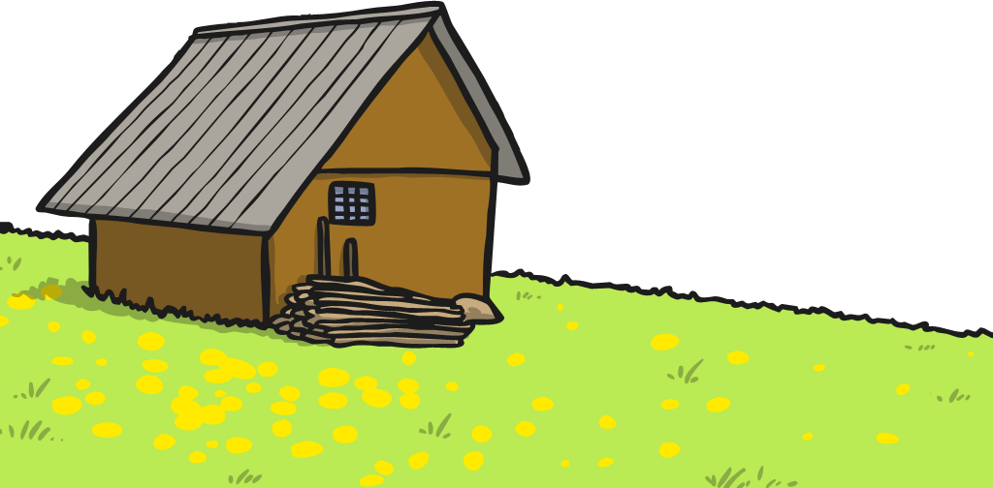
Perspective
Things that are far away look smaller.
Things that are very close look bigger.

Slide 9
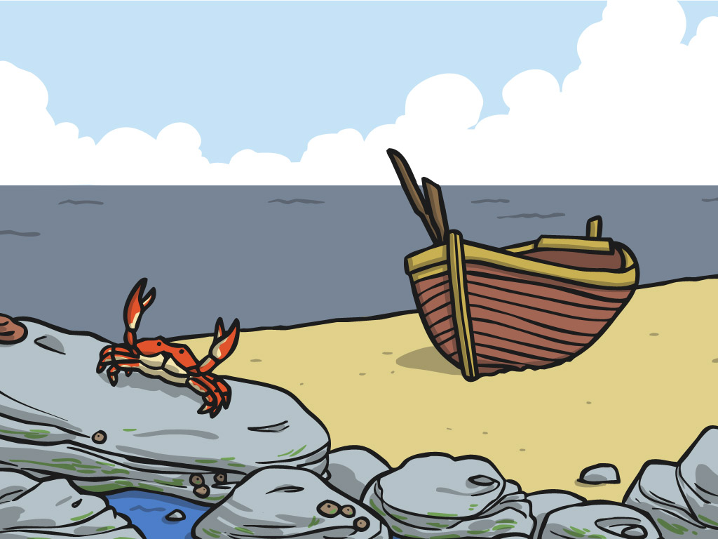

Perspective
Which things are very close?
Which things are in the middle?
Which things are far away?

Slide 10

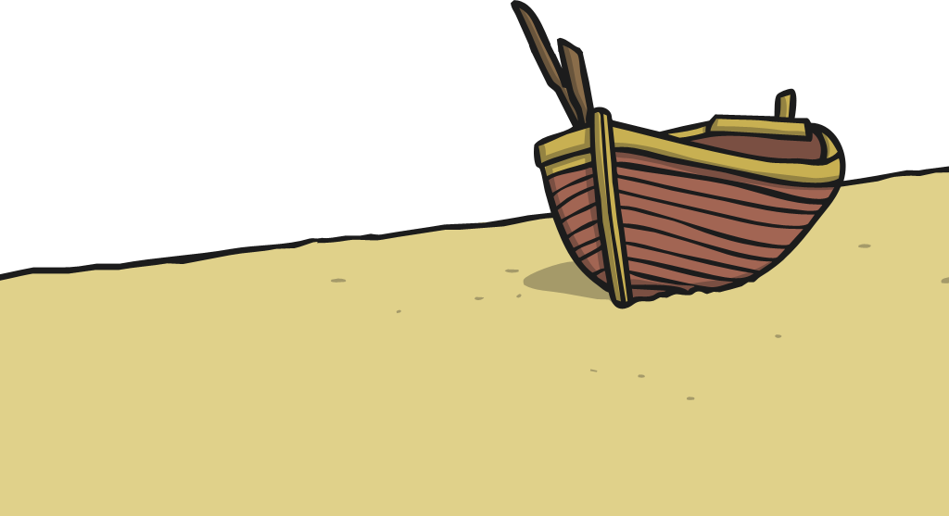
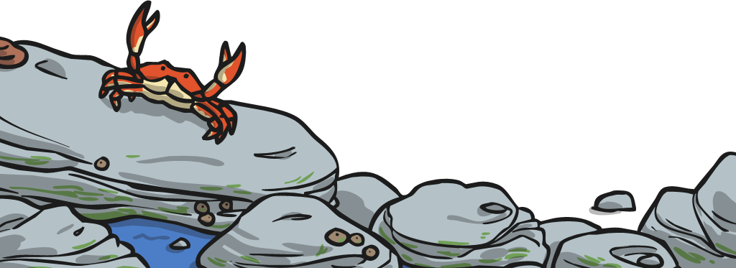
Perspective
Things that are far away look smaller.
Things that are very close look bigger.

Slide 11
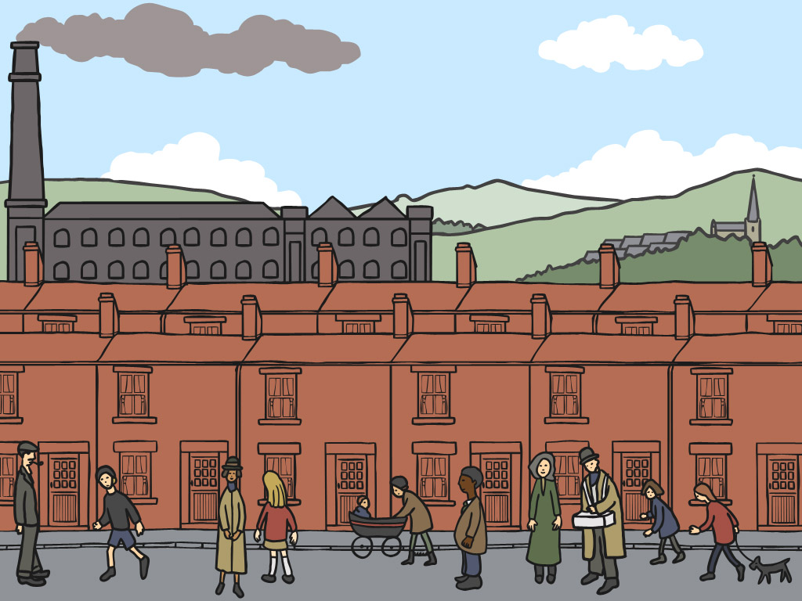
Perspective
Which things are very close?
Which things are in the middle?
Which things are far away?

Slide 12
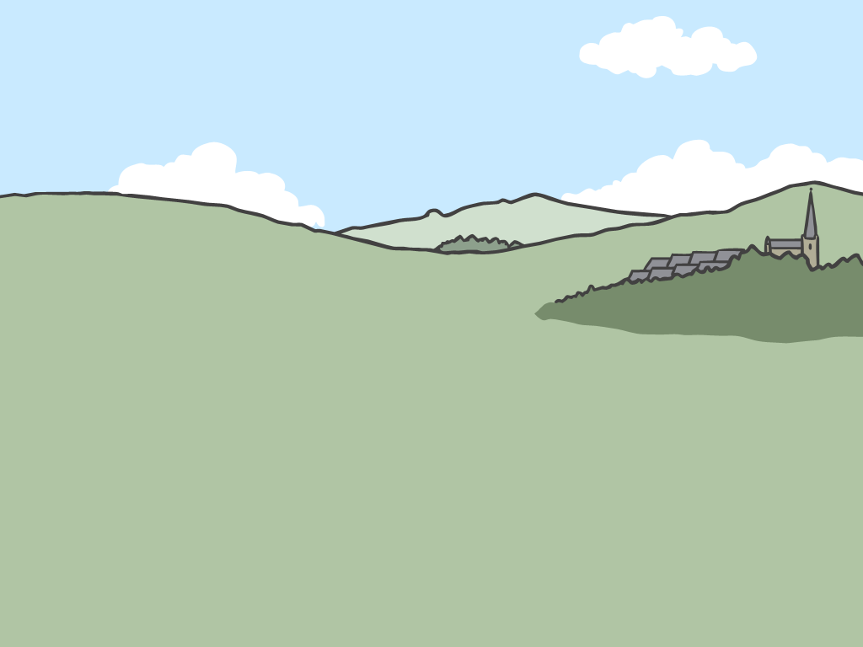
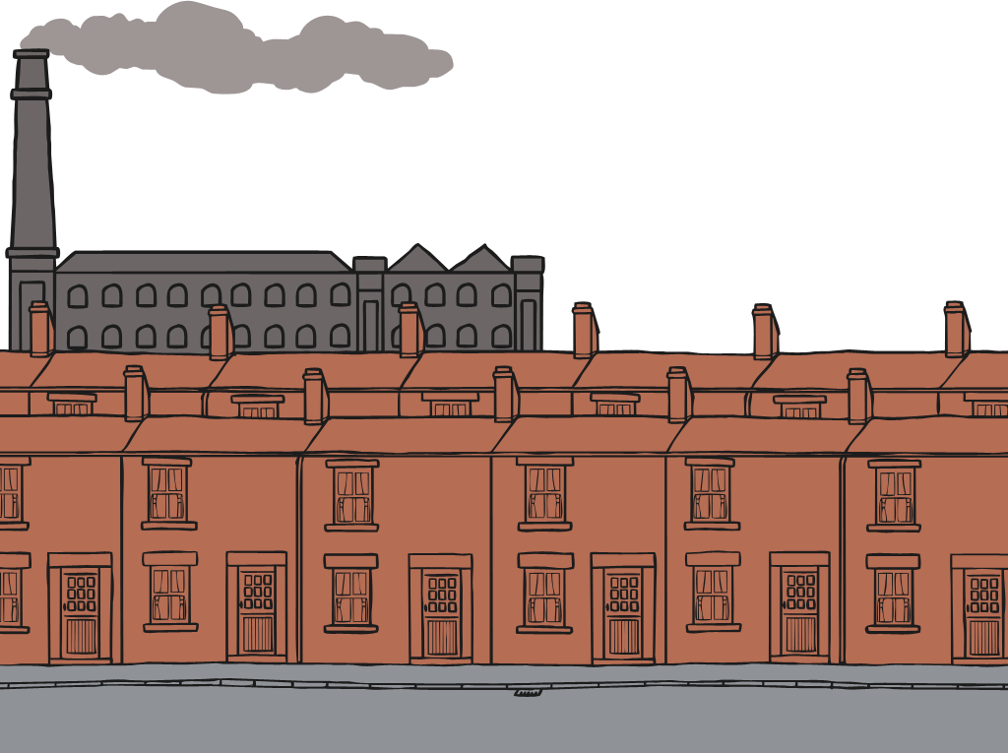
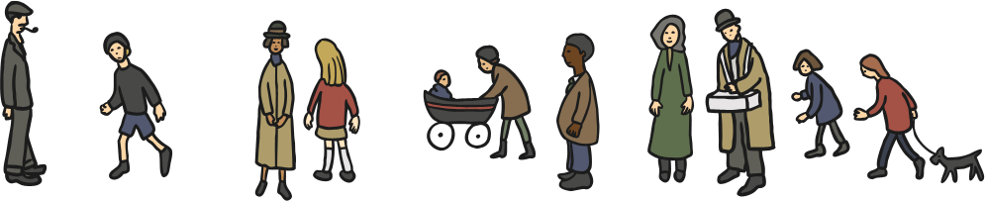
Perspective
Things that are far away look smaller.
Things that are very close look bigger.

Slide 13
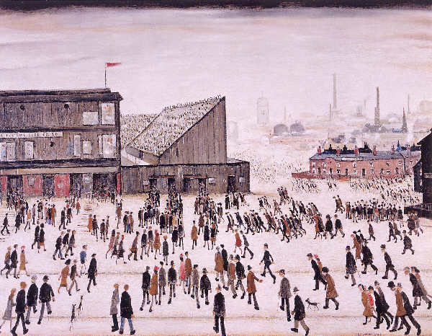
Perspective
This is one of Lowry’s industrial landscape paintings.
Which things are very close?
Which things are far away?
Which things are in the middle?
Photo courtesy of mrrobertwade (wadey) (@flickr.com)-granted under creative commons licence- attribution

Slide 14
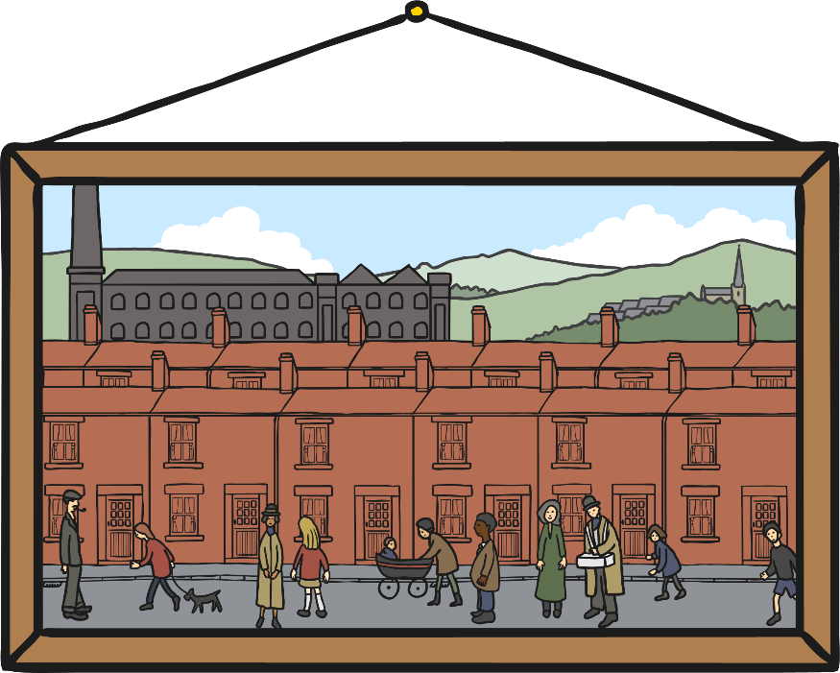
Painting a Background
We are going to make a Lowry City Collage!
A collage is a picture made of different kinds of art work.
We are going to make a picture in the style of Lowry from paintings, drawings and paper.

Slide 15
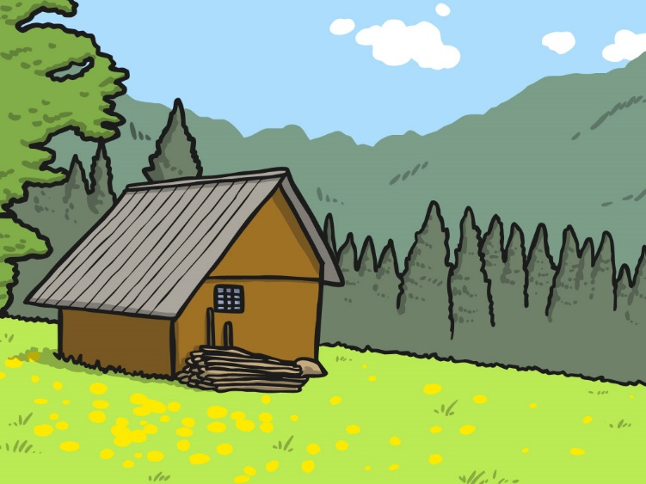

Painting a Background
Today we are going to paint a background for our Lowry City Collage.
This is the part of the picture that is very far away.

Slide 16
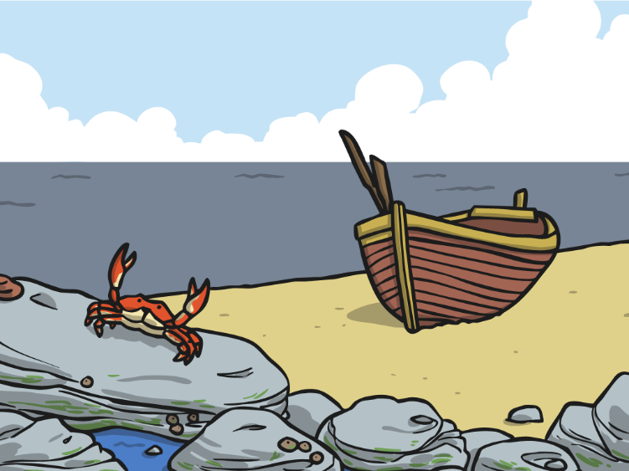

Painting a Background
Things in the background look less bright than things that are very close.

Slide 17
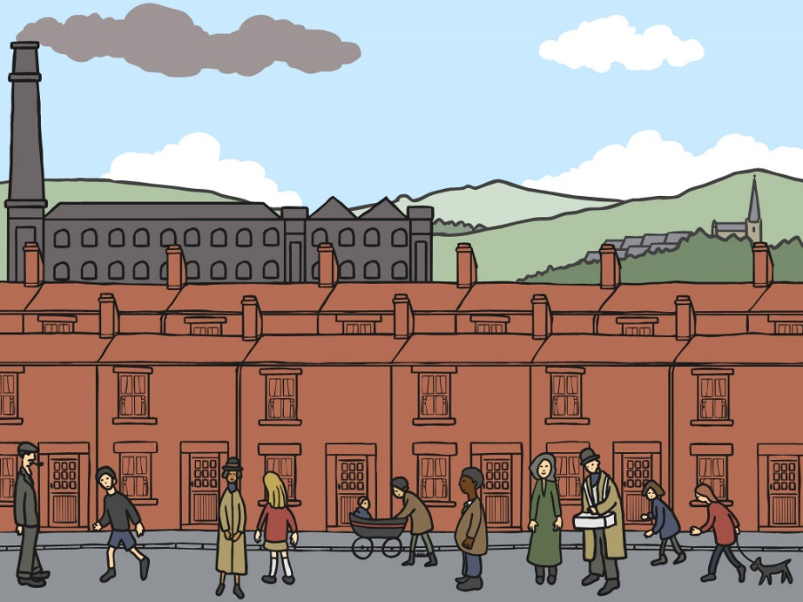
Painting a Background
Things in the background look very small because they are a long way in the distance.

Slide 18



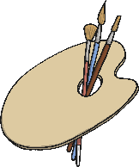



Painting a Background
You will need…
A3 card
Paint in
Lowry colours
Palette
Brushes
Water
Rag
Using your Lowry colours can you mix some light green, light blue, pale grey? Add white to your colours to make them paler because they are going to be far away in your picture.
First paint the sky. Add some clouds.
Next paint the hills. Make sure you paint them high up on your picture.
Add a few tiny towers or buildings on your hills. Make sure they look very small and very far away.

Slide 19
What a good one looks like…

Slide 20

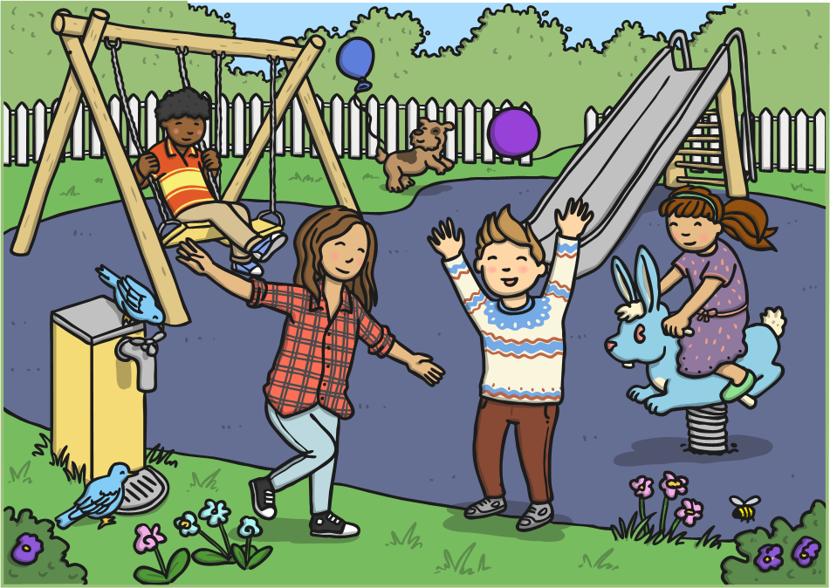
Close or Far Away?
Which things are very close?
Which things are in the middle?
Which things are far away?

Slide 21

Aim
I can paint a background.
Success Criteria
I can paint things that are small so they look far away.
I can paint things in pale colours so they look far away.

