Slide 1


Language Conventions
Suffix ‘-ed’
Year One
English | Year 2 | Language Conventions | Suffix ‘-ed’

Slide 3
Suffix ‘-ed’
Introductory Activity
Independent Focused Activity
Review Activity
Consolidation Activity
Assessment

Slide 4
Aim
I can add ‘-ed’ to words to make new words.
Success Criteria
I can sort ‘-ed’ words into their different sounds.
I can say a sentence using an ‘-ed’ word.
I can work out when to put ‘-ed’ at the end of a word.

Slide 5
Introductory Activity

Slide 6







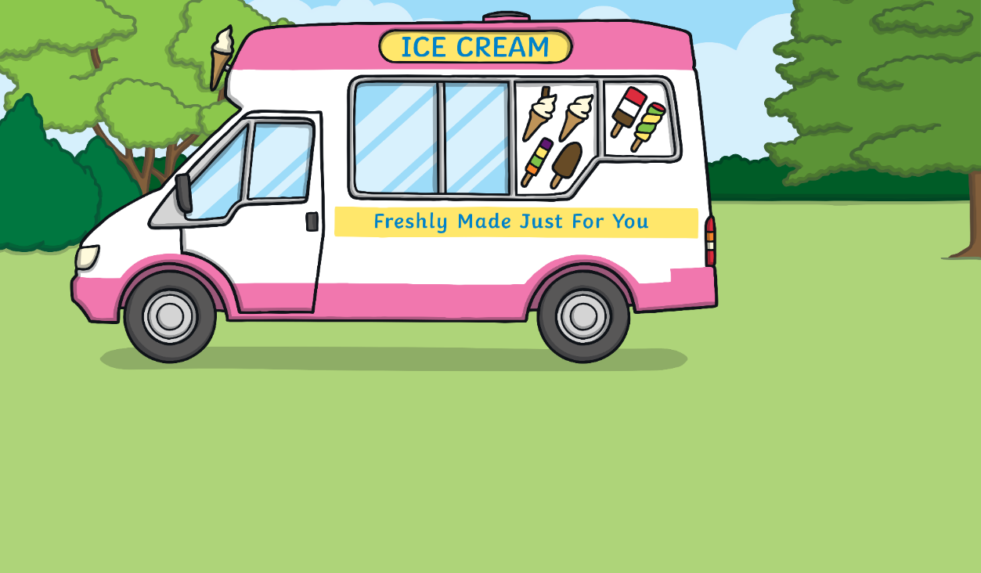
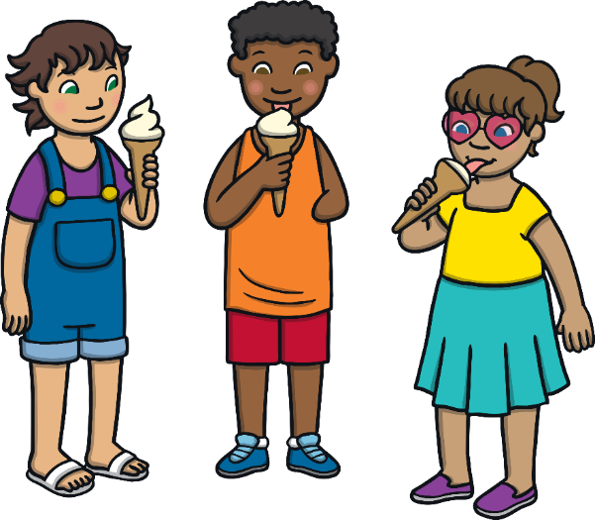
Adding ‘-ed’
Let’s read these words together:
lick
licked
What has been added to the second word?
How do we say this sound?

Slide 7


Adding ‘-ed’
Let’s read these words together:
work
worked
What has been added to the second word?
How do we say this sound?

Slide 8
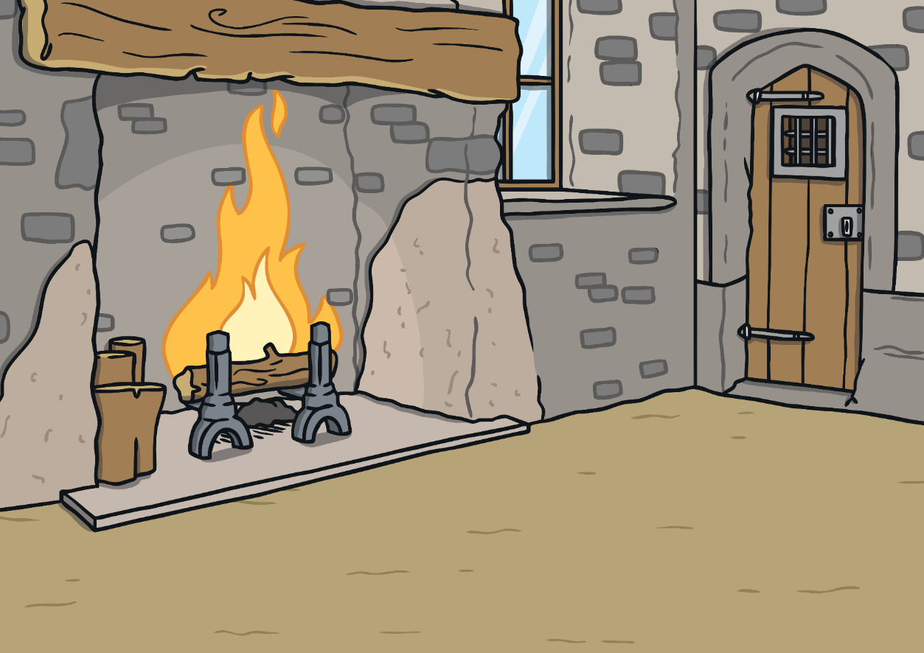

Adding ‘-ed’
Let’s read these words together:
burn
burned
What has been added to the second word?
How do we say this sound?

Slide 9
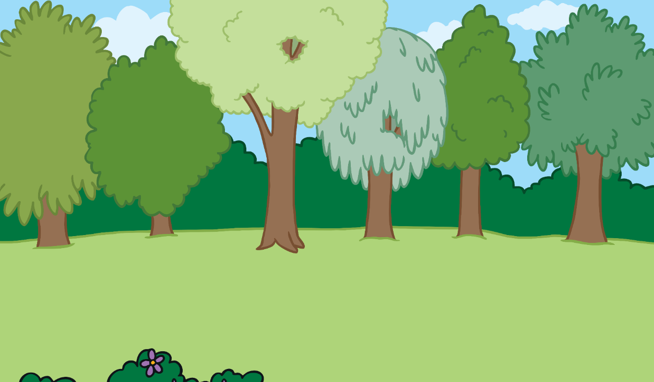
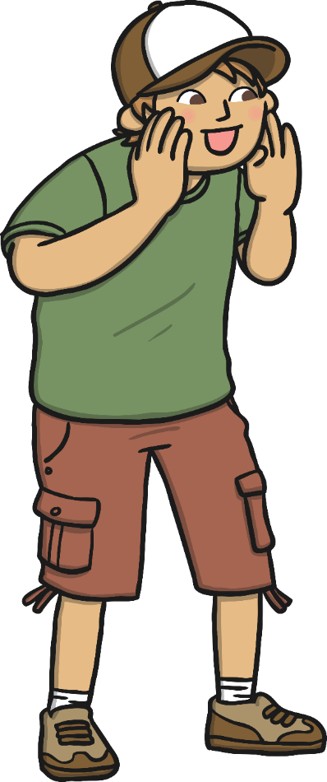

Adding ‘-ed’
Let’s read these words together:
yell
yelled
What has been added to the second word?
How do we say this sound?

Slide 10

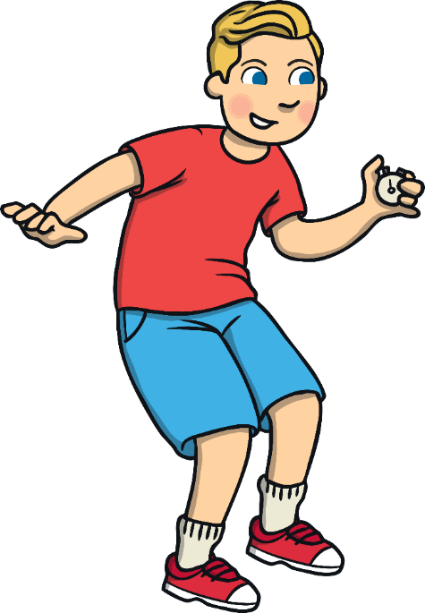
Adding ‘-ed’
Let’s read these words together:
start
started
What has been added to the second word?
How do we say this sound?

Slide 11
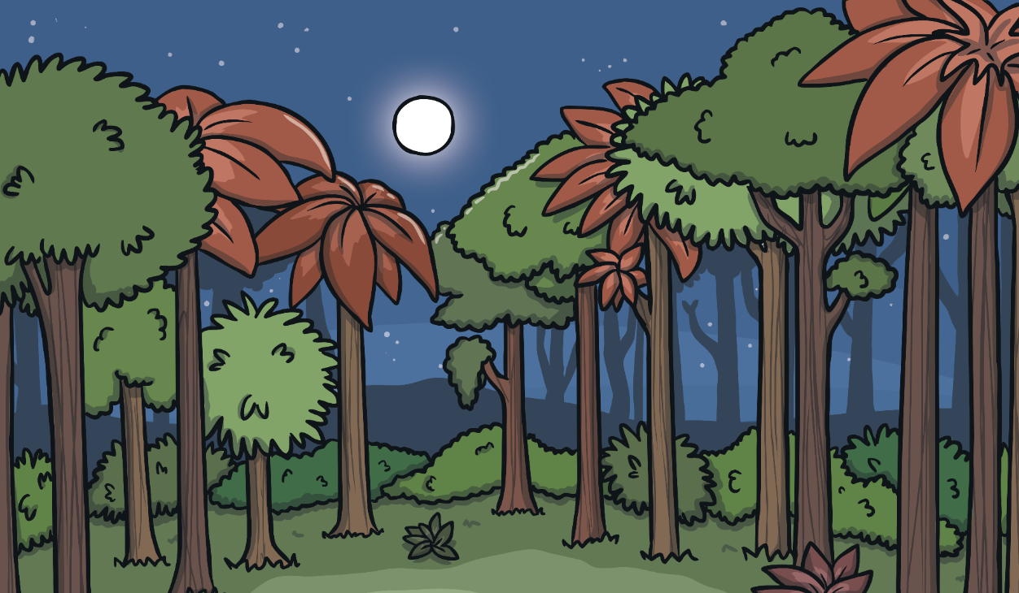
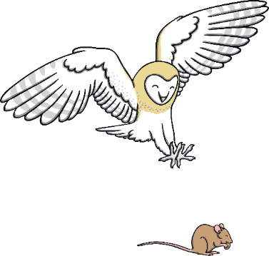
Adding ‘-ed’
Let’s read these words together:
hunt
hunted
What has been added to the second word?
How do we say this sound?

Slide 12
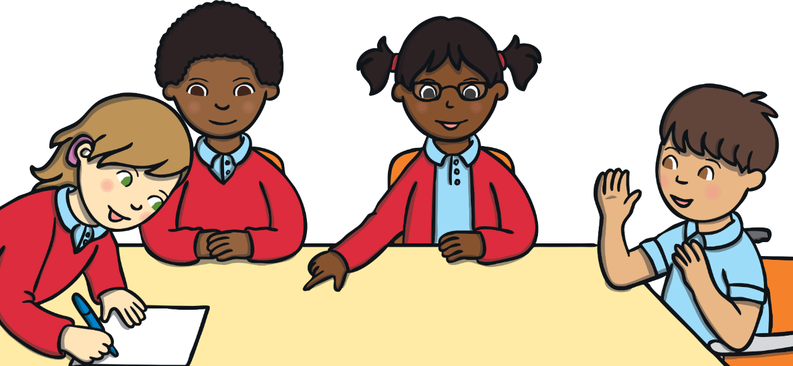
Sorting ‘–ed’ Words
Did you spot the ‘-ed’ endings? We call the ‘-ed’ bit of the word a suffix.
Could you hear the different sounds the ‘-ed’ endings made?
Work with the other children in your group to sort the ‘-ed’ words by their different sounds.

Slide 13
Sorting ‘–ed’ Words
Drag the words into the correct columns.
-ed (t) | -ed (d) | -ed (id)
mixed
started
burned
yelled
hunted
licked

Slide 14
Independent Focused Activity

Slide 15
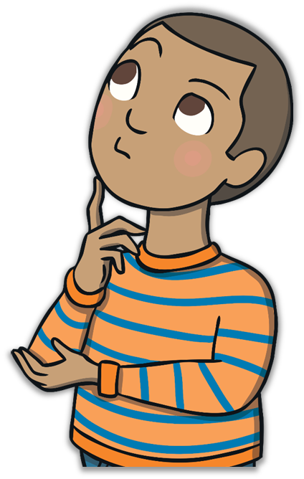
In the Past
What happens to the meaning of a word when ‘–ed’ is added?
It shows the action is happening in the past.
This is called past tense.

Slide 16
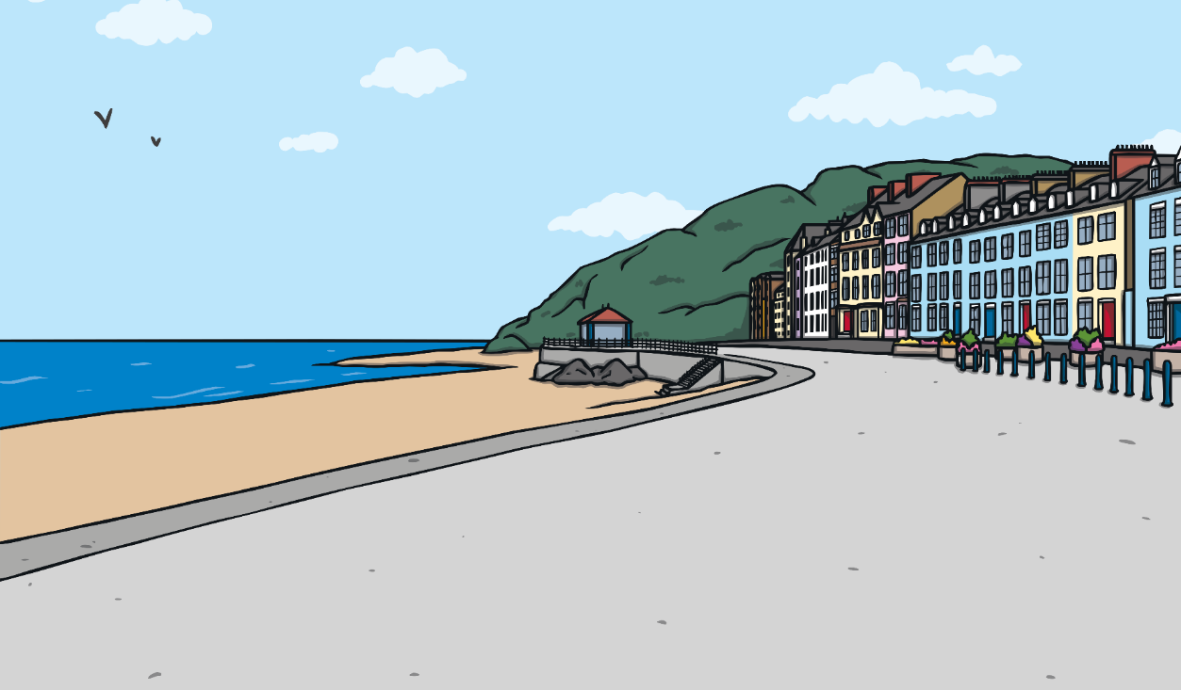
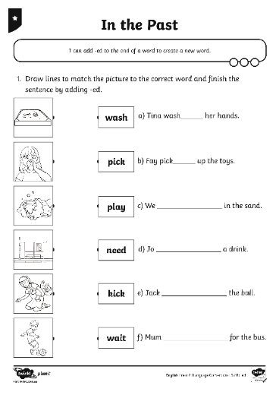
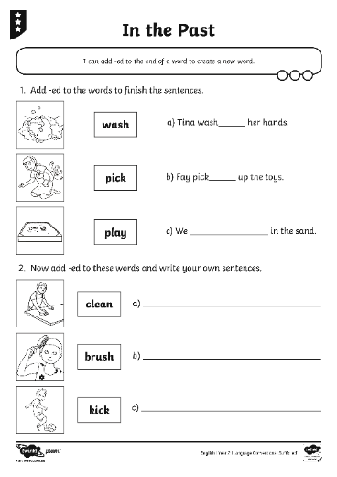
In the Past
You are going to complete the In the Past Activity Sheet to practise making ‘-ed’ words.

Slide 17
Review Activity

Slide 18
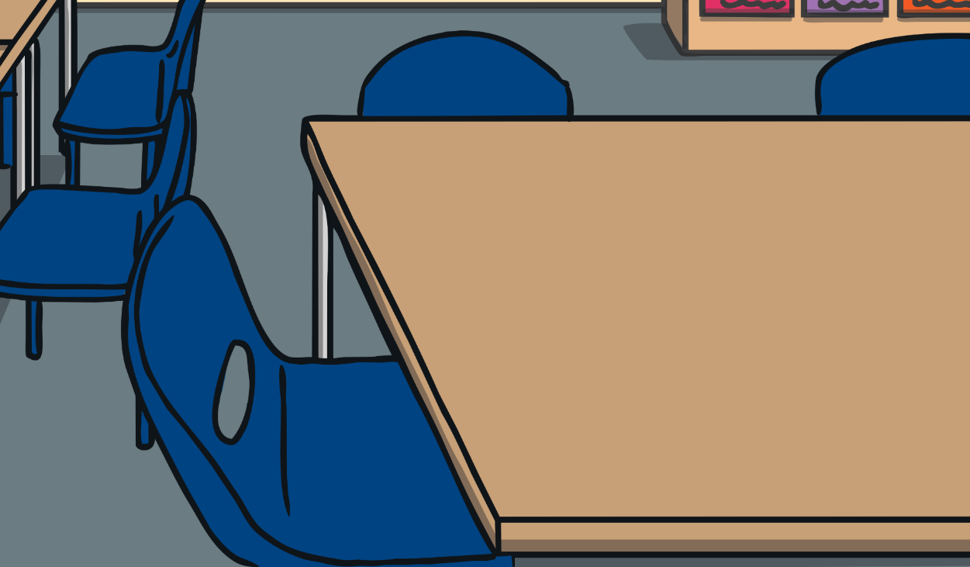
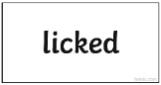
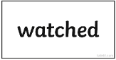
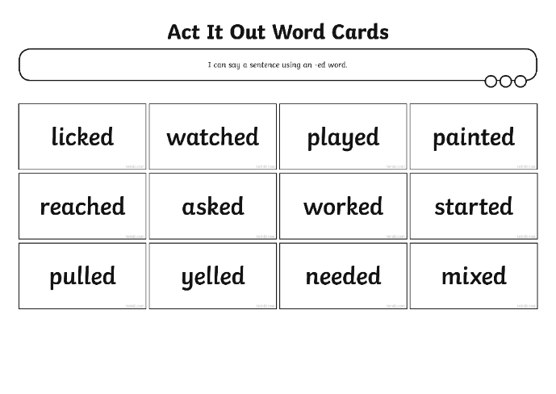
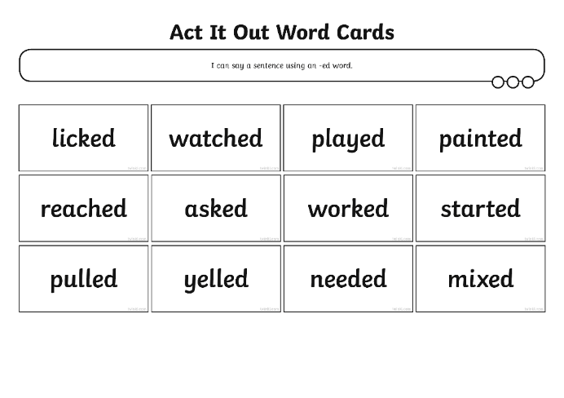
Act It Out Game
Shuffle the Act it Out Word Cards and lay them face down on the table.
Take turns to turn over a card.
(Don’t show your partner!)
Act out the word on the card and see if your partner can guess the word and write it down correctly on their whiteboard.

Slide 19
Consolidation Activity

Slide 20



When Do We Need ‘–ed’?
To show something has happened in the past.
Can you remember why we use ‘-ed’ at the end of a word?
Read this sentence together:
Ed look at the book.
What is wrong?

Slide 21
When Do We Need ‘–ed’?
We need to use ‘-ed’ if we want to show that the action has already happened (happened in the past).
Ed looked at the book.
We could say:
Read this sentence together:
Ed looks at the book.
Ed look at the book.
This shows the action is happening now.
What is wrong?

Slide 22
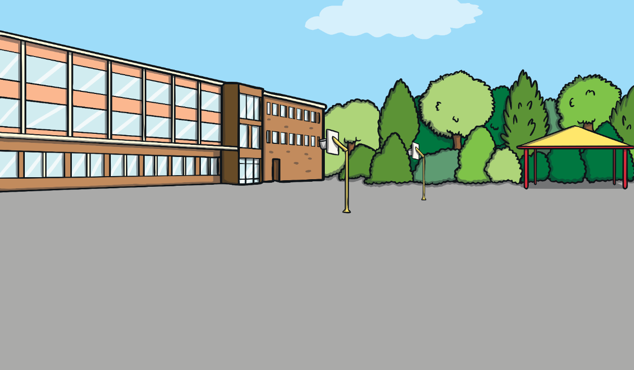
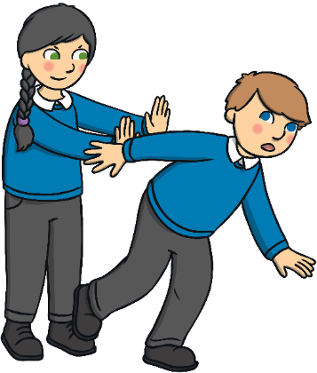
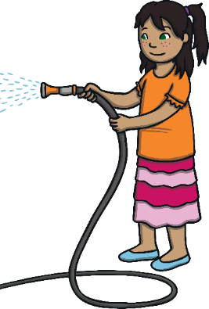
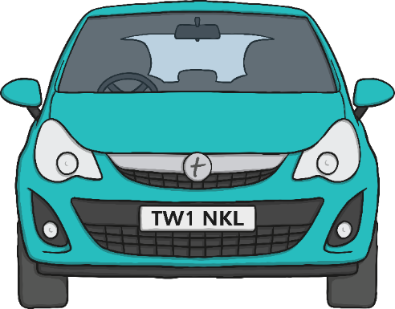
When Do We Need ‘–ed’?
Can you use ‘-ed’ to show that these sentences happened in the past? Say them to your partner.
Dee wash the car.
Steph push Sam over.

Slide 23
Assessment

Slide 24
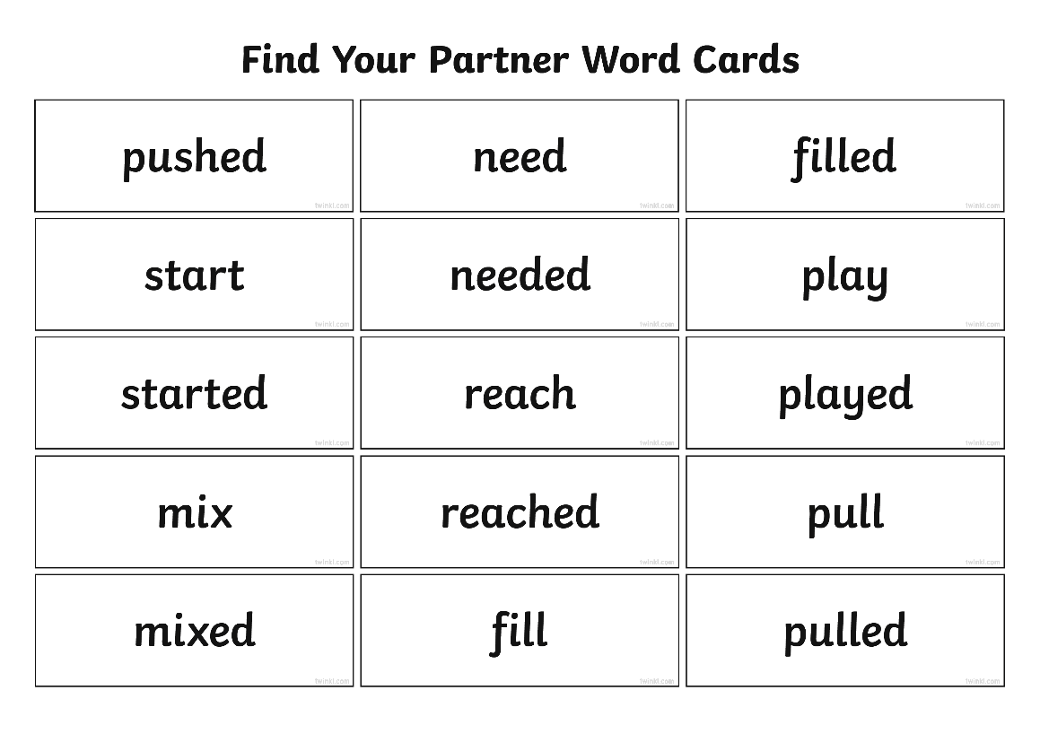
Find Your Partner
Look at the word card your teacher has given you.
Can you find your partner?
e.g. If your word is start, then your partner’s card will be started.
When you have found your partner, work together to think of a sentence using each word. Be ready to say your sentences to the rest of the class.

Slide 25
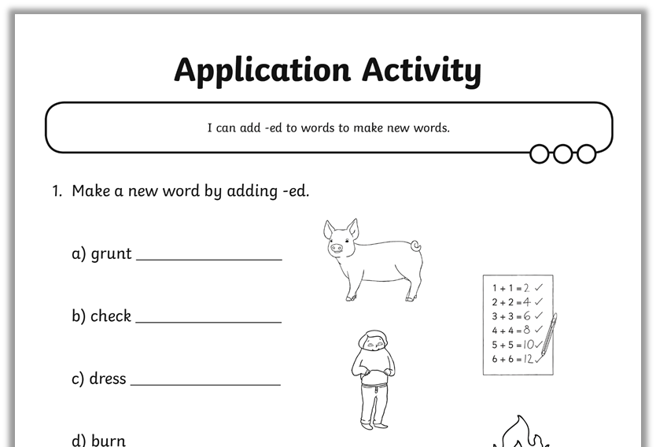

Writing ‘–ed’ Words
Show your teacher how well you can write ‘–ed’ words by completing the activity sheet.

Slide 26
Aim
I can add ‘-ed’ to words to make new words.
Success Criteria
I can sort ‘-ed’ words into their different sounds.
I can say a sentence using an ‘-ed’ word.
I can work out when to put ‘-ed’ at the end of a word.

