Slide 1

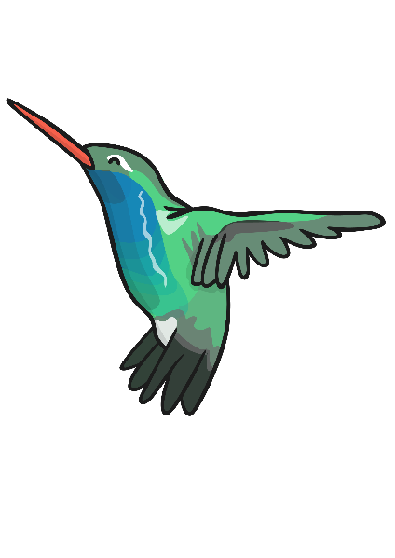
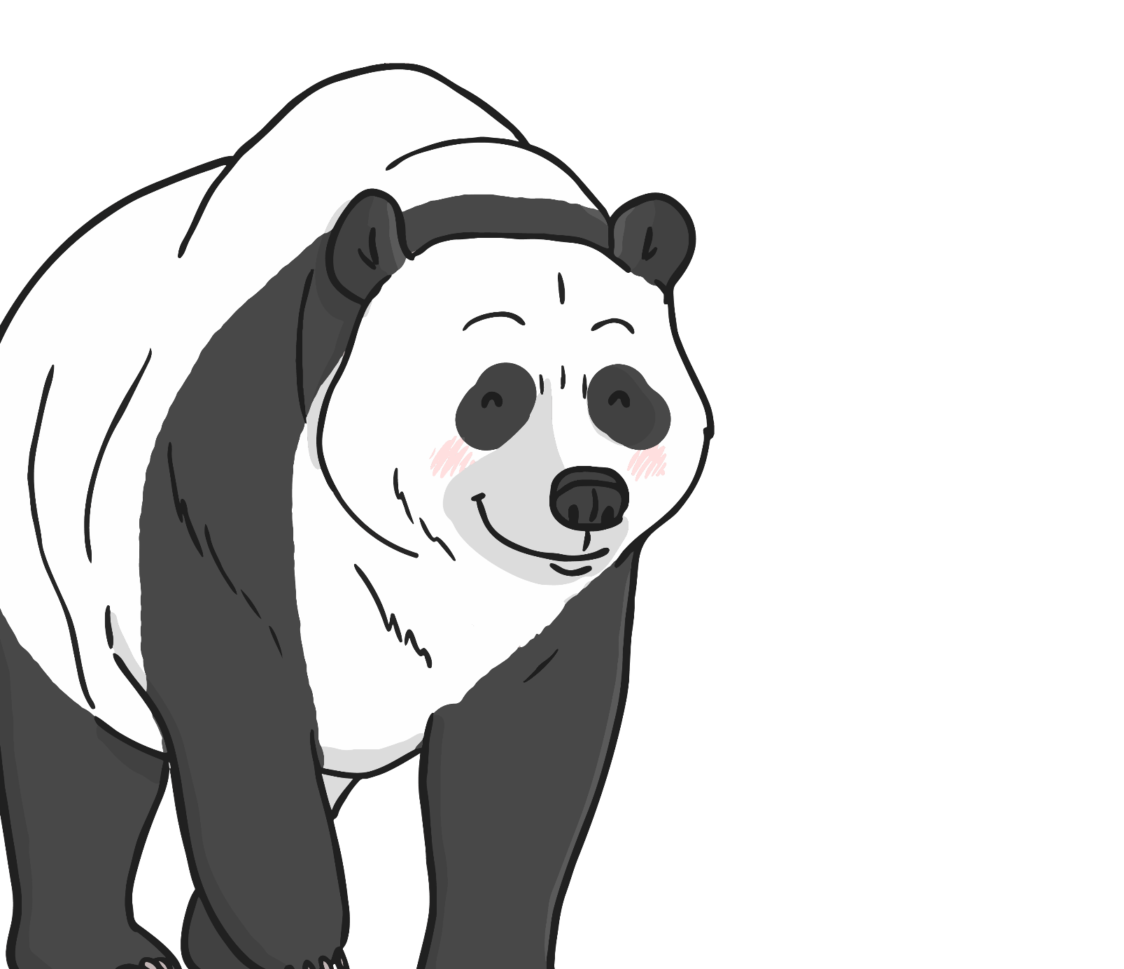
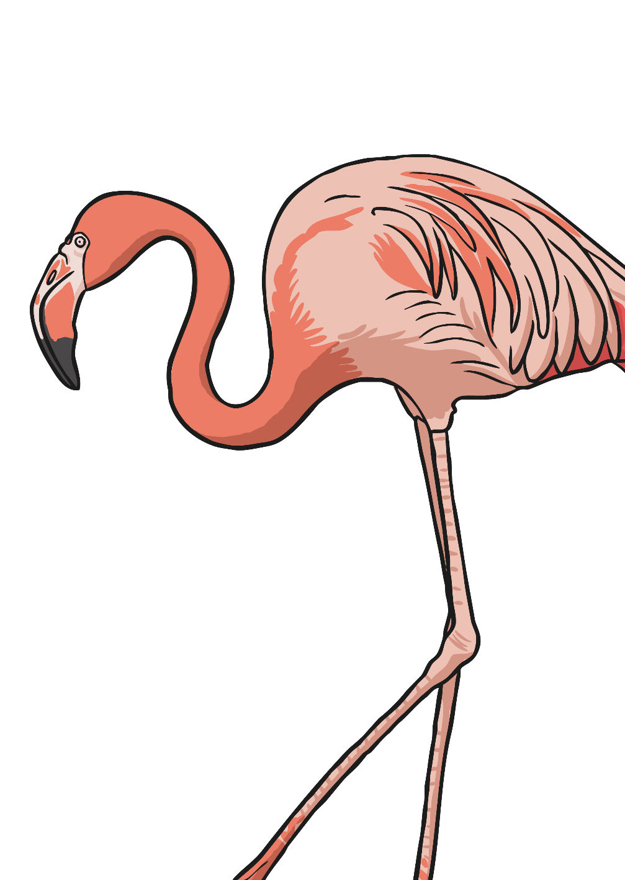
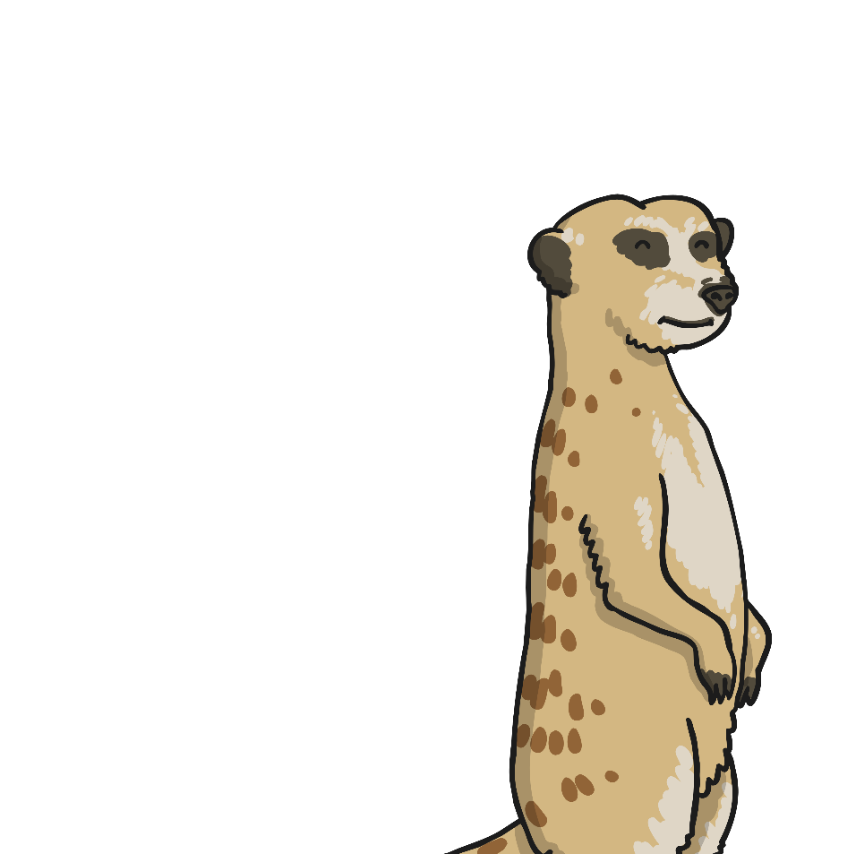
Variations in Animal Groups
Discussion Prompts

Slide 2
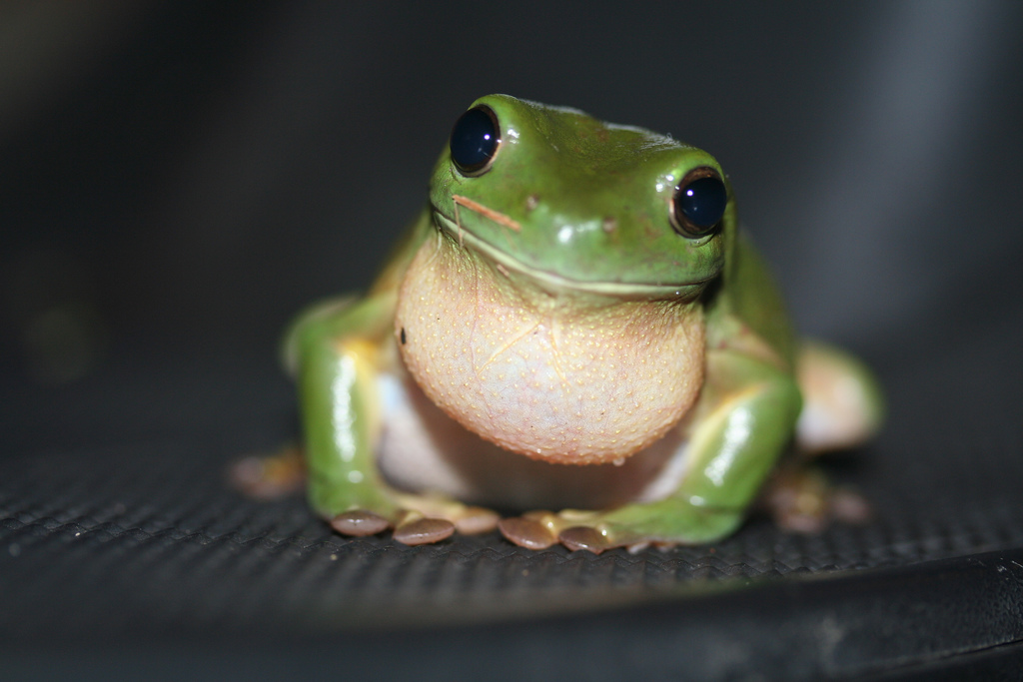
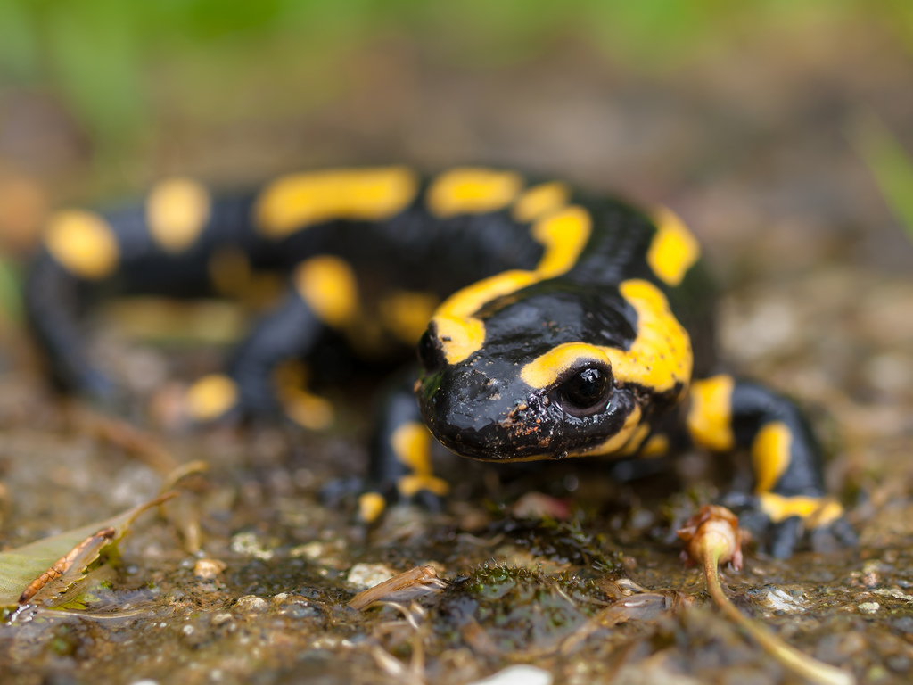
Amphibians
Amphibians live on land and in water. They lay their eggs in water.
frog
Note the similarities and differences between them.
salamander
Photo courtesy of wwarby, httpwwwflickrcomphotostopend (@flickr.com) - granted under creative commons licence - attribution

Slide 3
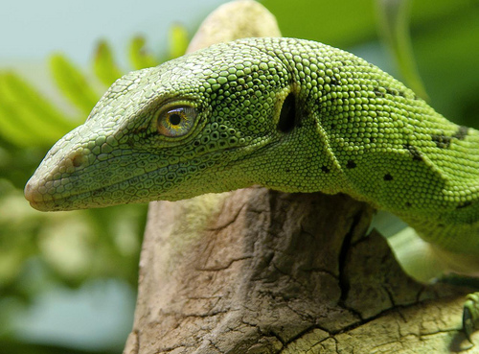
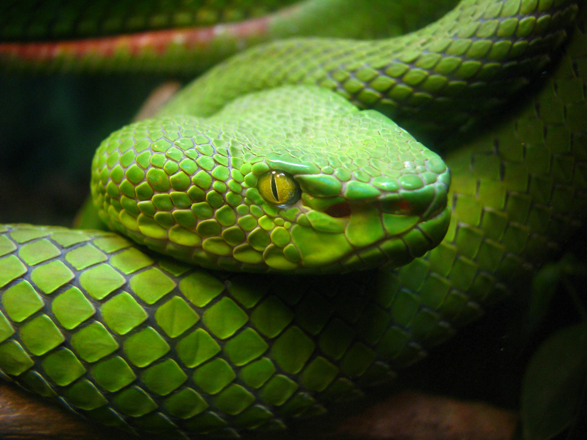
Reptiles
Reptiles live in water and on land.
They have scales and are cold blooded. This means that they cannot keep warm by themselves and need to be in a warm place.
They lay their eggs on land.
lizard
Note the similarities and differences between them.
snake
Photo courtesy of bestrated1, 75491103@N00 (@flickr.com) - granted under creative commons licence - attribution

Slide 4
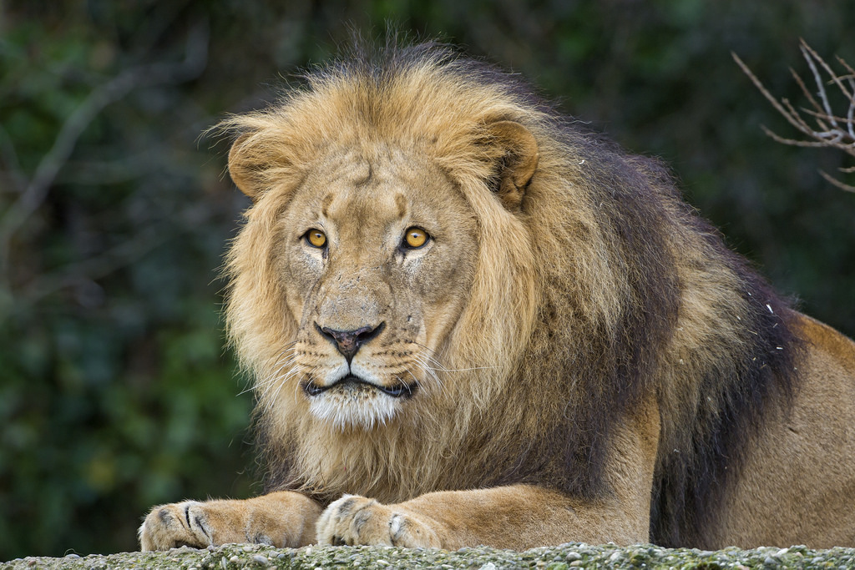
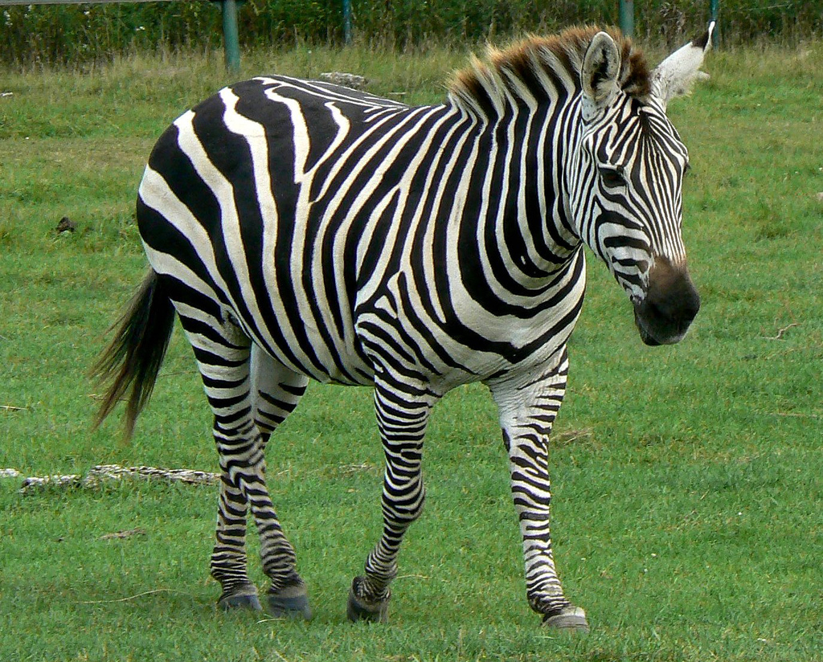
Mammals
Mammals usually have hair or fur.
Mammal babies are born alive.
The mothers feed their babies milk.
We are mammals.
lion
Note the similarities and differences between them.
zebra
Photo courtesy of vickispix, tambako(@flickr.com) - granted under creative commons licence - attribution

Slide 5
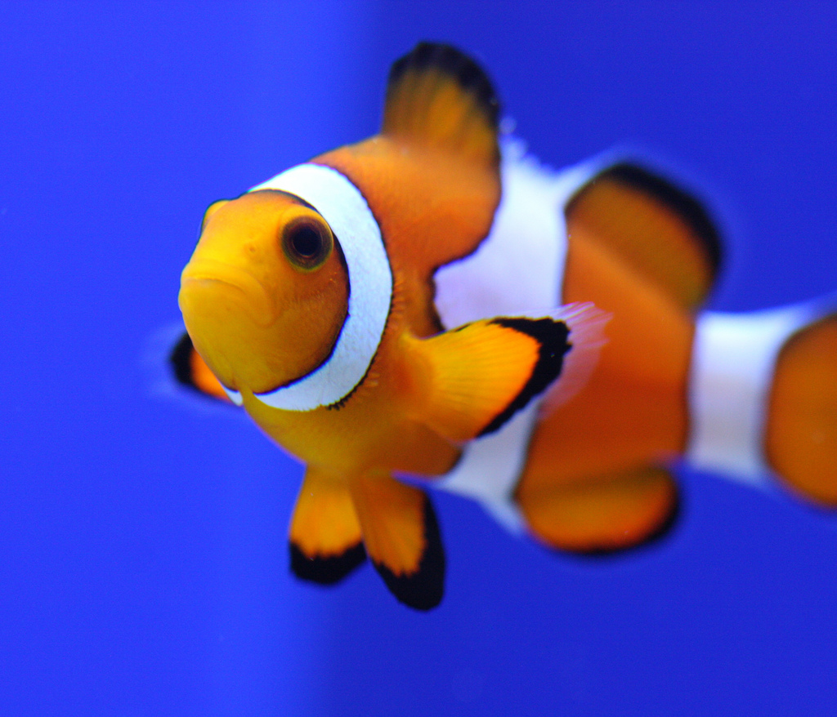
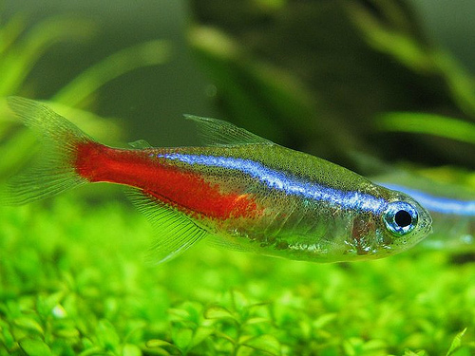
Fish
Fish live in water.
They have fins instead of legs and gills instead of lungs. They lay their eggs in water.
Clown Fish
Note the similarities and differences between them.
Neon Tetra
Photo courtesy of 24242453@N07, nathaninsandiego (@flickr.com) - granted under creative commons licence - attribution

Slide 6
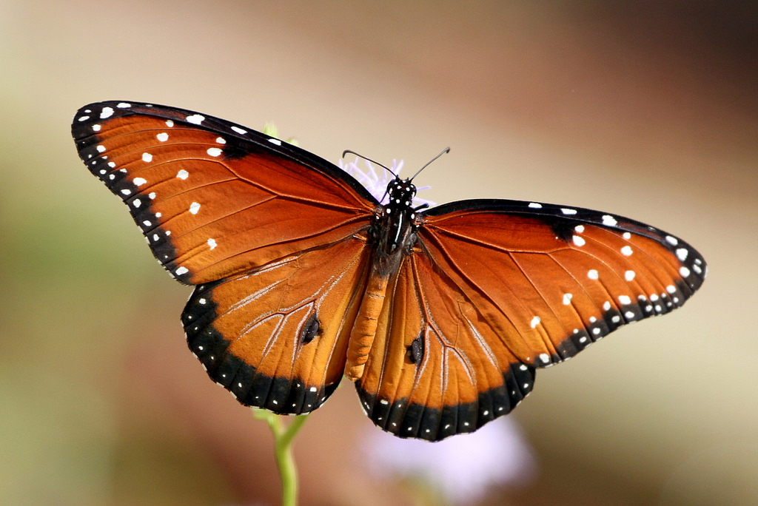
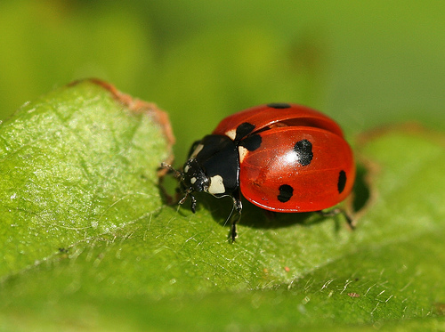
Insects
Insects have 6 legs.
Their bodies are made up of 3 parts. Some have wings.
They lay eggs.
butterfly
Note the similarities and differences between them.
ladybird
Photo courtesy of texaseagle, photos/rachel_s (@flickr.com) - granted under creative commons licence - attribution

Slide 7
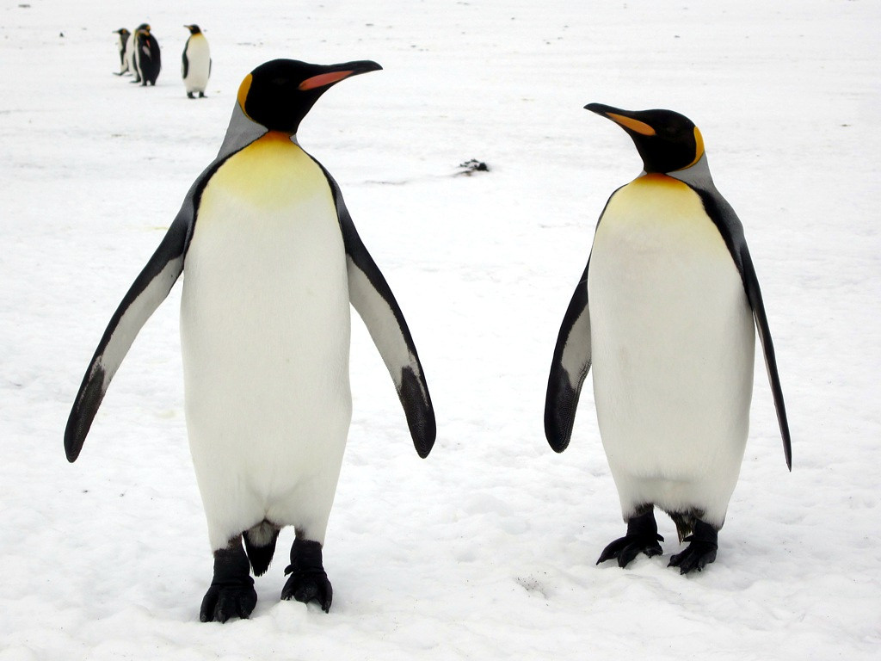
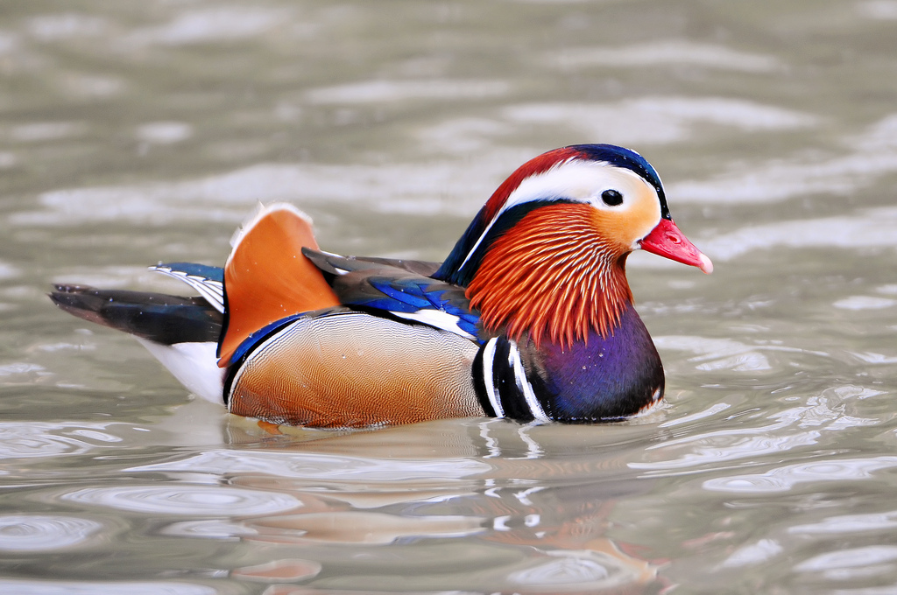
Birds
Birds have a beak, wings, feathers and 2 legs. They lay eggs.
penguins
Note the similarities and differences between them.
Mandarin Duck
Photo courtesy of davidstanleytravel, tambako (@flickr.com) - granted under creative commons licence - attribution

Slide 8


