Slide 1


Slide 2
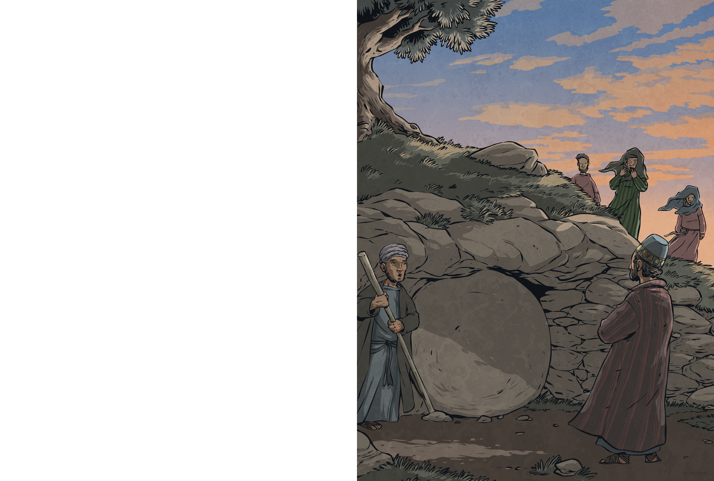
A rich man named Joseph of Arimathea asked the governor for Jesus’ body. With Pilate’s permission, he wrapped Jesus in a linen cloth and carried him away.
Joseph had a tomb close by, carved from rock. He placed Jesus inside. Nearby stood the women who followed Jesus; among them was Mary Magdalene, who had travelled with Jesus through Galilee ever since Jesus had healed her. The women watched sadly as Joseph’s servant rolled a huge stone across the entrance of the tomb.
Jesus had been betrayed and rejected, and now he lay in a tomb – but that wasn’t the end of the story...

Slide 3
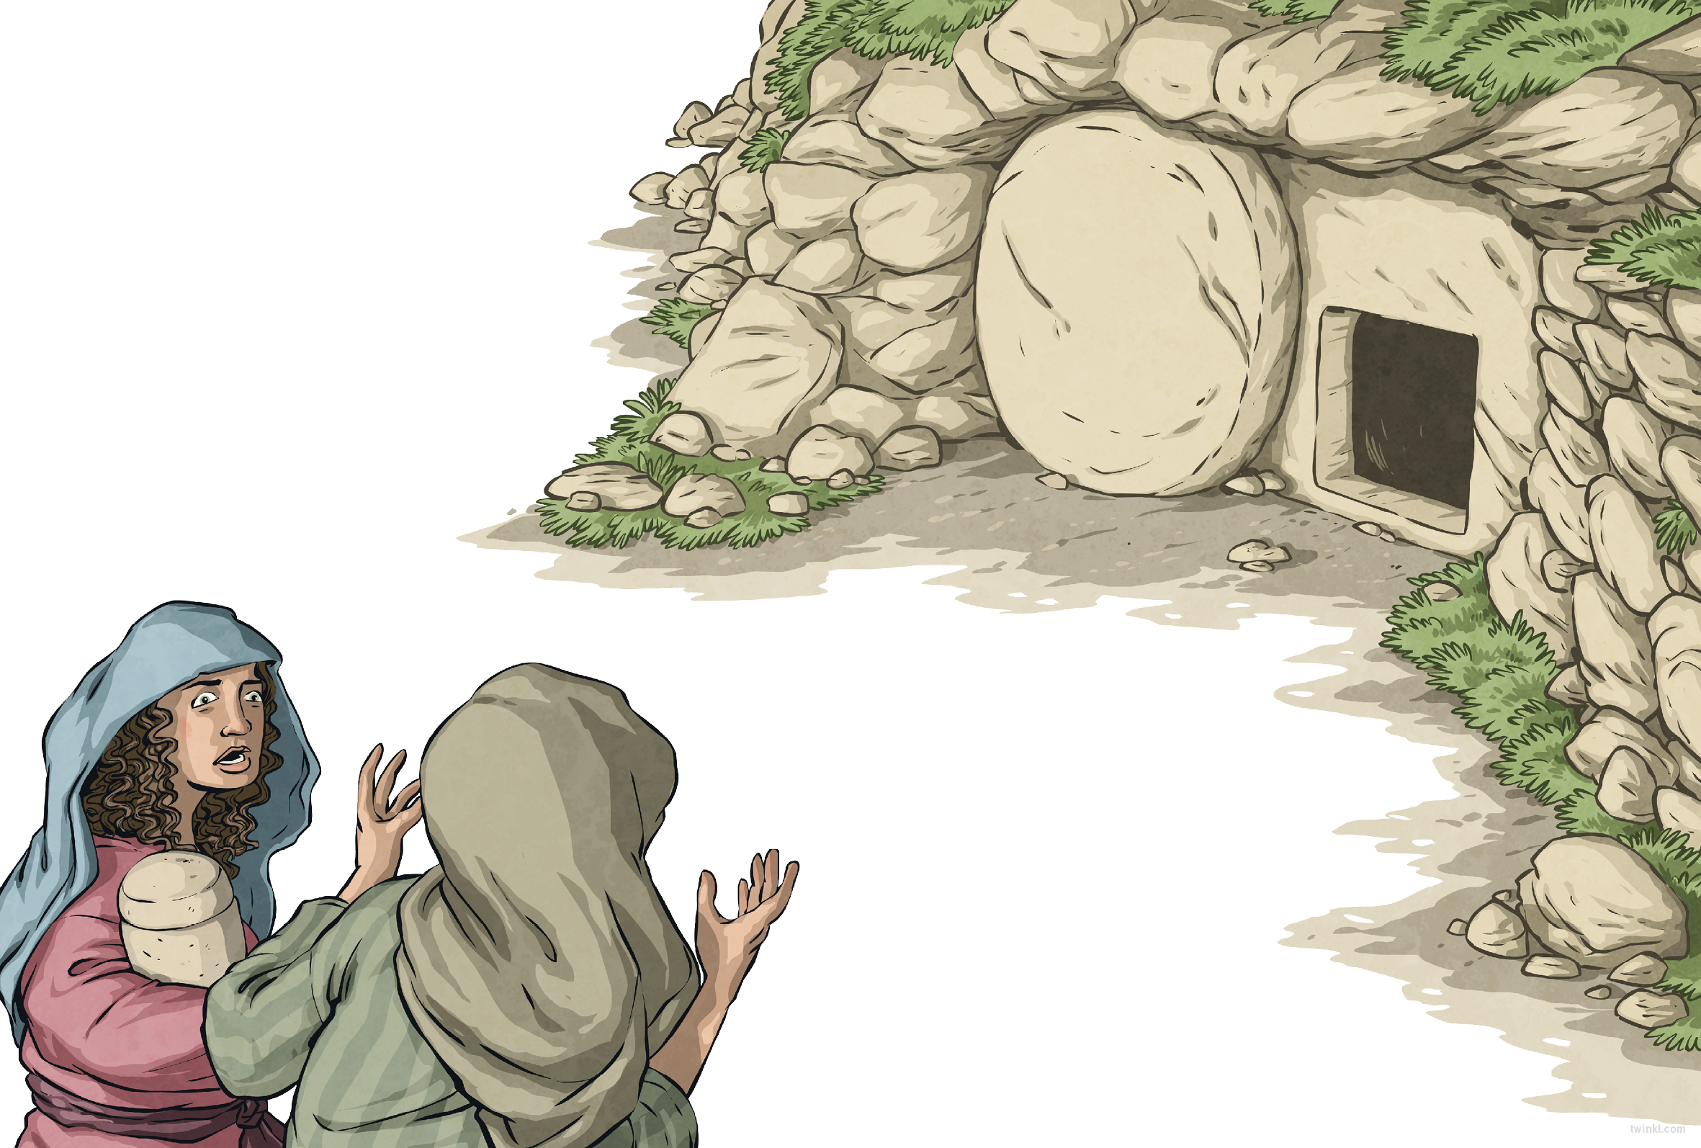
The next day was the Sabbath: a day of rest from the festivities. The following day – the third day after Jesus’ death – something very strange happened.
That morning, as the sun rose, Mary Magdalene and the other women returned to the tomb with spices to anoint Jesus’ body.
As they entered the garden, a sight greeted the women that made them stop in their tracks...
The stone covering the tomb’s entrance had been rolled away.

Slide 4
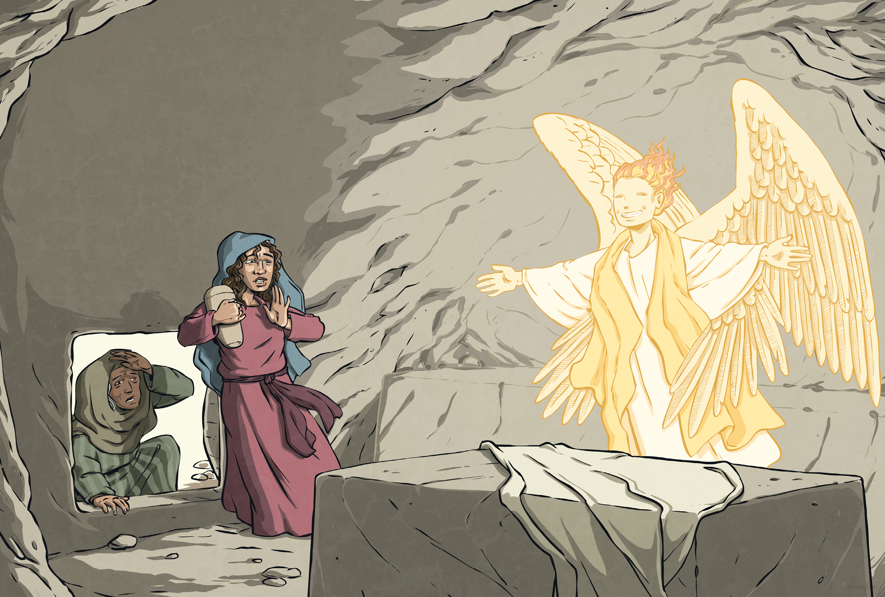
Nervously, the women stepped closer.
Inside the tomb, they saw an angel with a face like lightning and robes as white as snow.
“Don’t be afraid,” said the angel. “Jesus is not here – he has risen, as he said he would.”
The women rushed from the tomb, full of joy, to tell the disciples what they had seen and from there, the news spread all over Jerusalem.

Slide 5
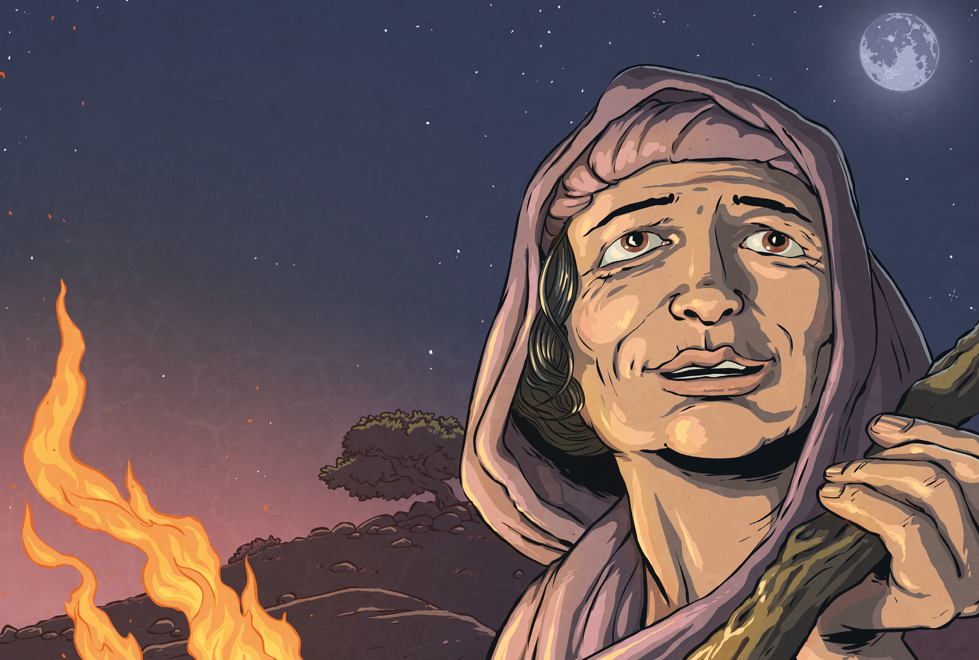
The Bible says that Jesus appeared to the women right there, in the garden. It also says that he met his disciples on the road to Emmaus, on a mountain, and at a feast in Galilee. What he prophesied (foretold) was fulfilled:
He was crucified, He rose from the dead and appeared to people.
Christians believe He is alive today and cares about us and one day He will come back to earth again.

