Slide 1
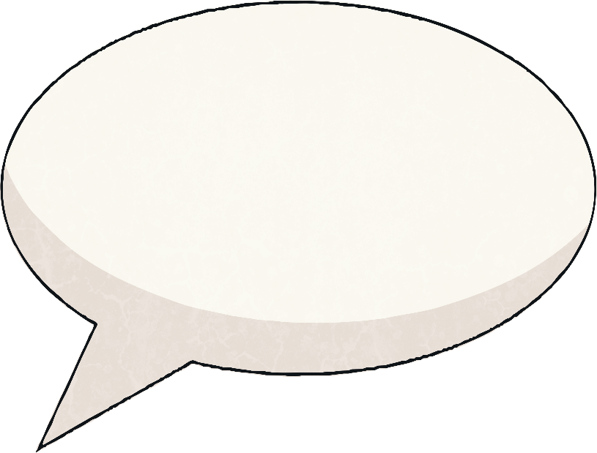
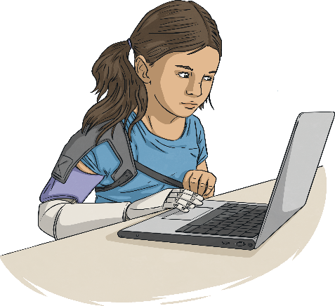
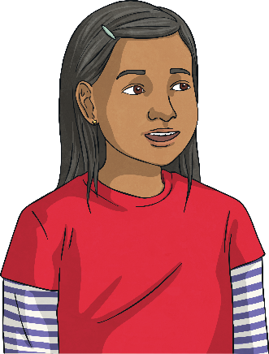
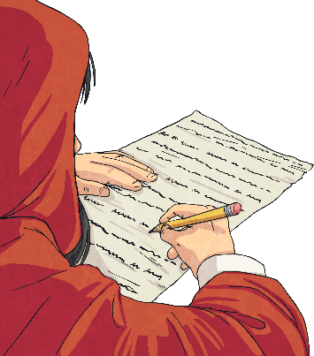
Writing to Persuade
When you are writing to persuade, you want to convince your reader about something. It might be that you’re persuading them to buy your product or you could be persuading them that what you’re saying is true.
There are different ways of writing to persuade. These are the ones you’re likely to see:
adverts/posters;
a persuasive talk/speech;
a persuasive letter.
Can you think of a time when you’ve had to persuade someone? Think about what you said and the words that you used.

Slide 2
Features of Writing to Persuade
The most important part of writing to persuade is being able to convince your reader. To do this effectively, you’ll need to use a range of
different features.
Expanded Noun Phrases
Whatever you’re persuading your reader about, you need to make it seem like the best idea ever.
Do this by including plenty of expanded noun phrases with amazing, incredible adjectives and modifying nouns.
Imperative Verbs
Imperative verbs tell the reader what to do. They help to get your message across really clearly.
Buy this spaghetti stretcher today!
Improve our school and our community.
Repetition
At the end of your persuasive text, the reader needs to be really clear about the main points. Ensure this by occasionally repeating key words throughout your writing.
Rhetorical Questions
Rhetorical questions are questions which don’t need to be answered. They can help your reader to feel like you are talking specifically to them. How could you live without it?

Slide 3
Features of Writing to Persuade
Imperative verbs tell the reader what to do. They help to get your message across really clearly.
Buy this spaghetti stretcher today!
Improve our school and our community.
Imperative
Verbs
At the end of your persuasive text, the reader needs to be really clear about the main points. Ensure this by occasionally repeating key words throughout your writing.
Repetition
Whatever you’re persuading your reader about, you need to make it seem like the best idea ever.
Do this by including plenty of expanded noun phrases with amazing, incredible adjectives and modifying nouns.
Expanded
Noun Phrases
Rhetorical questions are questions which don’t need to be answered. They can help your reader to feel like you are talking specifically to them.
How could you live without it?
Rhetorical
Questions

Slide 4
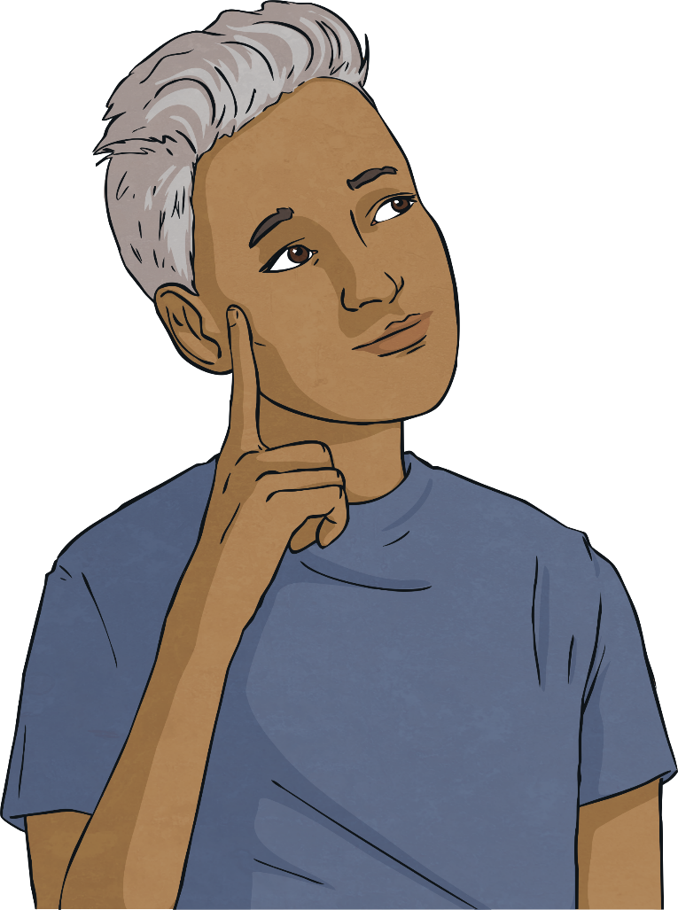
Can You Spot These Features?
Have a look at these different types of persuasive writing. Can you spot the features?
imperative verbs
repetition
expanded noun phrases
rhetorical questions

Slide 5
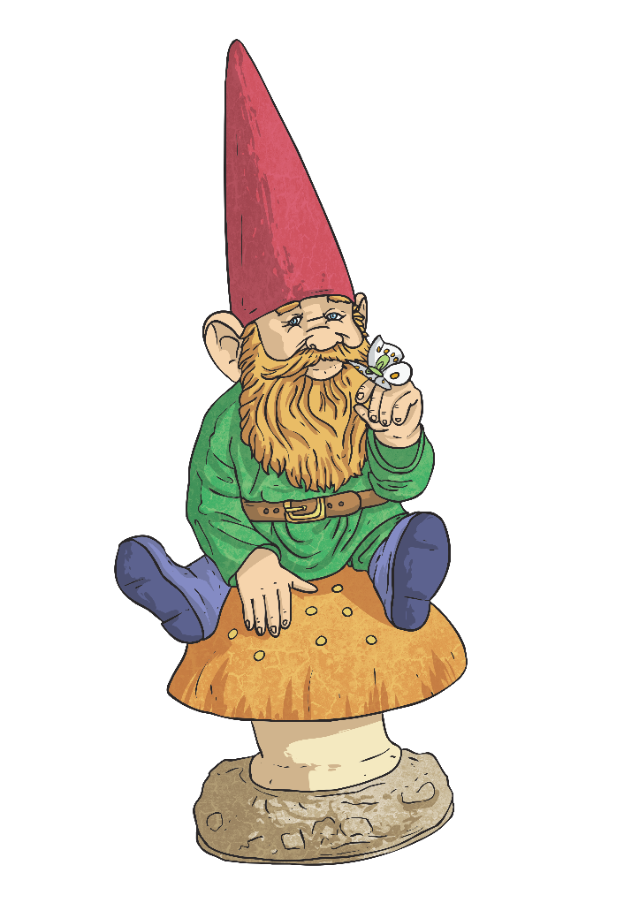

Persuasive Letter
Dear Sir/Madam,
I am writing to ask you to please reduce your extensive garden gnome collection so that I may deliver your letters without fear of injury.
For the past few years, I have found it increasingly difficult to work my way through your garden without treading on an unsuspecting gnome. Last week, when I arrived home and found a miniature fishing rod stuck in my shoe, I realised that this had gone on for too long. Surely you don’t want me to be injured, do you?
I enjoy gnomes and I think that a small collection can brighten up the garden substantially but the situation has become ridiculous. From now on, I will leave your letters beneath Goswald the Great until you significantly reduce your collection.
Yours sincerely,
Postal Worker Patricia
Which features did you manage to spot?

