Slide 1
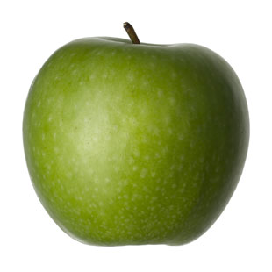

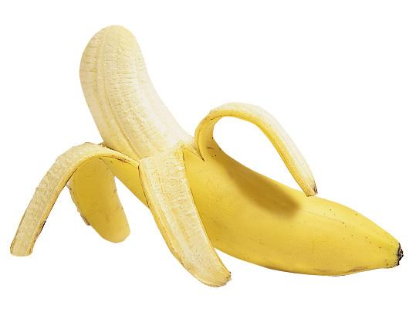
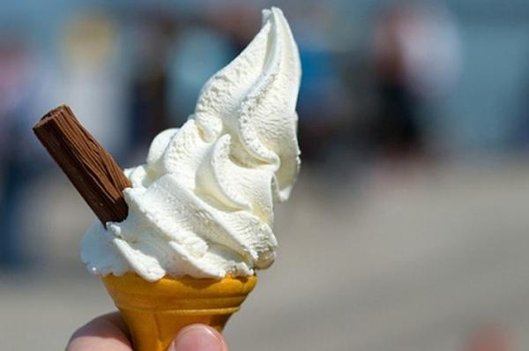

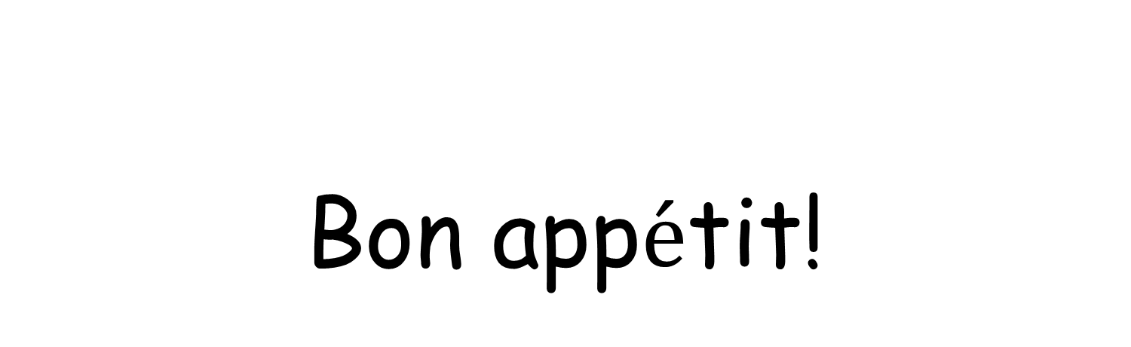
Bon app$\acute{e}$tit!
Enjoy your food!

Slide 2

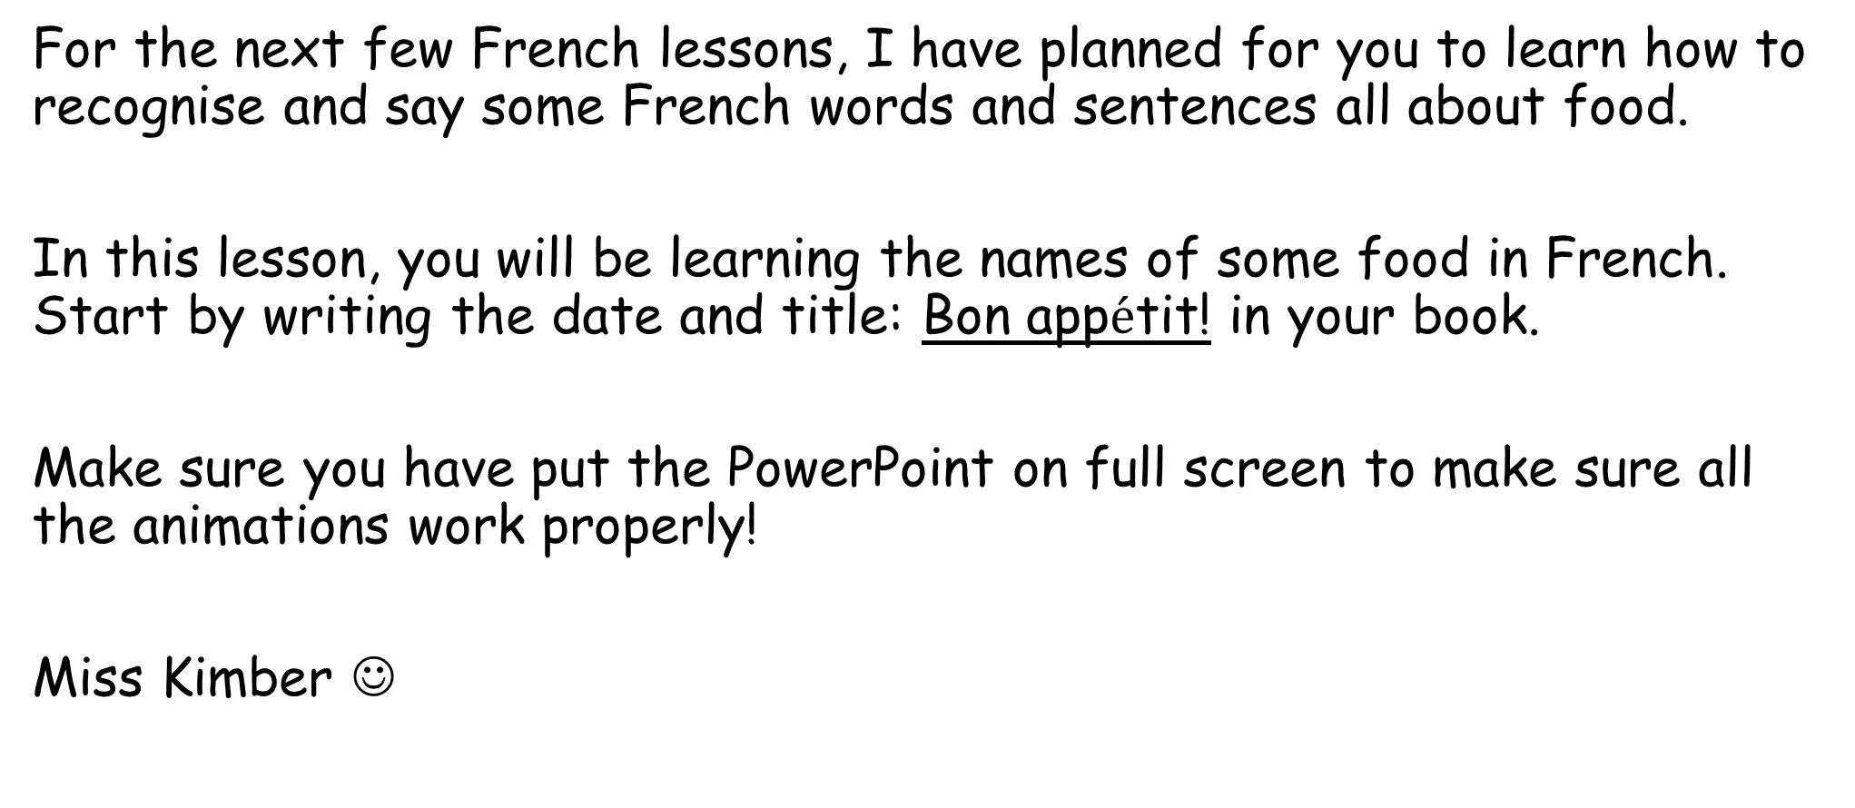
Bonjour class 3!
For the next few French lessons, I have planned for you to learn how to recognise and say some French words and sentences all about food.
In this lesson, you will be learning the names of some food in French. Start by writing the date and title: Bon app$\acute{e}$tit! in your book.
Make sure you have put the PowerPoint on full screen to make sure all the animations work properly!
Miss Kimber ☺

Slide 3

For each food:
Press the button that looks like this to hear how the word is pronounced
Listen and repeat each food 5 times
Write down the word in your book, along with the English translation and a drawing of the food
Then move onto the next food word!

Slide 4
un sandwich

Slide 5
une banane

Slide 6
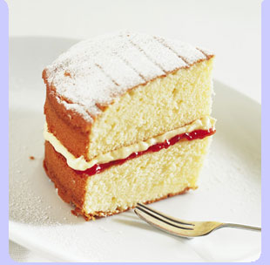
un gateau

Slide 7
une pomme

Slide 8
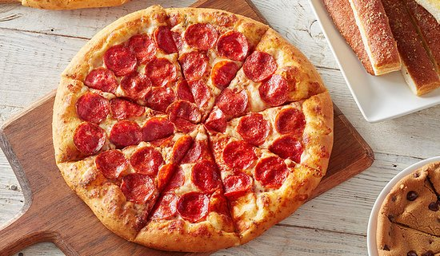
une pizza

Slide 9
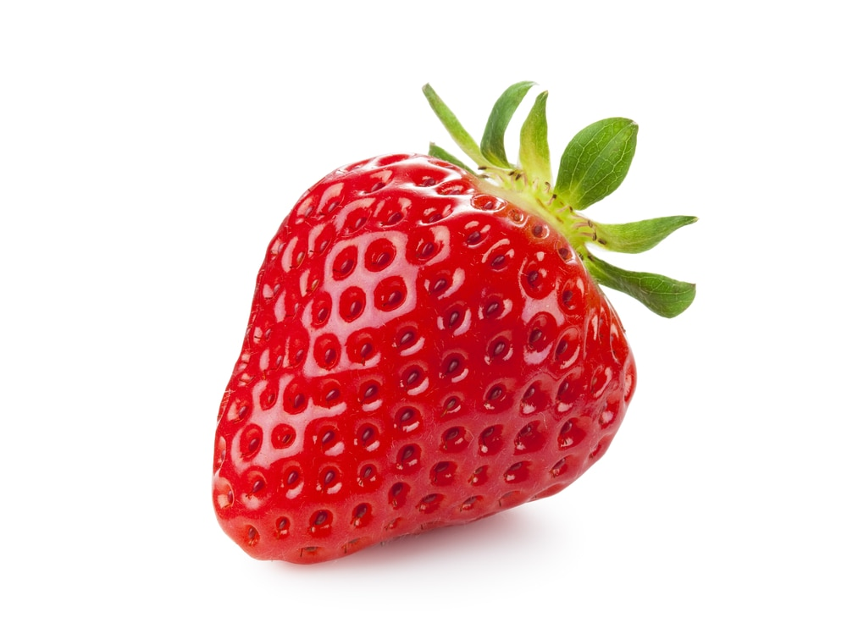
une fraise

Slide 10
une glace

Slide 11
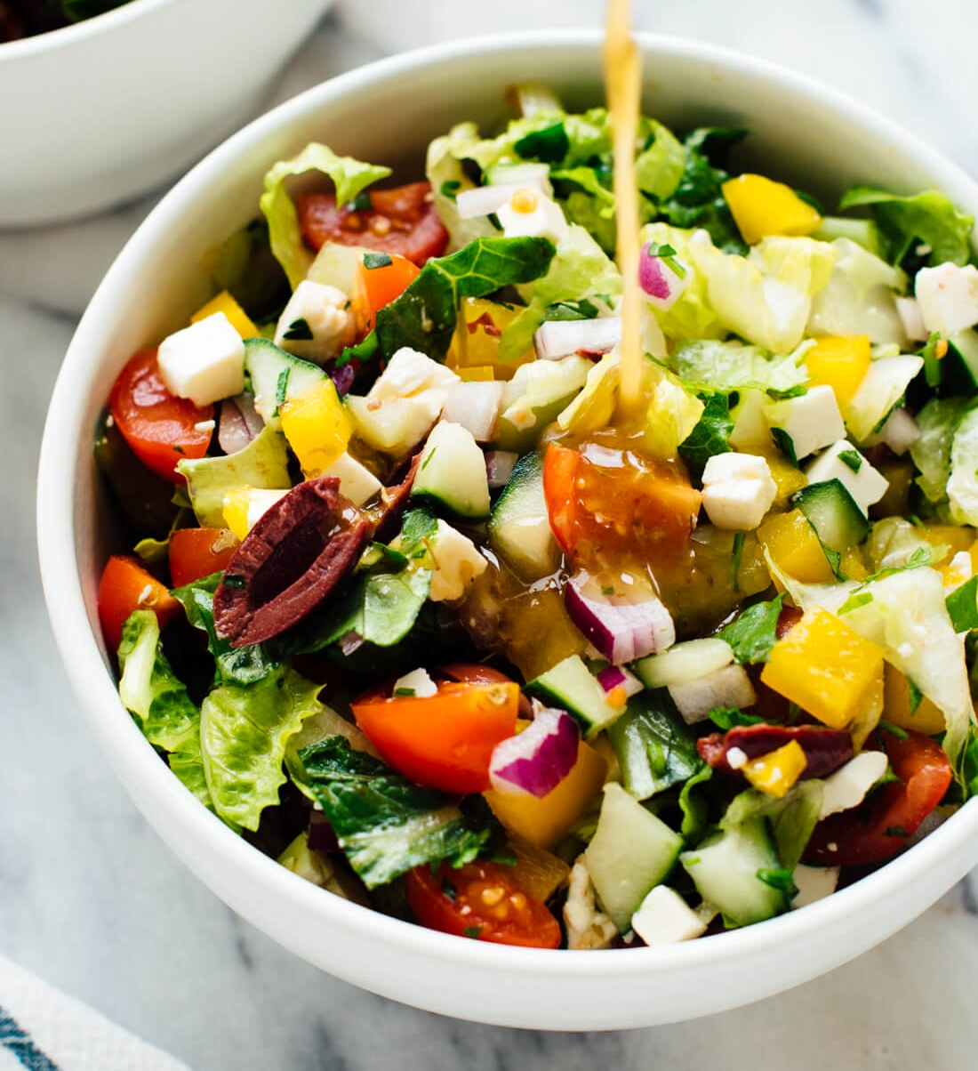
une salade

Slide 12
What can you remember?
Test your memory by choosing the correct English translation for each French word.
Try not to look at your list of words to cheat!

Slide 13
une pizza
or
Cake
Pizza

Slide 14
un sandwich
or
Banana
Sandwich

Slide 15
une pomme
or
Apple
Ice Cream

Slide 16
un gateau
or
Sandwich
Cake

Slide 17
une fraise
or
Salad
Strawberry

Slide 18
une glace
or
Ice cream
Banana

Slide 19
une salade
or
Pizza
Salad

Slide 20
une banane
or
Cake
Banana

Slide 21
Flying food game!
Each time you click the mouse, a picture of a food will fly across the screen. Pick out the correct French word for this food from the list on the screen. Write your answer in your book – be careful with spellings!
Keep your eyes peeled- they’re quick!

Slide 22
un sandwich
un gateau
une pomme
une banane
une pizza
une fraise
une glace
une salade

Slide 23
Answers:
un gateau (cake)
une salade (salad)
une pizza (pizza)
une pomme (apple)
une glace (ice cream)
une fraise (strawberry)
un sandwich (sandwich)
une banane (banana)
Give yourself a score out of 8. If you got any wrong, practise saying that word 5 times again. See if you can beat your score by playing the game again.

