Slide 2
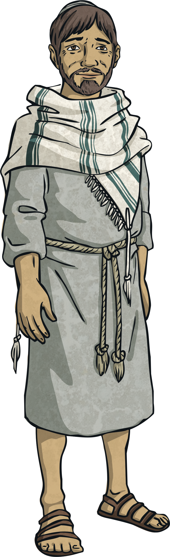
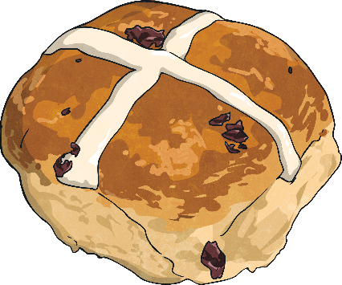
Good Friday
The story of Good Friday is a sad one. It is the day during Holy Week on which Jesus died. Good Friday is two days before Easter Sunday.
We often eat Hot Cross Buns on Good Friday to remember the crucifixion of Jesus.

Slide 3
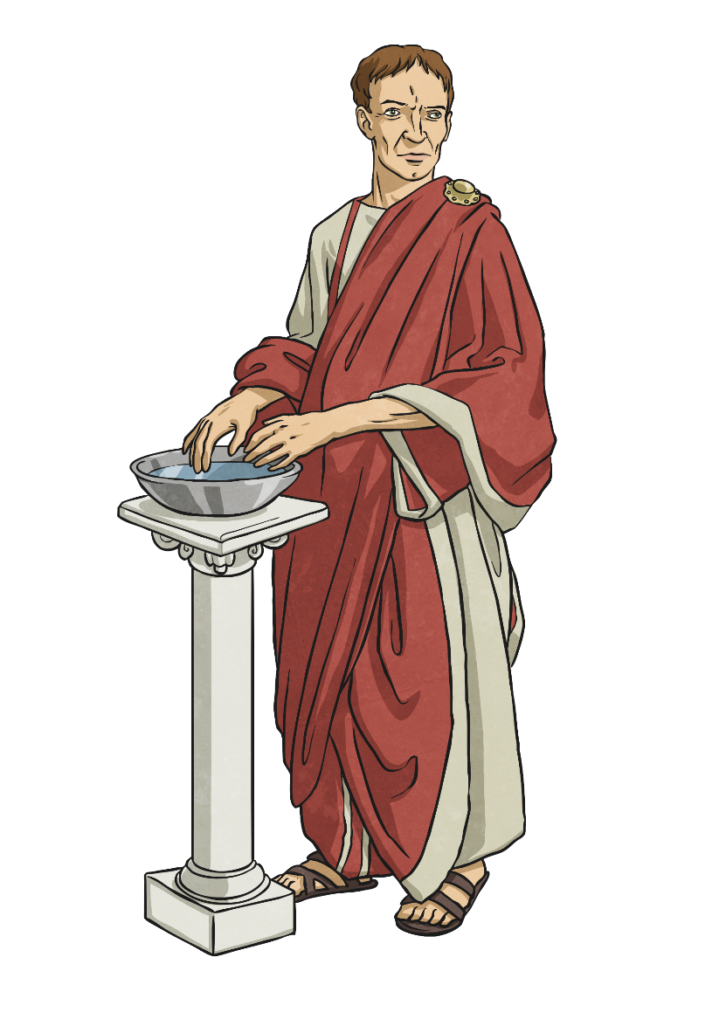
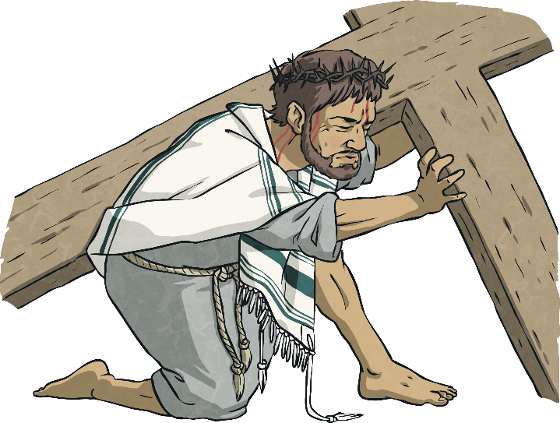
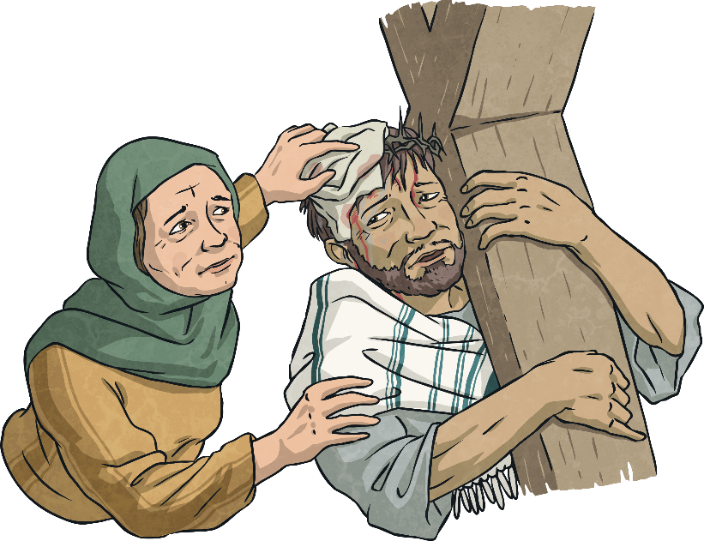
The Story of Good Friday
The Roman Governor, Pontius Pilate, asked the crowd what he should do. The enemies of Jesus shouted, “Crucify him!” so Pilate gave the order.
Jesus was mocked and made to wear a crown of thorns. He had to carry his cross to a hill outside of the city.
Some people helped Jesus. A lady believed to be named Veronica stopped to wipe his face and a man called Simon of Cyrene was forced to help carry Jesus’ cross by the Roman soldiers.

Slide 4
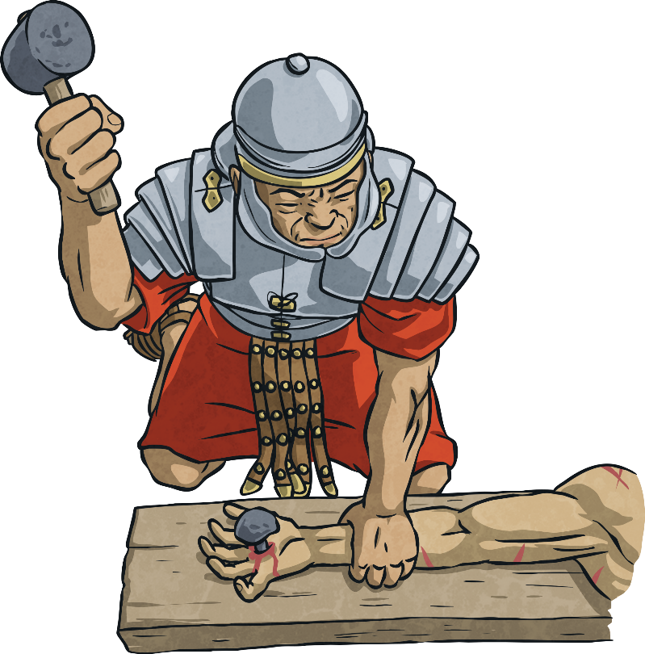
The Story of Good Friday
The Roman soldiers whipped and beat Jesus, then they nailed Him to the cross. He was crucified alongside two thieves. One thief mocked Jesus, saying that if he was the Son of God, he should save himself. The other thief, however, begged for forgiveness and was truly sorry for his crime. Jesus told this man he would be forgiven and enter heaven with him.
Just before Jesus died he cried out to God, “My God, My God, why have you forsaken me?”

Slide 5
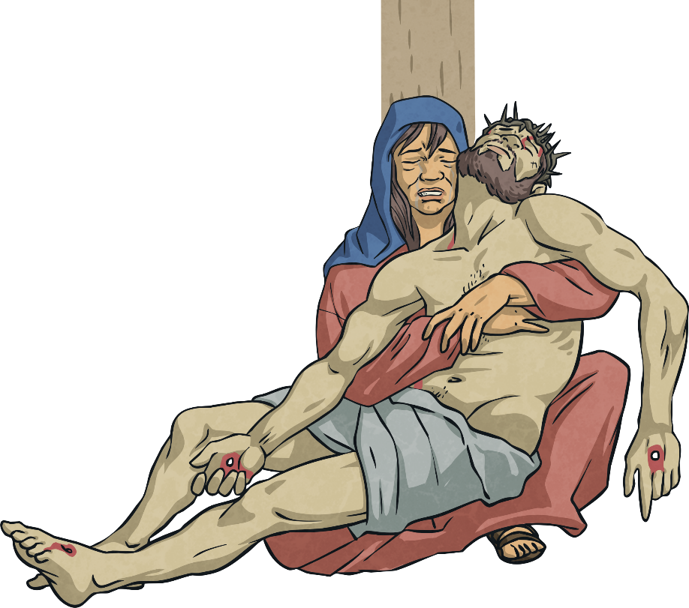
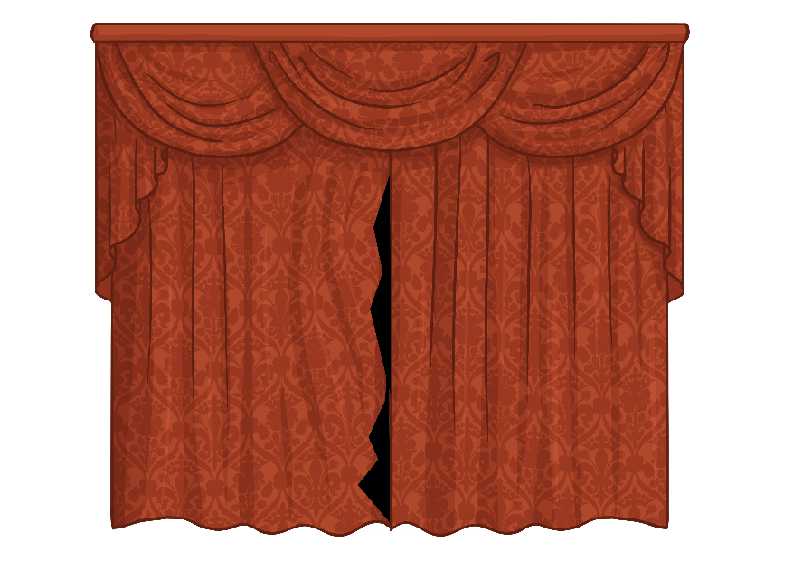
The Story of Good Friday
T
The Bible says that it grew very dark and the curtain in the temple tore in two at the moment Jesus died. The earth shook and the rocks split in two.
Jesus’ body was taken down from the cross and placed in a stone tomb.
A large rock was placed in front of the entrance to stop anyone from stealing the body.

Slide 6
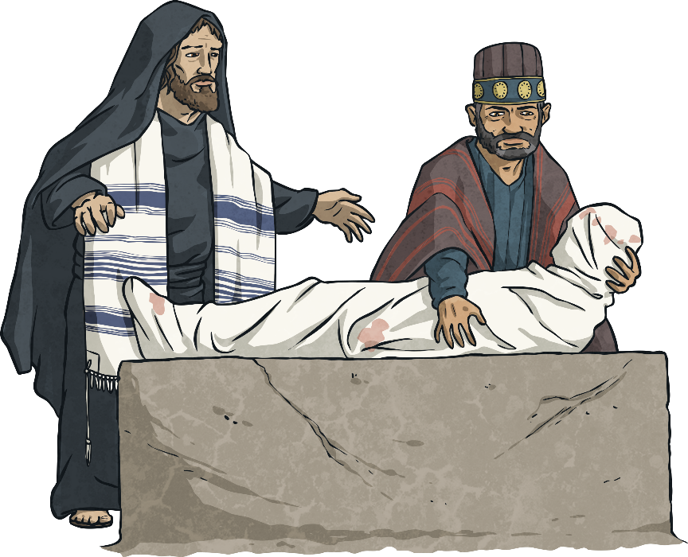
After Good Friday
For Christians, this is not the end of the Easter story.
Something very special would happen two days later on Easter Sunday.
Good Friday is a time when Christians remember the sacrifice Jesus made. They believe Jesus gave his life for the good of everyone. The Bible tells how if people are truly sorry for what they have done wrong, just like the second thief, they will be forgiven by God, and will be one day be with Jesus in heaven.

Slide 7
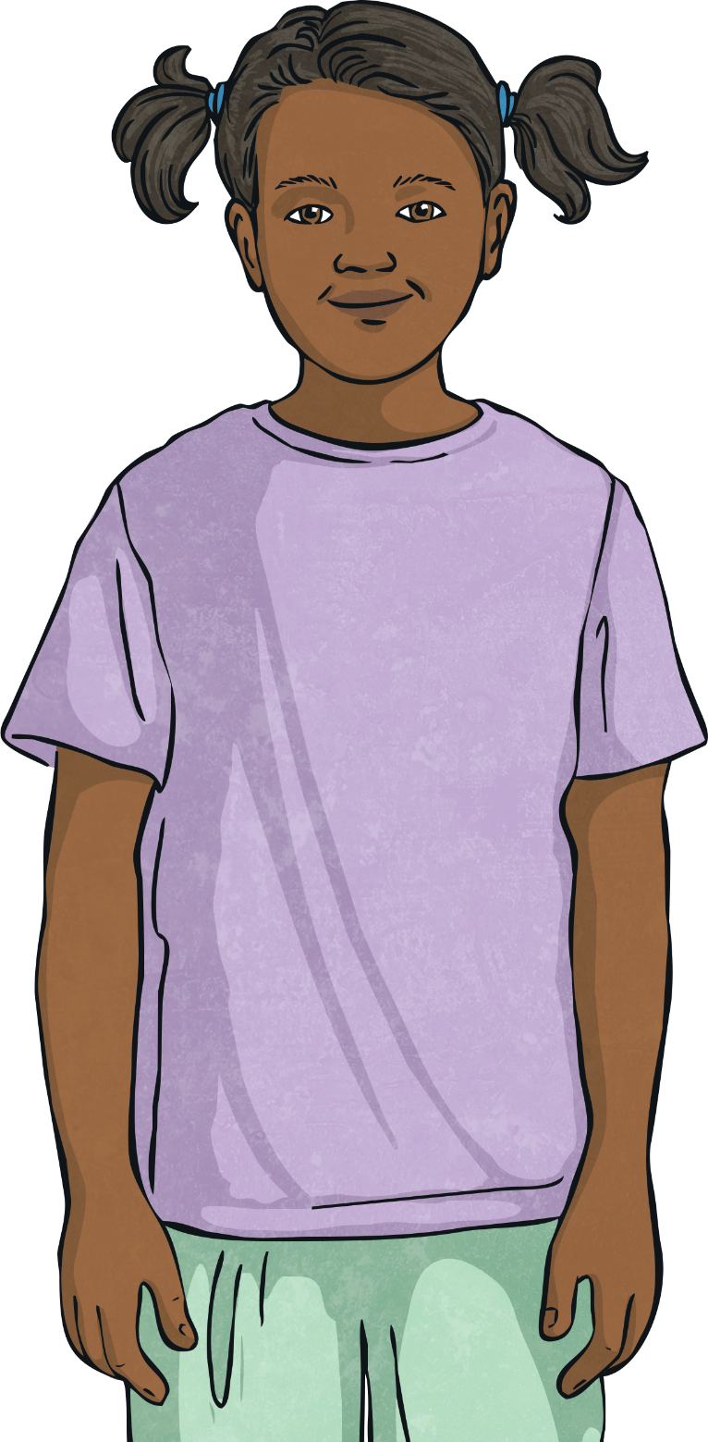
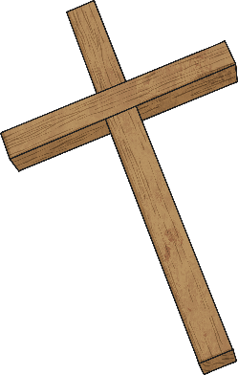

Reflect
Why is Good Friday referred to
as ‘good’?
Why do you think Christians have the cross as their special symbol?
Can you explain the symbolism of the hot cross bun?

